Slide 1
Teacher’s slide: Gatsby Benchmarks
To support you in meeting the Gatsby Benchmarks, we suggest dedicating one day per month to a ‘career of the month' and one day to a ‘subject of the month' for each year group. This can be done during registration or form time in a 15-minute session. Students will watch a video from the Unifrog platform and answer questions, either through group discussion or written responses.
Delivering these sessions can support the Gatsby Benchmarks as follows:
1. A stable careers programme | 2. Learning from career and labour market information
Regular timetabled sessions to discuss careers and subjects can form part of your stable careers programme. During these sessions you could also make links and remind students of what’s happening in your wider careers programme. | Watching the videos can help students to understand the skills, qualifications, and challenges related to specific jobs. You can support this by exploring the career or subject profile together, including linking to labour market information contained in the profiles.
3. Addressing the needs of each pupil | 4. Linking curriculum learning to careers
The questions promote tailored personal reflection. Students could record and upload their reflections to their Unifrog Locker. A range of careers and subjects are used to help students raise aspirations and challenge stereotypes. | The questions help students to reflect on how school subjects connect to real-world careers, helping students see the relevance of their studies to future job opportunities.
5. Encounters with employers and employees | 6. Experiences of workplaces
While these videos don't replace in-person encounters with employers, they provide insights into work environments and cultures, offering students a realistic view of different career paths. | While these videos don't replace in-person work experience, they can broaden students' awareness of different workplaces and help them identify areas they'd like to explore further.
7. Encounters with further and higher education | 8. Personal guidance
While these videos don't replace in-person encounters with further and higher education, they can help students understand the educational pathways needed for various subjects and careers, helping students understand their options for further study or training. | Students can draw on their discussions and reflections of a variety of careers and subjects in their personal guidance 1:1s.
Notes:
Teacher’s notes:
To further support these benchmarks, you could arrange a talk from a former student, FE/HE institution, or employer about a subject/career featured each month.

Slide 2















September
Click a box to go straight to the relevant slides
Year 7 Career of the month
Year 8 Career of the month
Year 9 Career of the month
Year 10 Career of the month
Year 11 Career of the month
Year 12 Career of the month
Year 13 Career of the month
Year 7 Subject of the month
Year 8 Subject of the month
Year 9 Subject of the month
Year 10 Subject of the month
Year 11 Subject of the month
Year 12 Subject of the month
Year 13 Subject of the month
Notes:
Teacher’s notes:
There are separate PowerPoints available for each month of the academic year within the resource profile ‘Career and subject of the month’.
Click the hyperlinked text boxes on this slide to be taken to the slides for the year group selected.

Slide 3

Career of the month
Year 7 – September
Notes:
Teacher’s notes:
September’s career of the month for year 7 is: Baker.

Slide 4

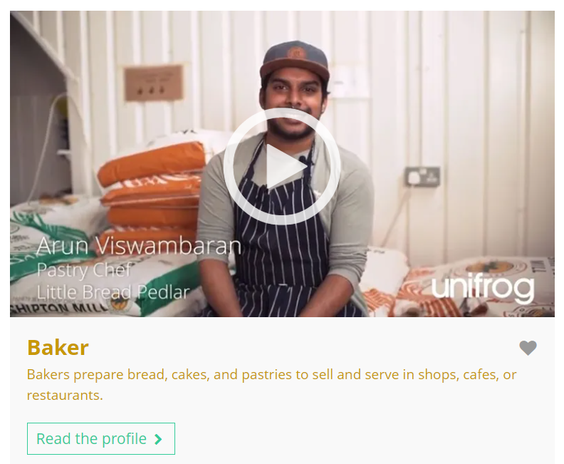


September’s career of the month is…
Baker
Note down at least one thing you think you know about this career.
Notes:
Teacher’s notes:
Click to reveal the career of the month: Baker.
Before you’re ready to watch the Careers library video as a class, ask students to note down anything they think they already know about this career.

Slide 5

September’s career of the month is… Baker
There are lots of roles that fall under the category of baker. Today we'll be hearing from Arun, who’s a pastry chef.
Whilst you’re watching, think about what you would or wouldn’t enjoy about this career and what skills are needed.
Notes:
Teacher’s notes:
Make sure you’re logged into your Unifrog account and click ‘use the platform as a student’. Click the image on the screen to go to the Careers library profile, then click the play button on the video. Alternatively, copy this URL into an internet browser: unifrog.org/student/careers/direct/baker
If you have more time available, you could read the career profile text as a class too.

Slide 6
September’s career of the month is… Baker
What do you think you’d enjoy the most about this career?
What do you think you’d enjoy the least about this career?
What skills are needed for this career? Do you use any of these skills in your school subjects?
What else would you like to find out about this career?
Notes:
Teacher’s notes:
This slide contains reflection questions about the career of the month. You could ask students to write down their answers, discuss in pairs or small groups, or discuss as a whole class.
The aim of this activity is for students to think about their own preferences, experiences, and skills and how these could relate to the career. Students are encouraged to draw links between skills used in their current school subjects and the career in the video. If students would like to know more about the career, encourage them to read the full career profile, which contains the following sections:
What you’ll do
Working hours and environment
Career path and progression
Skills required
Entry requirements
Related know-how guides
Related university subject profiles
Related career profiles
Explore
Labour Market Information (LMI)
People also liked…
Example answers:
I think I’d enjoy getting to be creative and thinking up new recipes and product ideas.
I don’t think I’d enjoy working shifts – I prefer routine in my life.
I think bakers need to be artistic as the food needs to look visually appealing, as well as taste good! I’m artistic in my DT lessons, as I think about creative ways to design products to solve everyday problems.
I’d like to know what the typical salary is. Encourage students to explore the career profile text to search for the answers to their questions.

Slide 7
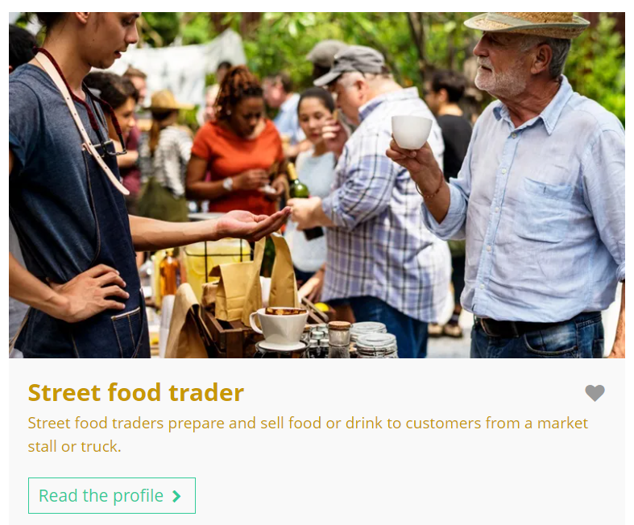
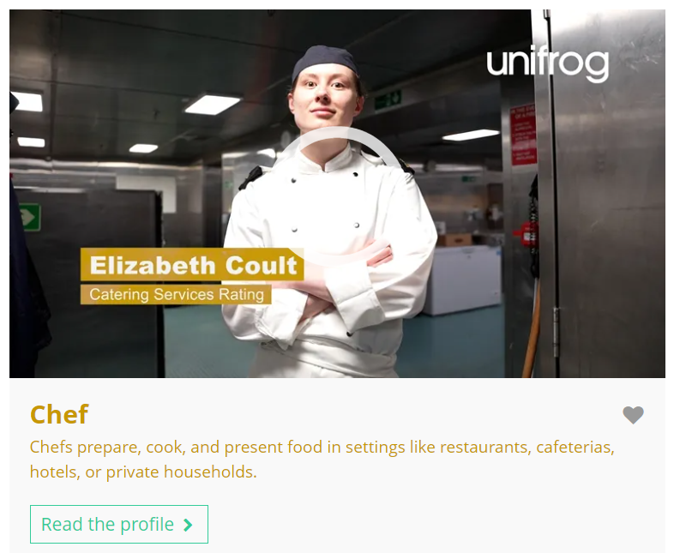
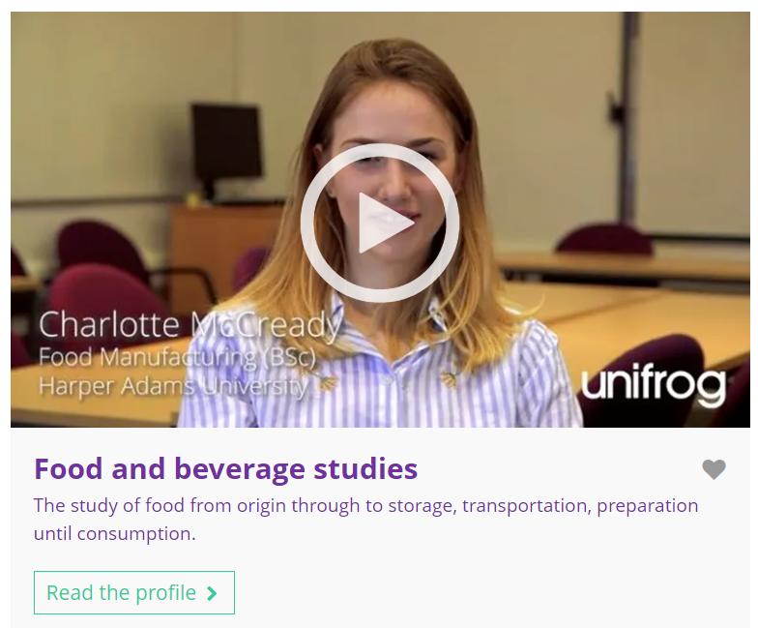

Curious about this career? Discover more on Unifrog!
Explore the baker career profile.
Explore related career profiles, like street food trader and chef.
Explore related subject profiles, like food and beverage studies.
Remember to click the heart symbol to add a profile to your Favourites!
Notes:
Teacher’s notes:
This slide contains career and subject profiles that are relevant to the career of the month.
If you have additional time available and students have computer access, you can direct them to these resources.
Remember to log into the student side of your Unifrog account to access these links and remind students to favourite any careers or subjects they like the look of.
You can track student progress with favouriting careers or subjects by clicking Advanced>Sort by>Library profiles in Favourites.

Slide 8


Slide 9
Subject of the month
Year 7 – September
Notes:
Teacher’s notes:
September’s subject of the month for year 7 is: Archaeology.

Slide 10

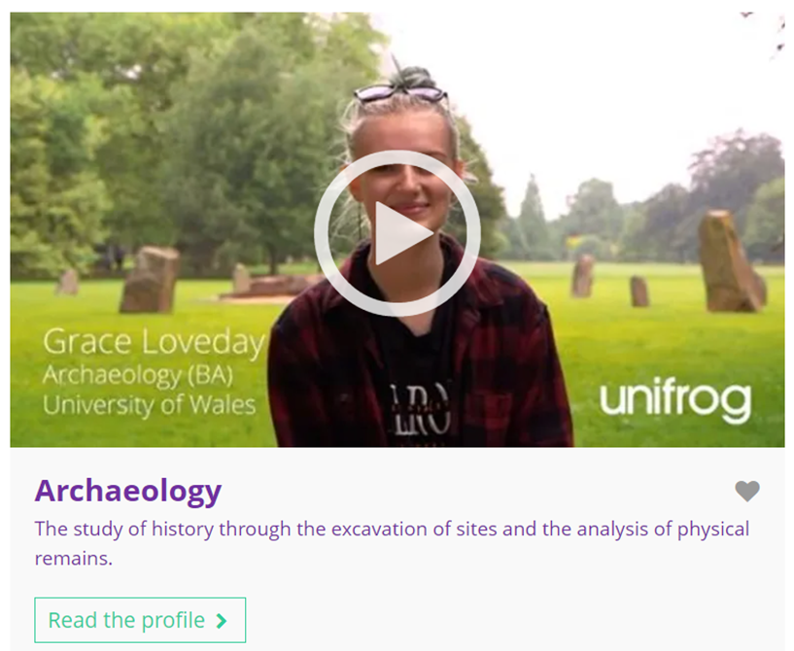

September’s subject of the month is…
Archaeology
Note down at least one thing you think you know about this subject.
Notes:
Teacher’s notes:
Click to reveal the subject of the month: Archaeology.
Before you’re ready to watch the Subjects library video as a class, ask students to note down anything they think they already know about this subject.

Slide 11
September’s subject of the month is… Archaeology
Today we’ll be hearing from Grace, who’s an archaeology student.
Whilst you’re watching, think about the careers and skills related to this subject.
Notes:
Teacher’s notes:
Make sure you’re logged into your Unifrog account and click ‘use the platform as a student’. Click the image on the screen to go to the Subjects library profile, then click the play button on the video. Alternatively, copy this URL into an internet browser: unifrog.org/student/subjects/direct/archaeology
If you have more time available, you could read the subject profile text as a class too.

Slide 12
September’s subject of the month is… Archaeology
Has anything in the video surprised you?
What careers could this subject lead to?
Name one of your best skills. Would studying this subject use this skill?
What advice would you give to someone who wants to study this subject?
Notes:
Teacher’s notes:
This slide contains reflection questions about the subject of the month. You could ask students to write down their answers, discuss in pairs or small groups, or discuss as a whole class.
The aim of this activity is for students to think about their own preferences, experiences, and skills and how these could relate to the subject. Students are encouraged to draw links between skills used in their current school subjects and the subject in the video. If students would like to know more about the subject, encourage them to read the full subject profile, which contains the following sections:
In a nutshell
Getting in
Prospects
Statement
Reference
Geek out
Recommendations: Read
Recommendations: Watch
Recommendations: Listen
Explore
People also liked…
Example answers:
I didn’t know that ‘nautical architecture’ was a topic you could study.
Careers in the museum sector, like a museum curator.
Reading. Yes – I’d need to read texts about historical artefacts.
Be open-minded to learning about lots of different types of archaeology.

Slide 13
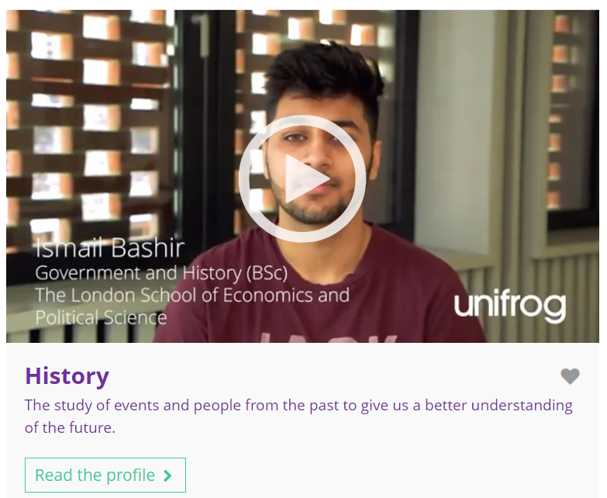
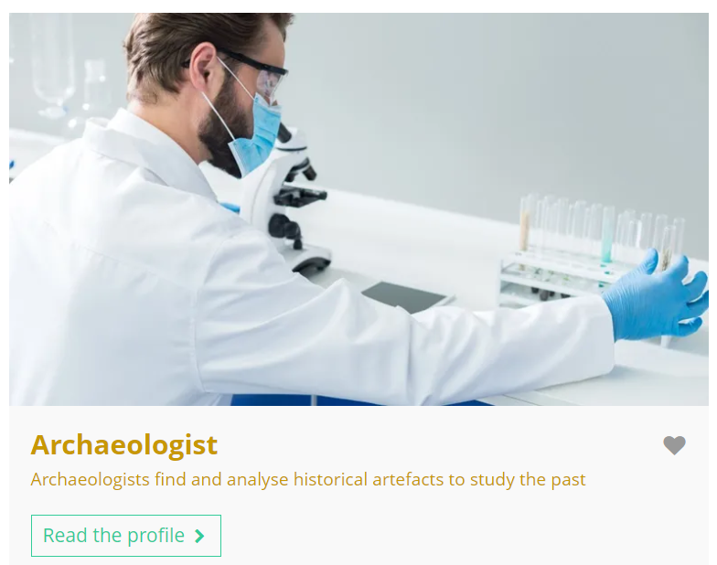
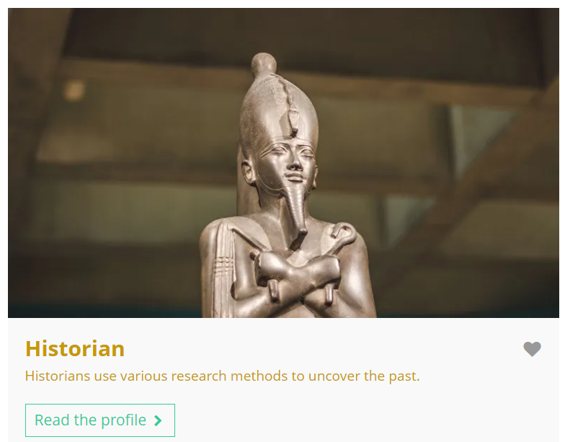
Fascinated by this field? Find out more on Unifrog!
Explore the archaeology subject profile.
Explore related subject profiles, like history.
Explore related career profiles, like archaeologist and historian.
Remember to click the heart symbol to add a profile to your Favourites!
Notes:
Teacher’s notes:
This slide contains career and subject profiles that are relevant to the subject of the month.
If you have additional time available and students have computer access, you can direct them to these resources.
Remember to log into the student side of your Unifrog account to access these links and remind students to favourite any careers or subjects they like the look of.
You can track student progress with favouriting careers or subjects by clicking Advanced>Sort by>Library profiles in Favourites.

Slide 15
Career of the month
Year 8 – September
Notes:
Teacher’s notes:
September’s career of the month for year 8 is: Sustainability analyst.

Slide 16

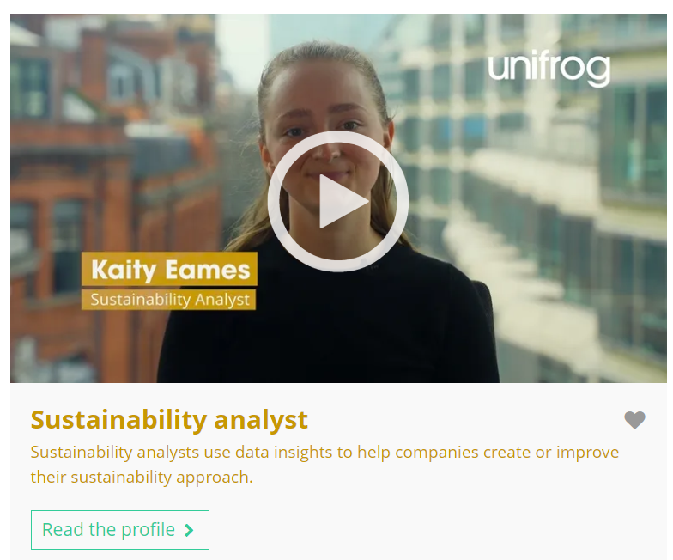

September’s career of the month is…
Sustainability analyst
Note down at least one thing you think you know about this career.
Notes:
Teacher’s notes:
Click to reveal the career of the month: Sustainability analyst.
Before you’re ready to watch the Careers library video as a class, ask students to note down anything they think they already know about this career.

Slide 17
September’s career of the month is… Sustainability analyst
There are lots of roles that fall under the category of sustainability analyst. Today we'll be hearing from Kaity, who’s a strategic environment specialist.
Whilst you’re watching, think about whether this career aligns with your own values and interests.
Notes:
Teacher’s notes:
Make sure you’re logged into your Unifrog account and click ‘use the platform as a student’. Click the image on the screen to go to the Careers library profile, then click the play button on the video. Alternatively, copy this URL into an internet browser: unifrog.org/student/careers/direct/sustainability-analyst
If you have more time available, you could read the career profile text as a class too.

Slide 18
September’s career of the month is… Sustainability analyst
What pathways or qualifications did Kaity mention that she needed to enter this career?
Kaity mentions travel – is this something you’d like to do in a future career? Why or why not?
In what ways does this career align (or not align) with your values or interests?
If you wanted to do this career, what could you do to prepare?
Notes:
Teacher’s notes:
This slide contains reflection questions about the career of the month. You could ask students to write down their answers, discuss in pairs or small groups, or discuss as a whole class.
The aim of this activity is for students to think about their own preferences, experiences, and skills and how these could relate to the career. Students are encouraged to draw links between skills used in their current school subjects and the career in the video. If students would like to know more about the career, encourage them to read the full career profile, which contains the following sections:
What you’ll do
Working hours and environment
Career path and progression
Skills required
Entry requirements
Related know-how guides
Related university subject profiles
Related career profiles
Explore
Labour Market Information (LMI)
People also liked…
Example answers:
A levels, undergraduate degree, Masters degree, graduate scheme.
I would love to travel in a future job, as I enjoy going to new places and meeting new people.
I’m really interested in sustainability so having a career that contributes to green energy would be great for me.
Read the full career profile, organise related work experience, do related online courses/MOOCs.

Slide 19
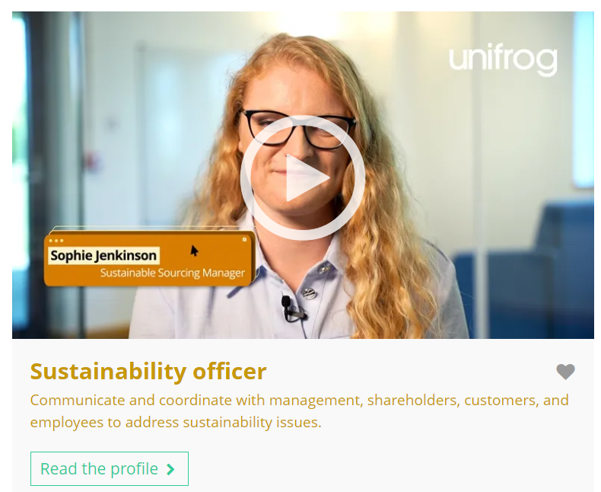
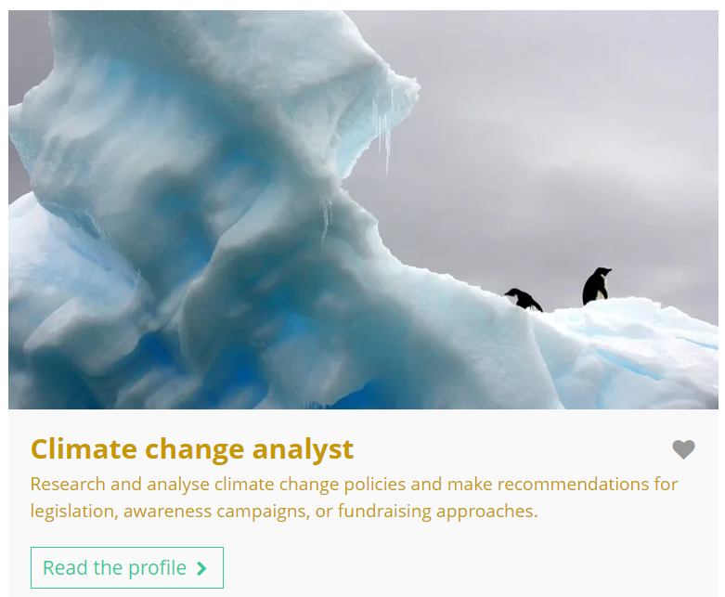
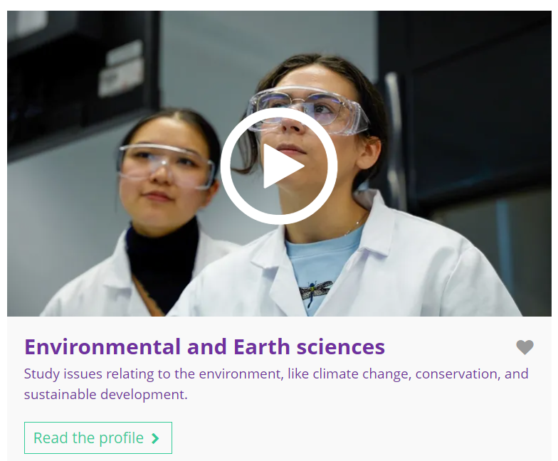
Curious about this career? Discover more on Unifrog!
Explore the sustainability analyst career profile.
Explore related career profiles, like sustainability officer and climate change analyst.
Explore related subject profiles, like environmental and earth sciences.
Remember to click the heart symbol to add a profile to your Favourites!
Notes:
Teacher’s notes:
This slide contains career and subject profiles that are relevant to the career of the month.
If you have additional time available and students have computer access, you can direct them to these resources.
Remember to log into the student side of your Unifrog account to access these links and remind students to favourite any careers or subjects they like the look of.
You can track student progress with favouriting careers or subjects by clicking Advanced>Sort by>Library profiles in Favourites.

Slide 20
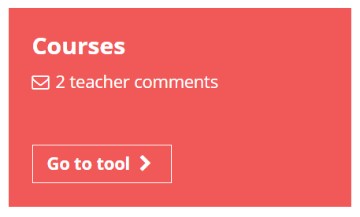
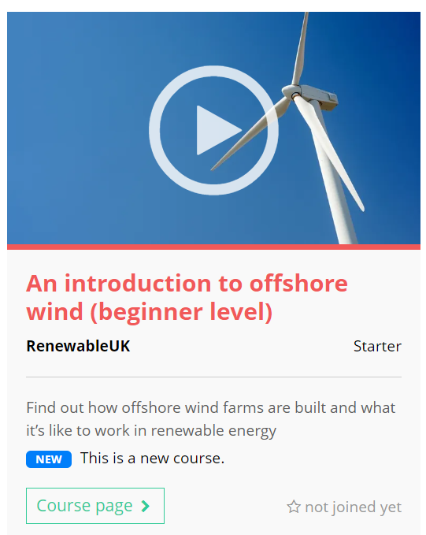
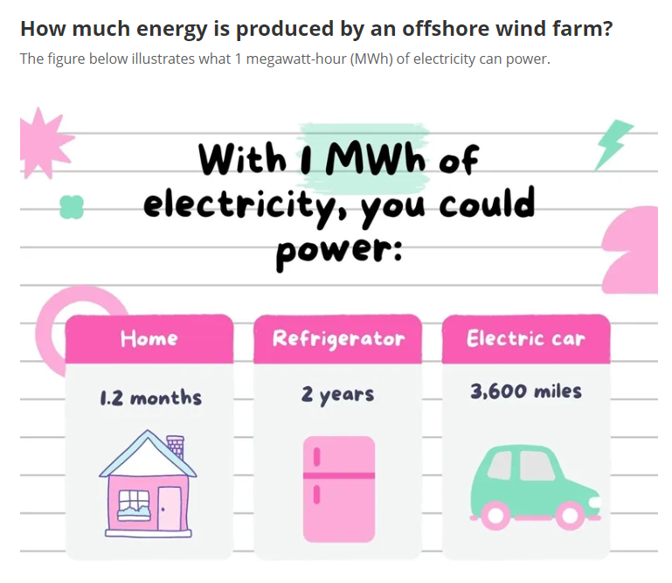

Further exploration
Visit the Courses tool to join courses relating to the career of the month:
An introduction to offshore wind (beginner level)
Eat more trees: how to save the planet
Notes:
Teacher’s notes:
This slide contains Unifrog courses that are relevant to the career of the month.
If you have additional time available and students have computer access, you can direct them to the Courses tool.
Remember to log into the student side of your Unifrog account to access these links and remind students to join any courses they like the look of.
You can track student progress with courses by clicking Advanced>Sort by>Courses.

Slide 22
Subject of the month
Year 8 – September
Notes:
Teacher’s notes:
September’s subject of the month for year 8 is: Sport science.

Slide 23

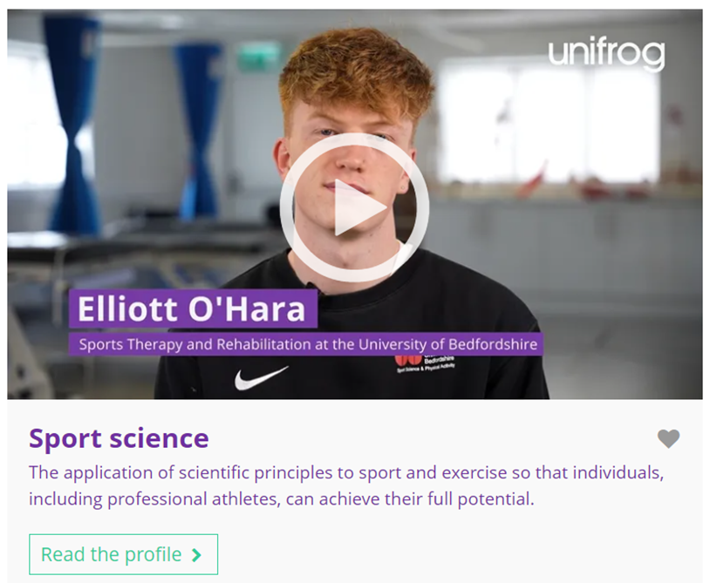

September’s subject of the month is…
Sport science
Note down at least one thing you think you know about this subject.
Notes:
Teacher’s notes:
Click to reveal the subject of the month: Sport science.
Before you’re ready to watch the Subjects library video as a class, ask students to note down anything they think they already know about this subject.

Slide 24
September’s subject of the month is… Sport science
There are lots of degrees that fall under the category of sport science. Today we'll be hearing from Elliott, who’s a sport therapy and rehabilitation student.
Whilst you’re watching, think about the school subjects and skills related to this subject.
Notes:
Teacher’s notes:
Make sure you’re logged into your Unifrog account and click ‘use the platform as a student’. Click the image on the screen to go to the Subjects library profile, then click the play button on the video. Alternatively, copy this URL into an internet browser: unifrog.org/student/subjects/direct/sport-science
If you have more time available, you could read the subject profile text as a class too.

Slide 25
September’s subject of the month is… Sport science
What do you think you’d enjoy about this subject?
What skills are needed to study this subject?
Which of your school subjects would help prepare you to study this subject?
What else would you like to find out about this subject?
Notes:
Teacher’s notes:
This slide contains reflection questions about the subject of the month. You could ask students to write down their answers, discuss in pairs or small groups, or discuss as a whole class.
The aim of this activity is for students to think about their own preferences, experiences, and skills and how these could relate to the subject. Students are encouraged to draw links between skills used in their current school subjects and the subject in the video. If students would like to know more about the subject, encourage them to read the full subject profile, which contains the following sections:
In a nutshell
Getting in
Prospects
Statement
Reference
Geek out
Recommendations: Read
Recommendations: Watch
Recommendations: Listen
Explore
People also liked…
Example answers:
I think I’d enjoy the practical and hands-on learning.
Independence, time management, leadership, reflectiveness, teamwork, problem solving.
PE, science, maths.
I’d like to know what careers this subject could lead to. Encourage students to explore the subject profile text to search for the answers to their questions.

Slide 26

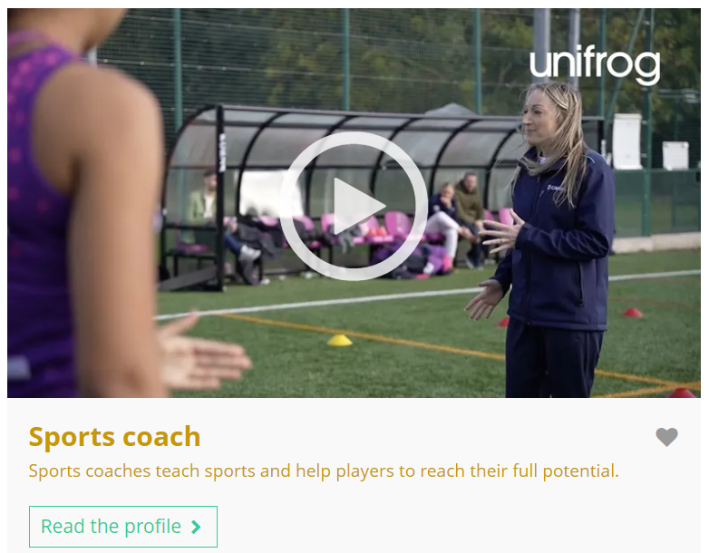

Fascinated by this field? Find out more on Unifrog!
Explore the sport science subject profile.
Explore related subject profiles, like nutrition.
Explore related career profiles, like sports coach and sport and exercise psychologist.
Remember to click the heart symbol to add a profile to your Favourites!
Notes:
Teacher’s notes:
This slide contains career and subject profiles that are relevant to the subject of the month.
If you have additional time available and students have computer access, you can direct them to these resources.
Remember to log into the student side of your Unifrog account to access these links and remind students to favourite any careers or subjects they like the look of.
You can track student progress with favouriting careers or subjects by clicking Advanced>Sort by>Library profiles in Favourites.

Slide 28
Career of the month
Year 9 – September
Notes:
Teacher’s notes:
September’s career of the month for year 9 is: Social media manager.

Slide 29
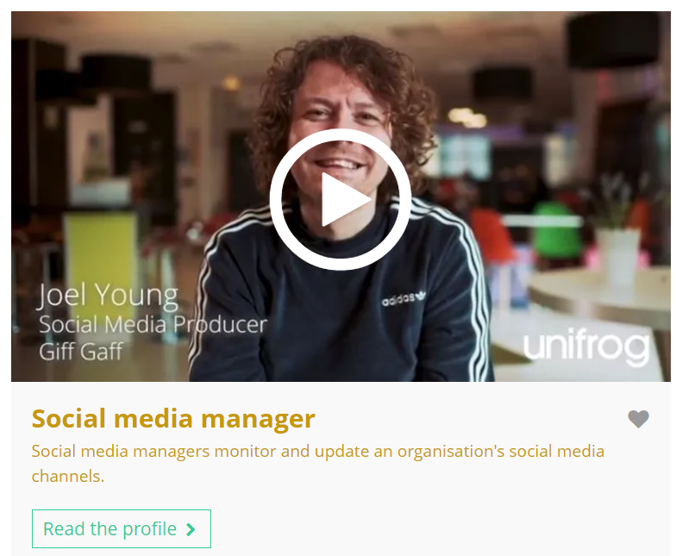


September’s career of the month is…
Social media manager
Note down at least one thing you think you know about this career.
Notes:
Teacher’s notes:
Click to reveal the career of the month: Social media manager.
Before you’re ready to watch the Careers library video as a class, ask students to note down anything they think they already know about this career.

Slide 30
September’s career of the month is… Social media manager
There are lots of roles that fall under the category of social media manager. Today we'll be hearing from Joel, who’s a social media producer.
Whilst you’re watching, think about what someone could do to help them prepare for this career.
Notes:
Teacher’s notes:
Make sure you’re logged into your Unifrog account and click ‘use the platform as a student’. Click the image on the screen to go to the Careers library profile, then click the play button on the video. Alternatively, copy this URL into an internet browser: unifrog.org/student/careers/direct/social-media-manager
If you have more time available, you could read the career profile text as a class too.

Slide 31
September’s career of the month is… Social media manager
If you could ask Joel anything about their career, what would you ask them?
What work experience might help someone prepare for this career?
Select one of your current school subjects. How does this subject relate to this career?
What could you do to prepare for this career, outside of school and work experience?
Notes:
Teacher’s notes:
This slide contains reflection questions about the career of the month. You could ask students to write down their answers, discuss in pairs or small groups, or discuss as a whole class.
The aim of this activity is for students to think about their own preferences, experiences, and skills and how these could relate to the career. Students are encouraged to draw links between skills used in their current school subjects and the career in the video. If students would like to know more about the career, encourage them to read the full career profile, which contains the following sections:
What you’ll do
Working hours and environment
Career path and progression
Skills required
Entry requirements
Related know-how guides
Related university subject profiles
Related career profiles
Explore
Labour Market Information (LMI)
People also liked…
Example answers:
What gets you out of bed each morning to do your job?
Work experience at a marketing department of a company.
English – you’d need to write catchy slogans, descriptions, and scripts.
You could create your own social media channel (although age restrictions can apply) and start posting content.

Slide 32
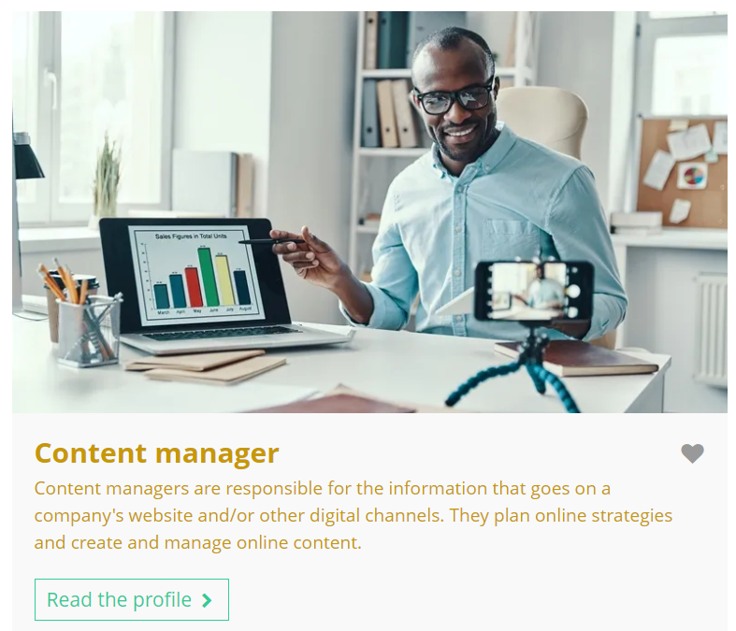

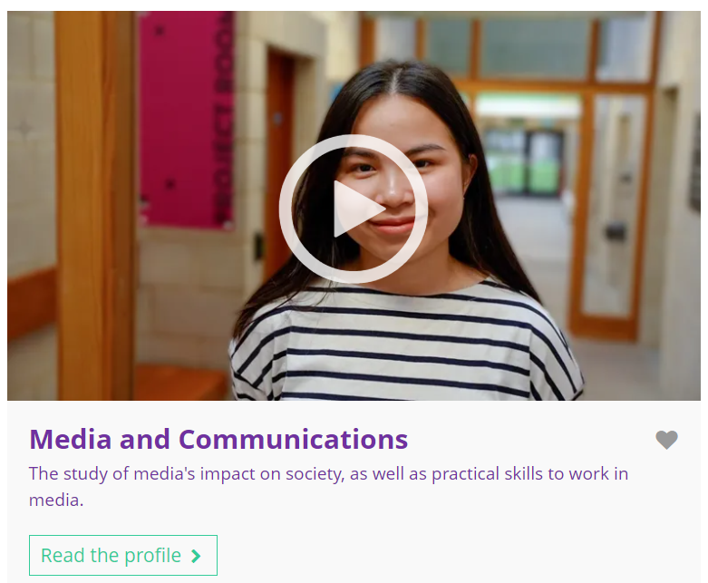
Curious about this career? Discover more on Unifrog!
Explore the social media manager career profile.
Explore related career profiles, like content manager and public relations executive.
Explore related subject profiles, like media and communications.
Remember to click the heart symbol to add a profile to your Favourites!
Notes:
Teacher’s notes:
This slide contains career and subject profiles that are relevant to the career of the month.
If you have additional time available and students have computer access, you can direct them to these resources.
Remember to log into the student side of your Unifrog account to access these links and remind students to favourite any careers or subjects they like the look of.
You can track student progress with favouriting careers or subjects by clicking Advanced>Sort by>Library profiles in Favourites.

Slide 34
Subject of the month
Year 9 – September
Notes:
Teacher’s notes:
September’s subject of the month for year 9 is: Geology.

Slide 35

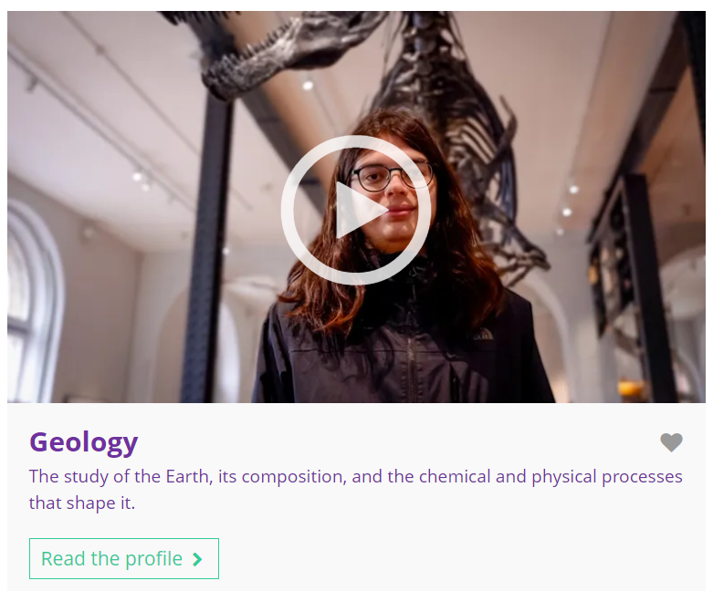

September’s subject of the month is…
Geology
Note down at least one thing you think you know about this subject.
Notes:
Teacher’s notes:
Click to reveal the subject of the month: Geology.
Before you’re ready to watch the Subjects library video as a class, ask students to note down anything they think they already know about this subject.

Slide 36
September’s subject of the month is… Geology
There are lots of degrees that fall under the category of geology. Today we'll be hearing from James, who’s a palaeontology and geology student.
Whilst you’re watching, think about what makes this subject similar or different to geography at school.
Notes:
Teacher’s notes:
Make sure you’re logged into your Unifrog account and click ‘use the platform as a student’. Click the image on the screen to go to the Subjects library profile, then click the play button on the video. Alternatively, copy this URL into an internet browser: unifrog.org/student/subjects/direct/geology
If you have more time available, you could read the subject profile text as a class too.

Slide 37
September’s subject of the month is… Geology
How does this subject (geology) help James in his joint studies of palaeontology?
What are the benefits of fieldwork in a degree?
How is this subject different to studying geography at school?
If you’re interested in this subject, what further research could you do next?
Notes:
Teacher’s notes:
This slide contains reflection questions about the subject of the month. You could ask students to write down their answers, discuss in pairs or small groups, or discuss as a whole class.
The aim of this activity is for students to think about their own preferences, experiences, and skills and how these could relate to the subject. Students are encouraged to draw links between skills used in their current school subjects and the subject in the video. If students would like to know more about the subject, encourage them to read the full subject profile, which contains the following sections:
In a nutshell
Getting in
Prospects
Statement
Reference
Geek out
Recommendations: Read
Recommendations: Watch
Recommendations: Listen
Explore
People also liked…
Example answers:
Gives you the basic skills you need to identify something out in the field.
You get to apply your learning and bond with your classmates.
Geography is human and physical – geology is entirely physical.
Read the subject profile, complete related online courses like MOOCs.

Slide 38
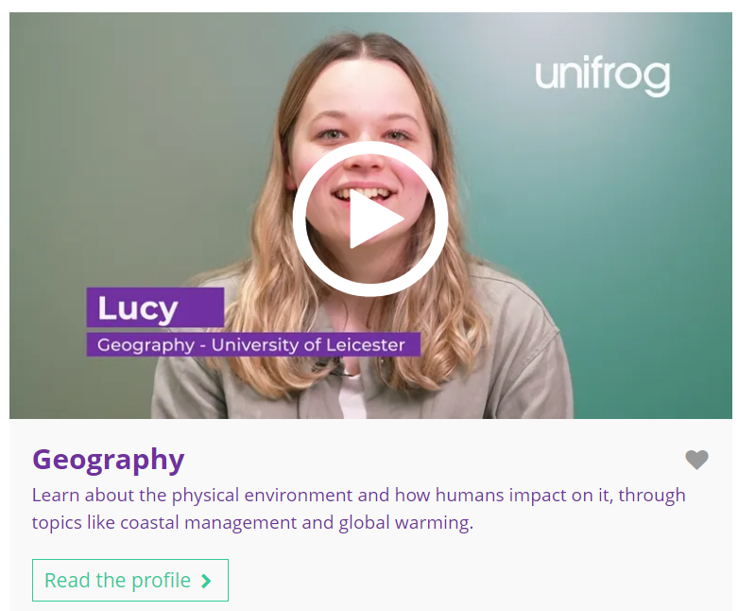
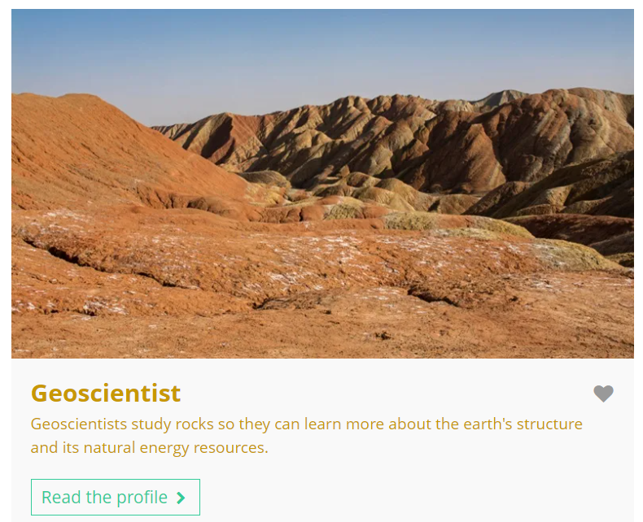
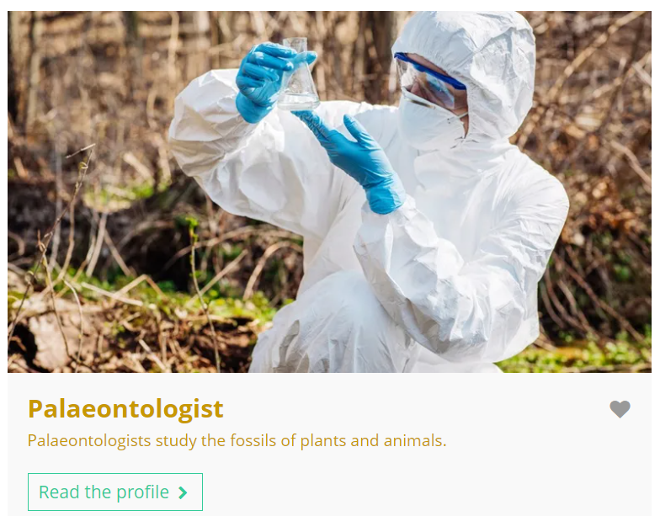
Fascinated by this field? Find out more on Unifrog!
Explore the geology subject profile.
Explore related subject profiles, like geography.
Explore related career profiles, like geoscientist and palaeontologist.
Remember to click the heart symbol to add a profile to your Favourites!
Notes:
Teacher’s notes:
This slide contains career and subject profiles that are relevant to the subject of the month.
If you have additional time available and students have computer access, you can direct them to these resources.
Remember to log into the student side of your Unifrog account to access these links and remind students to favourite any careers or subjects they like the look of.
You can track student progress with favouriting careers or subjects by clicking Advanced>Sort by>Library profiles in Favourites.

Slide 40
Career of the month
Year 10 – September
Notes:
Teacher’s notes:
September’s career of the month for year 10 is: Radiographer.

Slide 41

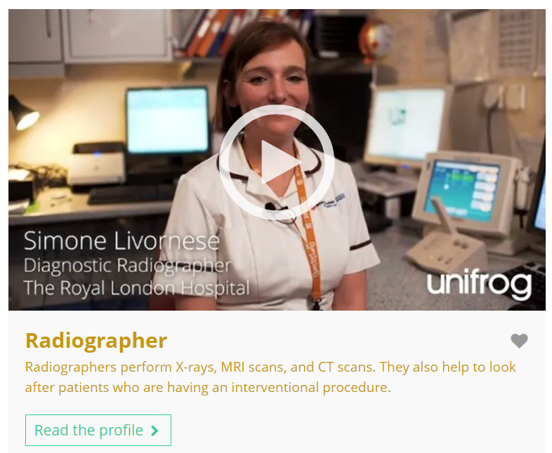

September’s career of the month is…
Radiographer
Note down at least one thing you think you know about this career.
Notes:
Teacher’s notes:
Click to reveal the career of the month: Radiographer.
Before you’re ready to watch the Careers library video as a class, ask students to note down anything they think they already know about this career.

Slide 42
September’s career of the month is… Radiographer
There are lots of roles that fall under the category of radiographer. Today we'll be hearing from Simone, who’s a diagnostic radiographer.
Whilst you’re watching, think about why this career would make you feel proud.
Notes:
Teacher’s notes:
Make sure you’re logged into your Unifrog account and click ‘use the platform as a student’. Click the image on the screen to go to the Careers library profile, then click the play button on the video. Alternatively, copy this URL into an internet browser: unifrog.org/student/careers/direct/radiographer
If you have more time available, you could read the career profile text as a class too.

Slide 43
September’s career of the month is… Radiographer
What do you think are the biggest challenges in this career?
What other professionals might Simone work alongside?
Simone says her career makes her ‘happy and proud’. How important is it for you to have a career that makes you feel proud?
What school subjects might help you prepare for this career?
Notes:
Teacher’s notes:
This slide contains reflection questions about the career of the month. You could ask students to write down their answers, discuss in pairs or small groups, or discuss as a whole class.
The aim of this activity is for students to think about their own preferences, experiences, and skills and how these could relate to the career. Students are encouraged to draw links between skills used in their current school subjects and the career in the video. If students would like to know more about the career, encourage them to read the full career profile, which contains the following sections:
What you’ll do
Working hours and environment
Career path and progression
Skills required
Entry requirements
Related know-how guides
Related university subject profiles
Related career profiles
Explore
Labour Market Information (LMI)
People also liked…
Example answers:
Knowing how to prioritise scans, being patient with different types of patients.
Doctors, nurses, clinical scientists, radiologists, neuroscientists.
It’s really important that I feel like I’m making a positive impact on society.
Science, e.g. biology.

Slide 44
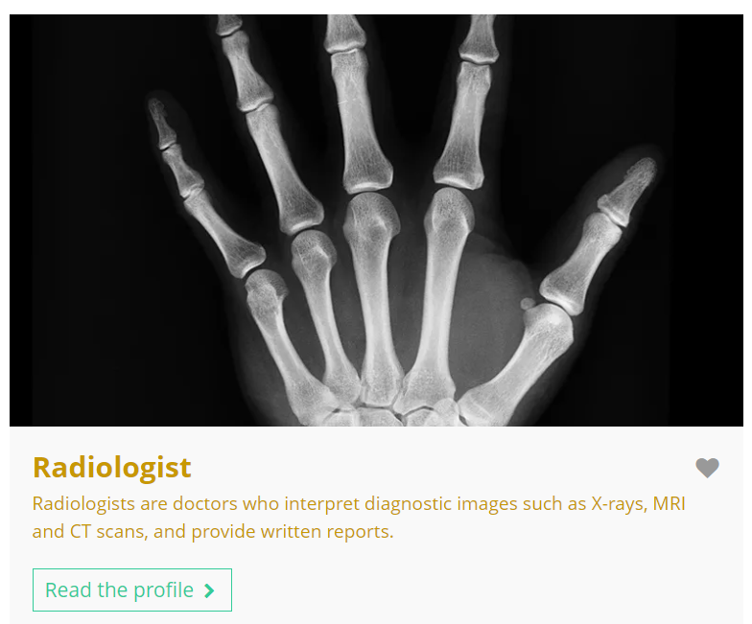

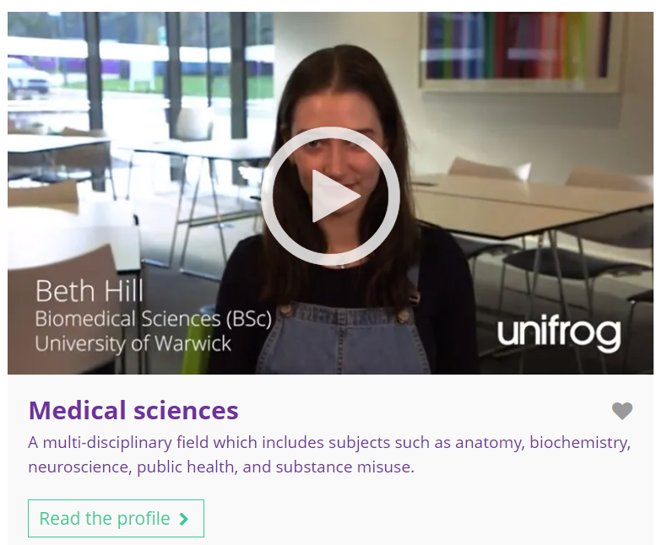
Curious about this career? Discover more on Unifrog!
Explore the radiographer career profile.
Explore related career profiles, like radiologist and clinical scientist.
Explore related subject profiles, like medical sciences.
Remember to click the heart symbol to add a profile to your Favourites!
Notes:
Teacher’s notes:
This slide contains career and subject profiles that are relevant to the career of the month.
If you have additional time available and students have computer access, you can direct them to these resources.
Remember to log into the student side of your Unifrog account to access these links and remind students to favourite any careers or subjects they like the look of.
You can track student progress with favouriting careers or subjects by clicking Advanced>Sort by>Library profiles in Favourites.

Slide 46
Subject of the month
Year 10 – September
Notes:
Teacher’s notes:
September’s subject of the month for year 10 is: Social work and community care.

Slide 47



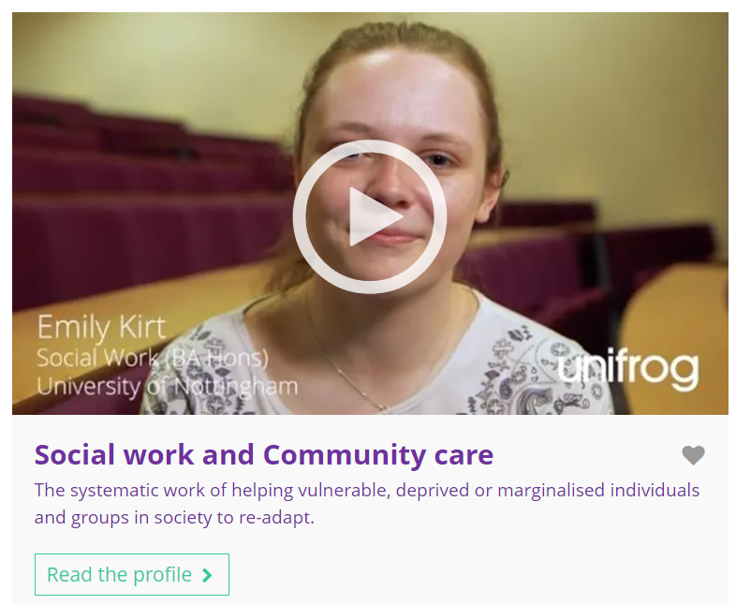
September’s subject of the month is…
Social work and community care
Note down at least one thing you think you know about this subject.
Notes:
Teacher’s notes:
Click to reveal the subject of the month: Social work and community care.
Before you’re ready to watch the Subjects library video as a class, ask students to note down anything they think they already know about this subject.

Slide 48
September’s subject of the month is… Social work and community care
There are lots of degrees that fall under the category of social work and community care. Today we'll be hearing from Joe, who’s a social work student.
Whilst you’re watching, think about the benefits of having a placement as part of your degree.
Notes:
Teacher’s notes:
Make sure you’re logged into your Unifrog account and click ‘use the platform as a student’. Click the image on the screen to go to the Subjects library profile, then click the play button on the video. Alternatively, copy this URL into an internet browser: unifrog.org/student/subjects/direct/social-work-and-community-care
Please note, there are two videos available on this subject profile: Emily and Joe.
If you have more time available, you could read the subject profile text as a class too.

Slide 49
September’s subject of the month is… Social work and community care
If you could ask Joe anything about this subject, what would you ask?
What are the benefits having a placement alongside lectures/seminars?
What skills are essential for this subject?
What qualifications and work experience does Joe mention that helped prepare him for this subject?
Notes:
Teacher’s notes:
This slide contains reflection questions about the subject of the month. You could ask students to write down their answers, discuss in pairs or small groups, or discuss as a whole class.
The aim of this activity is for students to think about their own preferences, experiences, and skills and how these could relate to the subject. Students are encouraged to draw links between skills used in their current school subjects and the subject in the video. If students would like to know more about the subject, encourage them to read the full subject profile, which contains the following sections:
In a nutshell
Getting in
Prospects
Statement
Reference
Geek out
Recommendations: Read
Recommendations: Watch
Recommendations: Listen
Explore
People also liked…
Example answers:
What do you want to do after you’ve completed your degree?
Allows you to apply your learning to the workplace and real-life situations.
Caring, open-mindedness, problem solving, communication, teamwork.
A levels, access course, relevant employment.

Slide 50

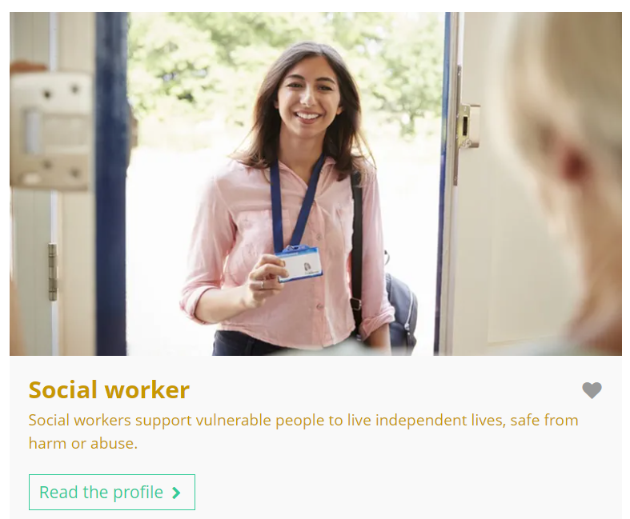
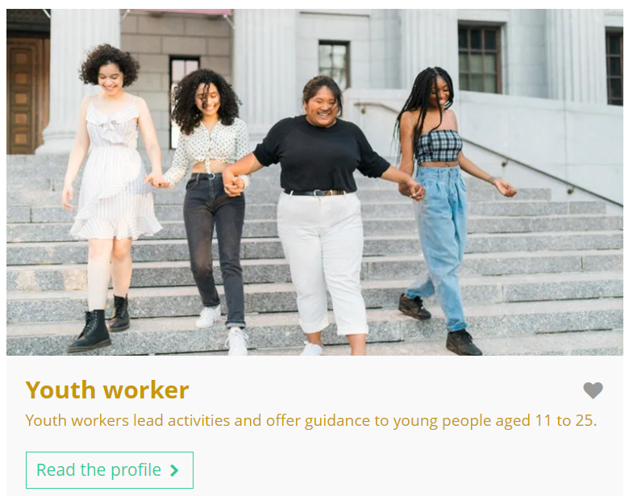
Fascinated by this field? Find out more on Unifrog!
Explore the social work and community care subject profile and watch Emily’s interview.
Explore related subject profiles, like psychology.
Explore related career profiles, like social worker and youth worker.
Remember to click the heart symbol to add a profile to your Favourites!
Notes:
Teacher’s notes:
This slide contains career and subject profiles that are relevant to the subject of the month.
If you have additional time available and students have computer access, you can direct them to these resources.
Remember to log into the student side of your Unifrog account to access these links and remind students to favourite any careers or subjects they like the look of.
You can track student progress with favouriting careers or subjects by clicking Advanced>Sort by>Library profiles in Favourites.

Slide 52
Career of the month
Year 11 – September
Notes:
Teacher’s notes:
September’s career of the month for year 11 is: Environmental engineer.

Slide 53
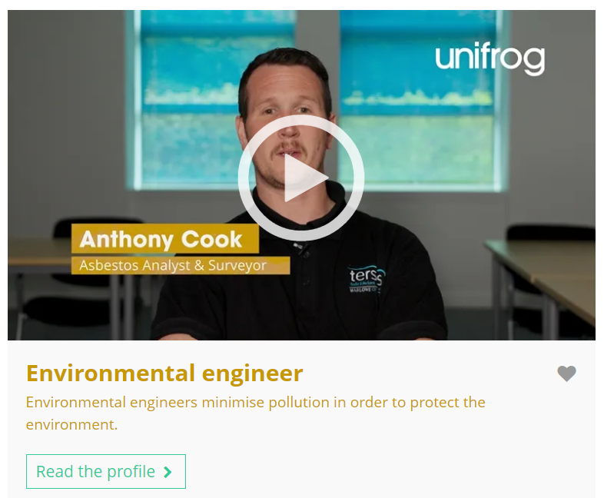


September’s career of the month is…
Environmental engineer
Note down at least one thing you think you know about this career.
Notes:
Teacher’s notes:
Click to reveal the career of the month: Environmental engineer..
Before you’re ready to watch the Careers library video as a class, ask students to note down anything they think they already know about this career.

Slide 54
September’s career of the month is… Environmental engineer
There are lots of roles that fall under the category of environmental engineer. Today we'll be hearing from Anthony, who’s an asbestos analyst and surveyor.
Whilst you’re watching, think about which school subjects are linked.
Notes:
Teacher’s notes:
Make sure you’re logged into your Unifrog account and click ‘use the platform as a student’. Click the image on the screen to go to the Careers library profile, then click the play button on the video. Alternatively, copy this URL into an internet browser: unifrog.org/student/careers/direct/environmental-engineering-technician
If you have more time available, you could read the career profile text as a class too.

Slide 55
September’s career of the month is… Environmental engineer
Anthony says ‘the satisfaction of keeping others safe through my work makes it all worthwhile’ – what does this statement mean to you?
What do you think is the most interesting element of this career?
Which school subjects would help prepare someone for this career?
What skills did Anthony learn in his previous role, which prepared him for this career?
Notes:
Teacher’s notes:
This slide contains reflection questions about the career of the month. You could ask students to write down their answers, discuss in pairs or small groups, or discuss as a whole class.
The aim of this activity is for students to think about their own preferences, experiences, and skills and how these could relate to the career. Students are encouraged to draw links between skills used in their current school subjects and the career in the video. If students would like to know more about the career, encourage them to read the full career profile, which contains the following sections:
What you’ll do
Working hours and environment
Career path and progression
Skills required
Entry requirements
Related know-how guides
Related university subject profiles
Related career profiles
Explore
Labour Market Information (LMI)
People also liked…
Example answers:
It means that Anthony values seeing the impact of his day-to-day work, through protecting others’ safety.
Working with nuclear power stations.
Engineering, science, maths, physics, chemistry.
Self-discipline, teamwork, adaptability, and how to work in high-pressure environments.

Slide 56
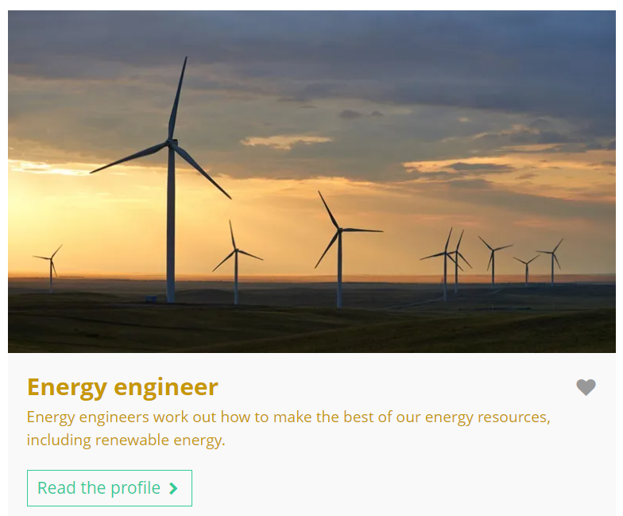
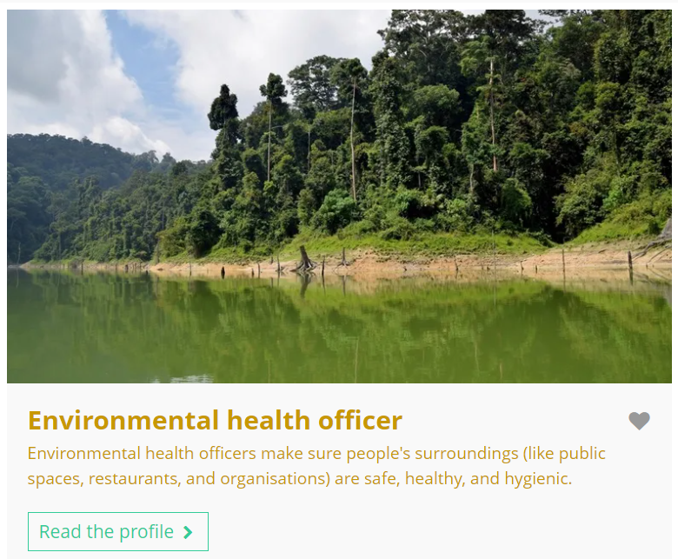
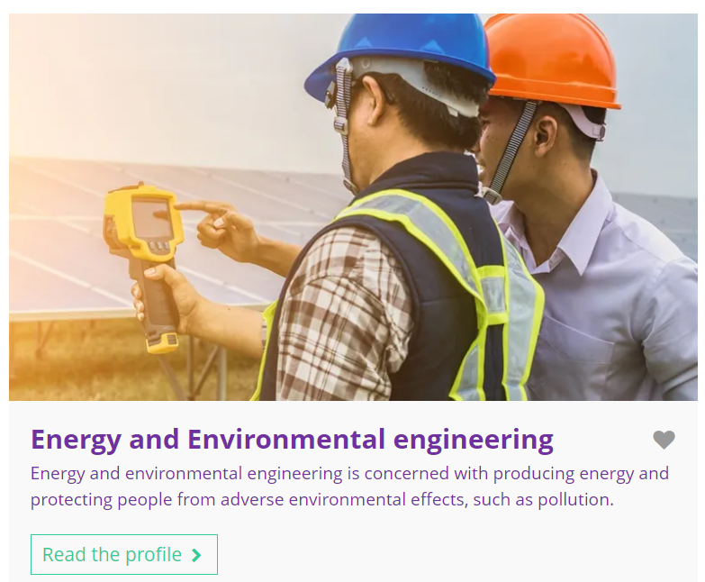
Curious about this career? Discover more on Unifrog!
Explore the environmental engineer career profile.
Explore related career profiles, like energy engineer and environmental health officer.
Explore related subject profiles, like energy and environmental engineering.
Remember to click the heart symbol to add a profile to your Favourites!
Notes:
Teacher’s notes:
This slide contains career and subject profiles that are relevant to the career of the month.
If you have additional time available and students have computer access, you can direct them to these resources.
Remember to log into the student side of your Unifrog account to access these links and remind students to favourite any careers or subjects they like the look of.
You can track student progress with favouriting careers or subjects by clicking Advanced>Sort by>Library profiles in Favourites.

Slide 58
Subject of the month
Year 11 – September
Notes:
Teacher’s notes:
September’s subject of the month for year 11 is: Physics.

Slide 59



September’s subject of the month is…
Physics
Note down at least one thing you think you know about this subject.
Notes:
Teacher’s notes:
Click to reveal the subject of the month: Physics.
Before you’re ready to watch the Subjects library video as a class, ask students to note down anything they think they already know about this subject.

Slide 60
September’s subject of the month is… Physics
There are lots of degrees that fall under the category of physics. Today we'll be hearing from Rohini, who’s a physics and astrophysics student.
Whilst you’re watching, think about the benefits of studying abroad as part of your degree.
Notes:
Teacher’s notes:
Make sure you’re logged into your Unifrog account and click ‘use the platform as a student’. Click the image on the screen to go to the Subjects library profile, then click the play button on the video. Alternatively, copy this URL into an internet browser: unifrog.org/student/subjects/direct/physics
If you have more time available, you could read the subject profile text as a class too.

Slide 61
September’s subject of the month is… Physics
What advice would you give someone who wants to study this subject?
Rohini studied abroad for a year – would this interest you? Why or why not?
Other than physics, what other school subjects would help you prepare for this degree?
What careers could this subject lead to?
Notes:
Teacher’s notes:
This slide contains reflection questions about the subject of the month. You could ask students to write down their answers, discuss in pairs or small groups, or discuss as a whole class.
The aim of this activity is for students to think about their own preferences, experiences, and skills and how these could relate to the subject. Students are encouraged to draw links between skills used in their current school subjects and the subject in the video. If students would like to know more about the subject, encourage them to read the full subject profile, which contains the following sections:
In a nutshell
Getting in
Prospects
Statement
Reference
Geek out
Recommendations: Read
Recommendations: Watch
Recommendations: Listen
Explore
People also liked…
Example answers:
Explore optional modules, like teaching physics at a school.
I’d love to study abroad because you could experience a completely different culture for a year, whilst still studying for your degree.
Maths, English, chemistry, biology.
Clinical scientist, careers in nuclear medicine, astronaut.

Slide 62
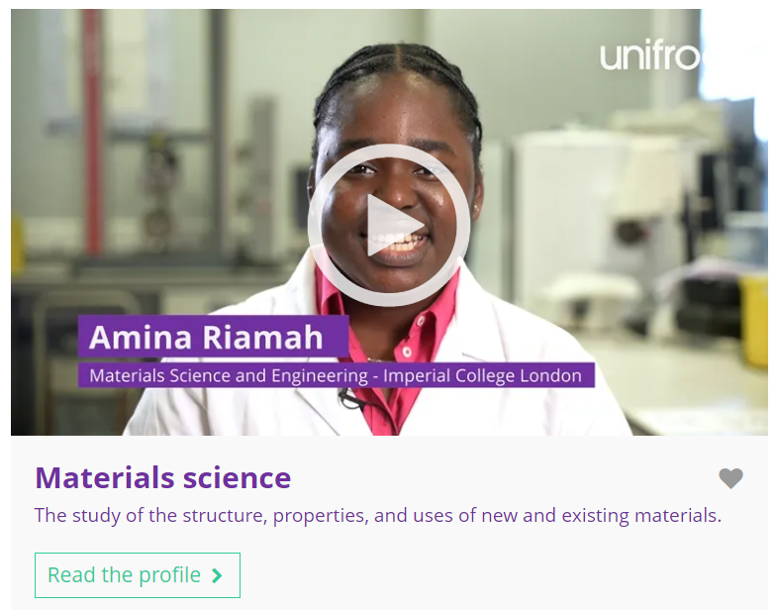

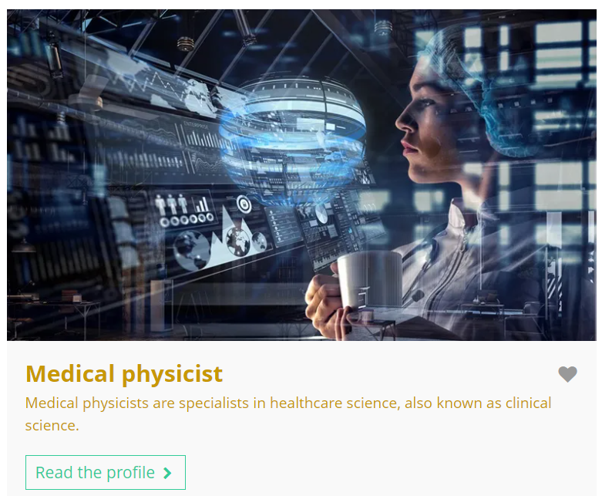
Fascinated by this field? Find out more on Unifrog!
Explore the physics subject profile.
Explore related subject profiles, like materials science.
Explore related career profiles, like physicist and medical physicist.
Remember to click the heart symbol to add a profile to your Favourites!
Notes:
Teacher’s notes:
This slide contains career and subject profiles that are relevant to the subject of the month.
If you have additional time available and students have computer access, you can direct them to these resources.
Remember to log into the student side of your Unifrog account to access these links and remind students to favourite any careers or subjects they like the look of.
You can track student progress with favouriting careers or subjects by clicking Advanced>Sort by>Library profiles in Favourites.

Slide 64
Career of the month
Year 12 – September
Notes:
Teacher’s notes:
September’s career of the month for year 12 is: Auditor.

Slide 65

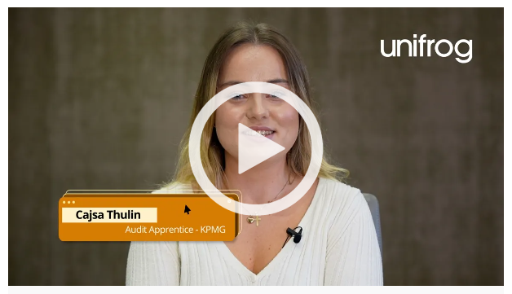

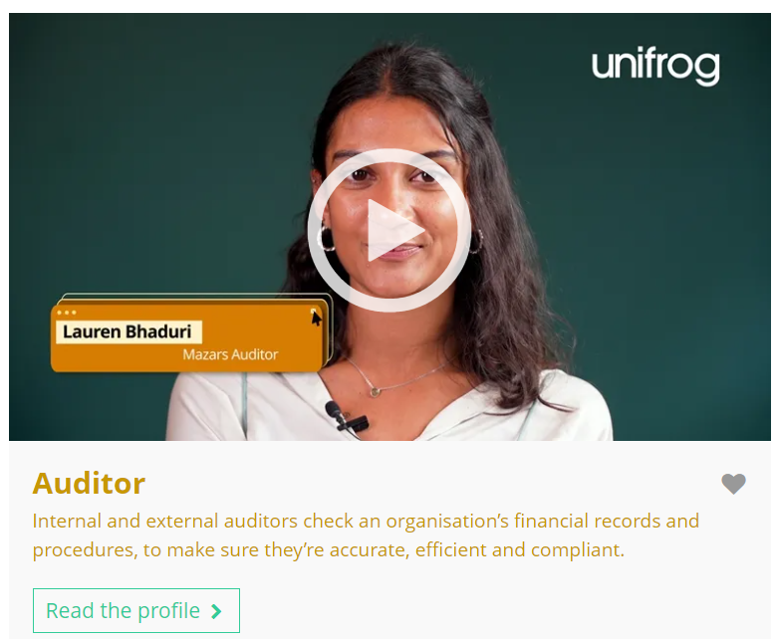
September’s career of the month is…
Auditor
Note down at least one thing you think you know about this career.
Notes:
Teacher’s notes:
Click to reveal the career of the month: Auditor.
Before you’re ready to watch the Careers library video as a class, ask students to note down anything they think they already know about this career.

Slide 66
September’s career of the month is… Auditor
There are lots of roles that fall under the category of auditor. Today we'll be hearing from Cajsa, who’s an audit apprentice.
Whilst you’re watching, think about the differences between an apprenticeship and university.
Notes:
Teacher’s notes:
Make sure you’re logged into your Unifrog account and click ‘use the platform as a student’. Click the image on the screen to go to the Careers library profile, then click the play button on the video. Alternatively, copy this URL into an internet browser: unifrog.org/student/careers/direct/auditor
Please note, there are two videos available on this subject profile: Lauren and Cajsa.
If you have more time available, you could read the career profile text as a class too.

Slide 67
September’s career of the month is… Auditor
Cajsa mentions office social events organised by their employer – how important is this to you when looking for potential employers?
Why is teamwork an essential skill required for this career?
What could be the benefits of choosing an apprenticeship as the pathway into this career?
What else would you like to find out about this career?
Notes:
Teacher’s notes:
This slide contains reflection questions about the career of the month. You could ask students to write down their answers, discuss in pairs or small groups, or discuss as a whole class.
The aim of this activity is for students to think about their own preferences, experiences, and skills and how these could relate to the career. Students are encouraged to draw links between skills used in their current school subjects and the career in the video. If students would like to know more about the career, encourage them to read the full career profile, which contains the following sections:
What you’ll do
Working hours and environment
Career path and progression
Skills required
Entry requirements
Related know-how guides
Related university subject profiles
Related career profiles
Explore
Labour Market Information (LMI)
People also liked…
Example answers:
I think it’s quite important, as it helps you to bond with colleagues, particularly if you’re working a remote job.
You need to work together with other people to achieve tight deadlines.
Applying theoretical learning ‘on the job’, experience in the workplace, receiving a salary.
I’d like to know what other professionals you commonly work with in your day-to-day duties. Encourage students to explore the career profile text to search for the answers to their questions.

Slide 68
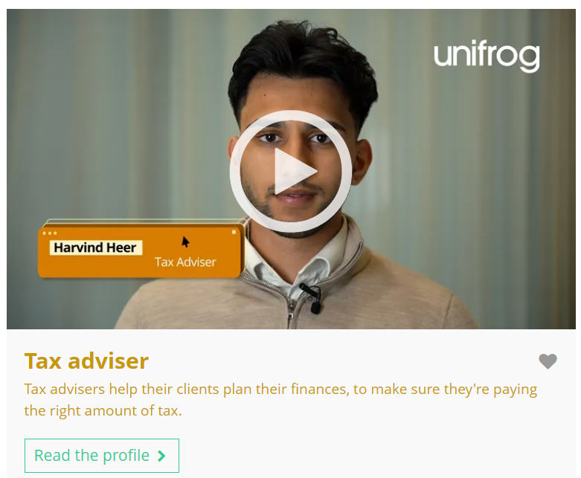

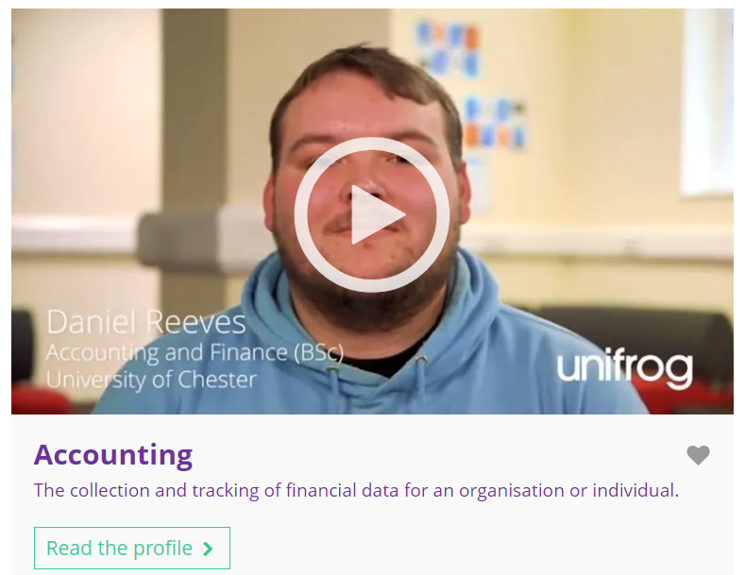
Curious about this career? Discover more on Unifrog!
Explore the auditor career profile and watch Lauren’s interview.
Explore related career profiles, like tax adviser and credit risk analyst.
Explore related subject profiles, like accounting.
Remember to click the heart symbol to add a profile to your Favourites!
Notes:
Teacher’s notes:
This slide contains career and subject profiles that are relevant to the career of the month.
If you have additional time available and students have computer access, you can direct them to these resources.
Remember to log into the student side of your Unifrog account to access these links and remind students to favourite any careers or subjects they like the look of.
You can track student progress with favouriting careers or subjects by clicking Advanced>Sort by>Library profiles in Favourites.

Slide 69


Further exploration
Visit the Courses tool to join courses relating to the career of the month:
Mathematics: the size of infinity
Proof in Mathematics
Notes:
Teacher’s notes:
This slide contains Unifrog courses that are relevant to the career of the month.
If you have additional time available and students have computer access, you can direct them to the Courses tool.
Remember to log into the student side of your Unifrog account to access these links and remind students to join any courses they like the look of.
You can track student progress with courses by clicking Advanced>Sort by>Courses.

Slide 71
Subject of the month
Year 12 – September
Notes:
Teacher’s notes:
September’s subject of the month for year 12 is: Medicine.

Slide 72

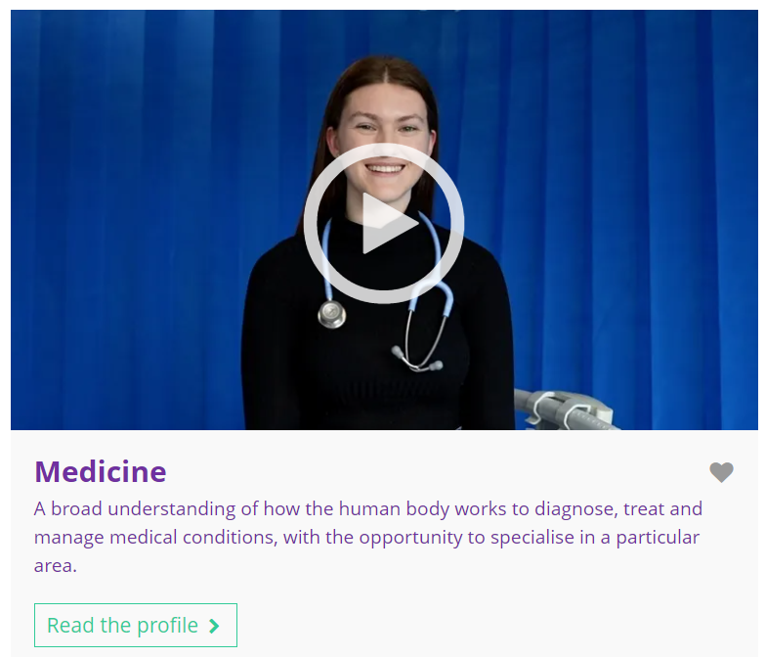

September’s subject of the month is…
Medicine
Note down at least one thing you think you know about this subject.
Notes:
Teacher’s notes:
Click to reveal the subject of the month: Medicine.
Before you’re ready to watch the Subjects library video as a class, ask students to note down anything they think they already know about this subject.

Slide 73
September’s subject of the month is… Medicine
Today we'll be hearing from Laura, who’s a medicine student.
Whilst you’re watching, think about what someone could do to prepare to study this subject at university.
Notes:
Teacher’s notes:
Make sure you’re logged into your Unifrog account and click ‘use the platform as a student’. Click the image on the screen to go to the Subjects library profile, then click the play button on the video. Alternatively, copy this URL into an internet browser: unifrog.org/student/subjects/direct/medicine
If you have more time available, you could read the subject profile text as a class too.

Slide 74
September’s subject of the month is… Medicine
Laura treats her degree like a 9-5 job – do you think this strategy would work well for you? Why or why not?
What other subjects are similar to this subject?
Does this subject suit your skillset? Why or why not?
How could someone prepare to study this subject at university?
Notes:
Teacher’s notes:
This slide contains reflection questions about the subject of the month. You could ask students to write down their answers, discuss in pairs or small groups, or discuss as a whole class.
The aim of this activity is for students to think about their own preferences, experiences, and skills and how these could relate to the subject. Students are encouraged to draw links between skills used in their current school subjects and the subject in the video. If students would like to know more about the subject, encourage them to read the full subject profile, which contains the following sections:
In a nutshell
Getting in
Prospects
Statement
Reference
Geek out
Recommendations: Read
Recommendations: Watch
Recommendations: Listen
Explore
People also liked…
Example answers:
I don’t think this strategy would work well for me – I focus well in the evenings, so I’d probably do lots of my independent work in the evenings instead.
Medical sciences, biology and biological sciences, genetics, pharmacy and pharmacology, allied health.
Yes – some of my best skills are communication, accountability, resilience, and working under pressure.
Study science subjects at A level (or equivalent), complete relevant online courses like MOOCs, read around the subject, seek relevant work experience e.g. at a GP surgery.

Slide 75
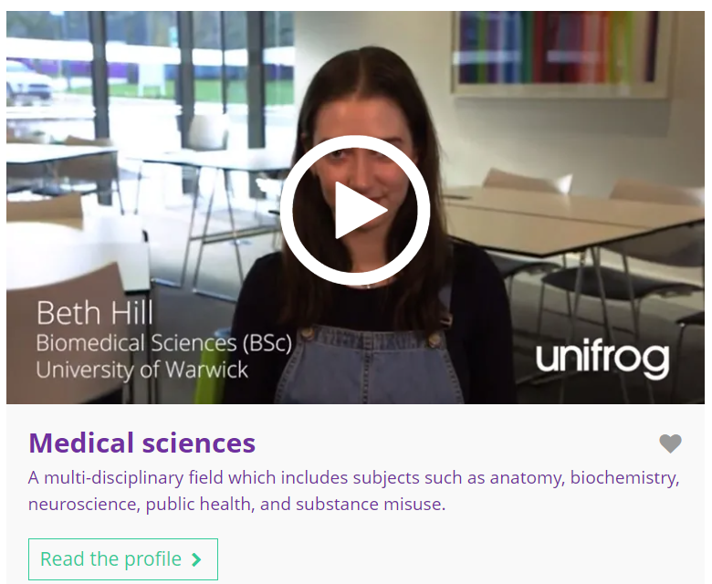
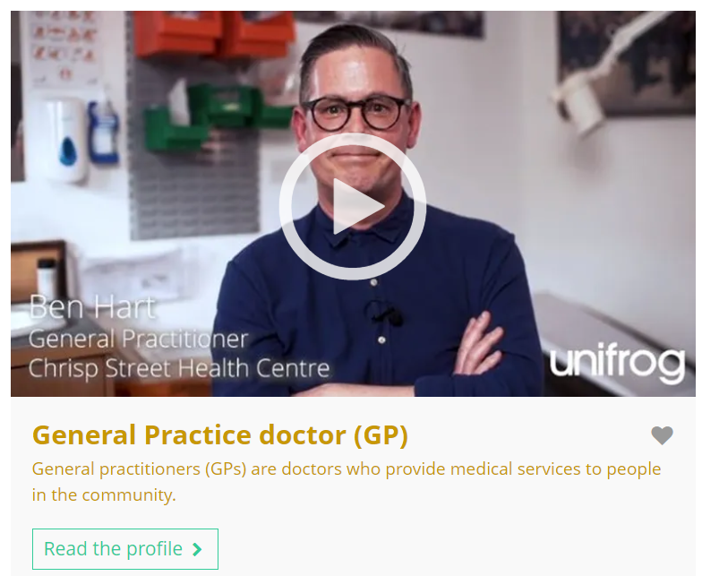
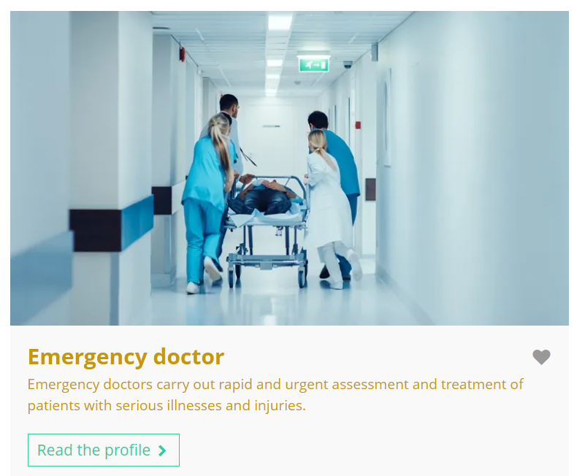
Fascinated by this field? Find out more on Unifrog!
Explore the medicine subject profile.
Explore related subject profiles, like medical sciences.
Explore related career profiles, like general practice doctor (GP) and emergency doctor.
Remember to click the heart symbol to add a profile to your Favourites!
Notes:
Teacher’s notes:
This slide contains career and subject profiles that are relevant to the subject of the month.
If you have additional time available and students have computer access, you can direct them to these resources.
Remember to log into the student side of your Unifrog account to access these links and remind students to favourite any careers or subjects they like the look of.
You can track student progress with favouriting careers or subjects by clicking Advanced>Sort by>Library profiles in Favourites.

Slide 77
Career of the month
Year 13 – September
Notes:
Teacher’s notes:
September’s career of the month for year 13 is: Network engineer.

Slide 78

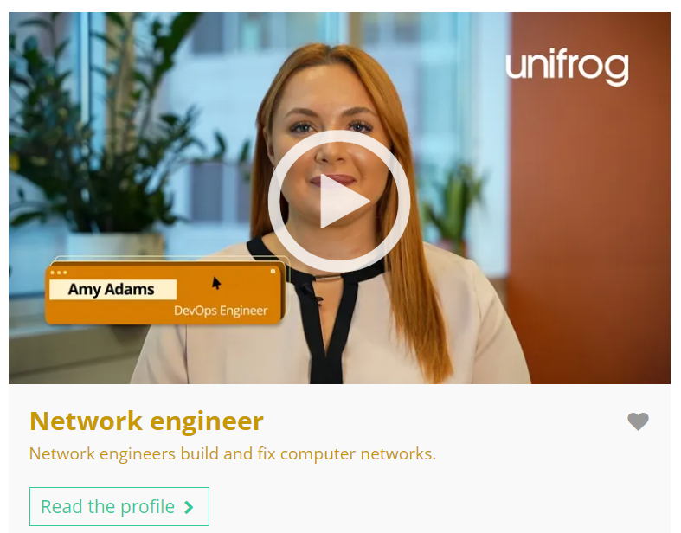

September’s career of the month is…
Network engineer
Note down at least one thing you think you know about this career.
Notes:
Teacher’s notes:
Click to reveal the career of the month: Network engineer.
Before you’re ready to watch the Careers library video as a class, ask students to note down anything they think they already know about this career.

Slide 79
September’s career of the month is… Network engineer
There are lots of roles that fall under the category of network engineer. Today we'll be hearing from Amy, who’s a DevOps engineer.
Whilst you’re watching, think about the work patterns and collaboration in this career.
Notes:
Teacher’s notes:
Make sure you’re logged into your Unifrog account and click ‘use the platform as a student’. Click the image on the screen to go to the Careers library profile, then click the play button on the video. Alternatively, copy this URL into an internet browser: unifrog.org/student/careers/direct/network-engineer
If you have more time available, you could read the career profile text as a class too.

Slide 80
September’s career of the month is… Network engineer
What other professionals would someone in this career work alongside?
Amy mentions working ‘on call’ outside of her typical working hours. Would you like a career with this work pattern? Why or why not?
How important is it for your career to contribute to creating a greener, more sustainable future, like Amy’s?
Why is it important to stay up to date with industry news in the career area you want to work in?
Notes:
Teacher’s notes:
This slide contains reflection questions about the career of the month. You could ask students to write down their answers, discuss in pairs or small groups, or discuss as a whole class.
The aim of this activity is for students to think about their own preferences, experiences, and skills and how these could relate to the career. Students are encouraged to draw links between skills used in their current school subjects and the career in the video. If students would like to know more about the career, encourage them to read the full career profile, which contains the following sections:
What you’ll do
Working hours and environment
Career path and progression
Skills required
Entry requirements
Related know-how guides
Related university subject profiles
Related career profiles
Explore
Labour Market Information (LMI)
People also liked…
Example answers:
Software developers, graphic designers, programmers, operations teams.
I’d prefer to work to a regular routine as I like to plan what I’m going to do in my free time.
This is an important career value for me – I’d like my career to make a positive difference to the world.
To keep up to date with the latest career trends to help you make a decision about entering this career area, to discuss in a future application or interview, to make sure it’s a career area that you’re truly interested in and passionate about.

Slide 81



Curious about this career? Discover more on Unifrog!
Explore the network engineer career profile.
Explore related career profiles, like IT systems architect or systems analyst.
Explore related subject profiles, like computer science and AI.
Remember to click the heart symbol to add a profile to your Favourites!
Notes:
Teacher’s notes:
This slide contains career and subject profiles that are relevant to the career of the month.
If you have additional time available and students have computer access, you can direct them to these resources.
Remember to log into the student side of your Unifrog account to access these links and remind students to favourite any careers or subjects they like the look of.
You can track student progress with favouriting careers or subjects by clicking Advanced>Sort by>Library profiles in Favourites.

Slide 83
Subject of the month
Year 13 – September
Notes:
Teacher’s notes:
September’s subject of the month for year 13 is: Industrial, product, and packaging design.

Slide 84

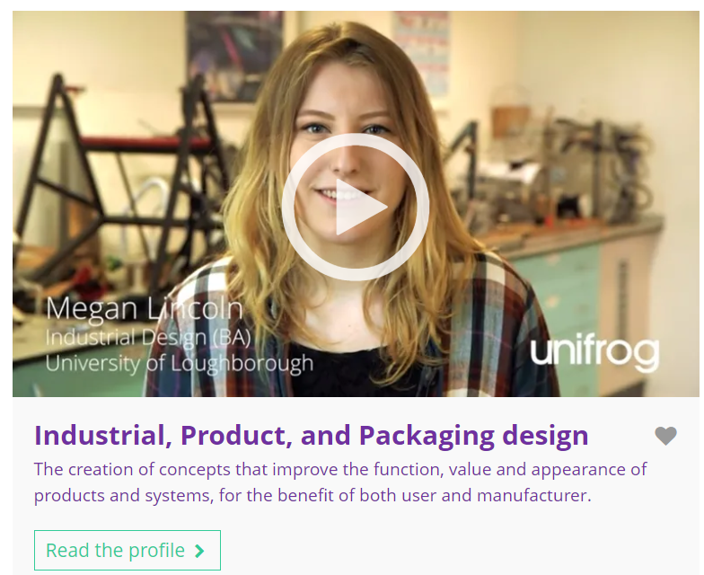

September’s subject of the month is…
Industrial, product, and packaging design
Note down at least one thing you think you know about this subject.
Notes:
Teacher’s notes:
Click to reveal the subject of the month: Industrial, product, and packaging design.
Before you’re ready to watch the Subjects library video as a class, ask students to note down anything they think they already know about this subject.

Slide 85
September’s subject of the month is… IPP design
There are lots of degrees that fall under the category of IPP design. Today we'll be hearing from Megan, who’s an industrial design student.
Whilst you’re watching, think about how this subject might link to one of your current subjects at school/college.
Notes:
Teacher’s notes:
Make sure you’re logged into your Unifrog account and click ‘use the platform as a student’. Click the image on the screen to go to the Subjects library profile, then click the play button on the video. Alternatively, copy this URL into an internet browser: unifrog.org/student/subjects/direct/industrial-product-and-packaging-design
If you have more time available, you could read the subject profile text as a class too.

Slide 86
September’s subject of the month is… IPP design
What are the benefits of studying a variety of modules within a degree?
What do you think the biggest challenge would be when studying this subject?
Select a subject you currently study at school/college. How does it link to this subject?
If someone’s interested in this subject, what could they do to prepare, outside of school/college?
Notes:
Teacher’s notes:
This slide contains reflection questions about the subject of the month. You could ask students to write down their answers, discuss in pairs or small groups, or discuss as a whole class.
The aim of this activity is for students to think about their own preferences, experiences, and skills and how these could relate to the subject. Students are encouraged to draw links between skills used in their current school subjects and the subject in the video. If students would like to know more about the subject, encourage them to read the full subject profile, which contains the following sections:
In a nutshell
Getting in
Prospects
Statement
Reference
Geek out
Recommendations: Read
Recommendations: Watch
Recommendations: Listen
Explore
People also liked…
Example answers:
Variety within your timetable, learning new and varied skills, opportunities to apply your learning to different fields.
Time commitment – a lot of hours need to go into projects.
History – you might study the changes in design trends over time, requiring an analytical mindset.
Research designers, visit design events, seek out relevant work experience, network with designers.

Slide 87
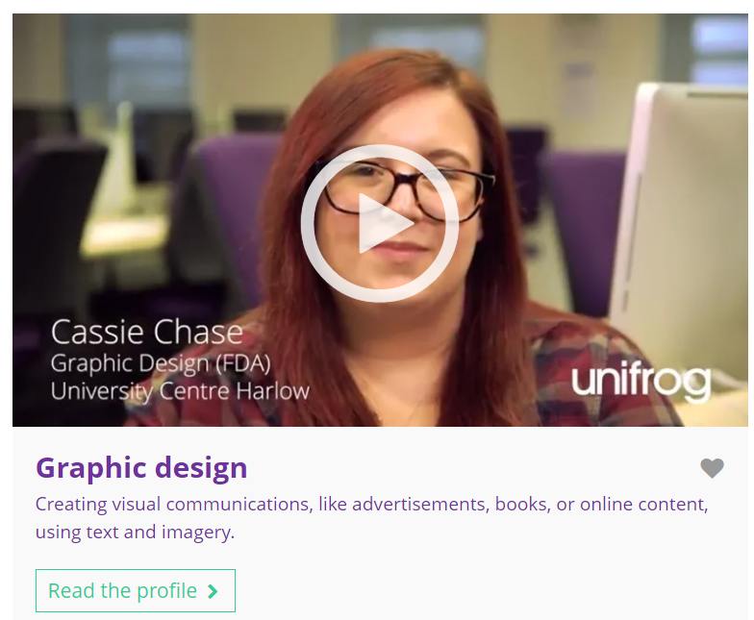
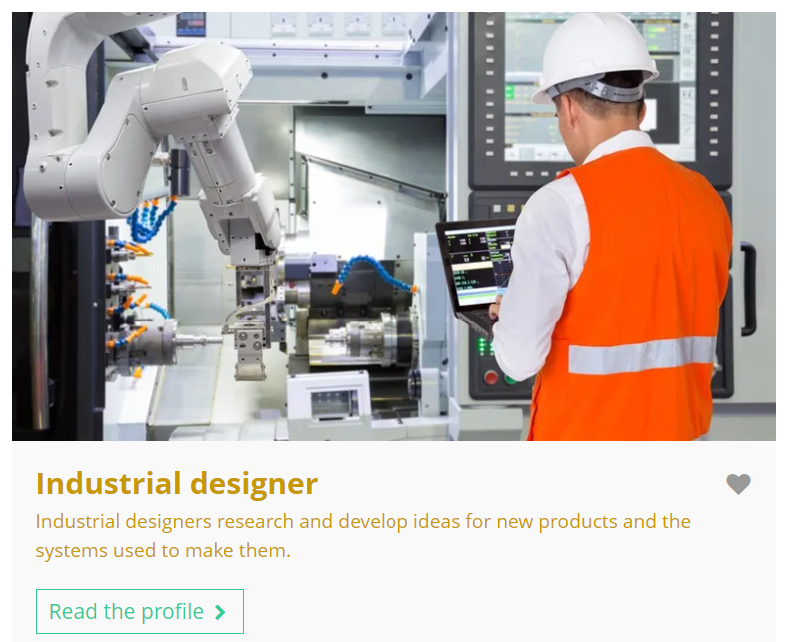
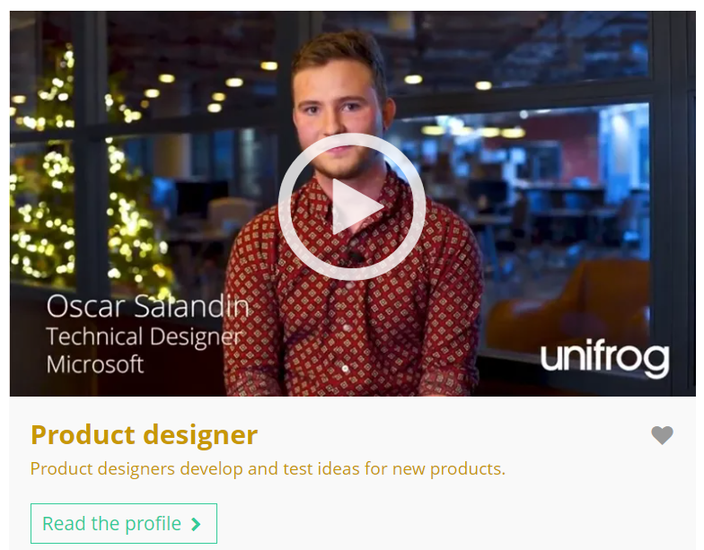
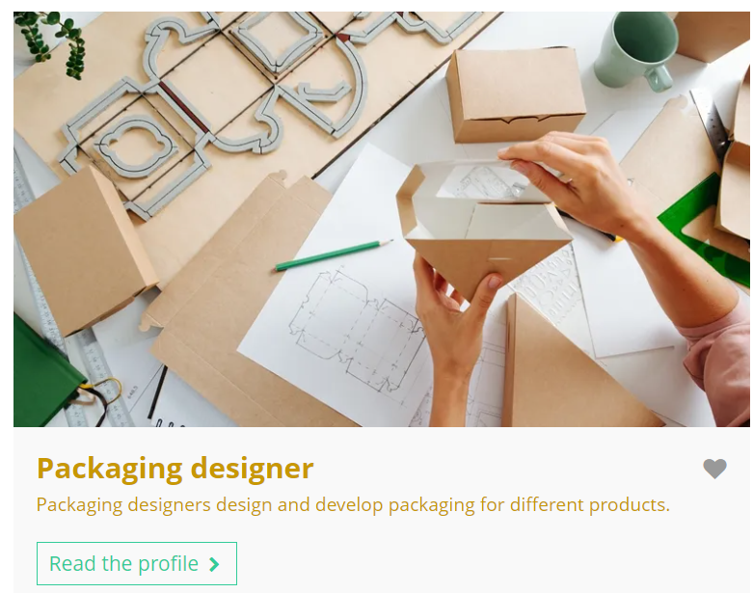
Fascinated by this field? Find out more on Unifrog!
Explore the industrial, product, and packaging design subject profile.
Explore related subject profiles, like graphic design.
Explore related career profiles, like industrial designer, product designer, and packaging designer.
Remember to click the heart symbol to add a profile to your Favourites!
Notes:
Teacher’s notes:
This slide contains career and subject profiles that are relevant to the subject of the month.
If you have additional time available and students have computer access, you can direct them to these resources.
Remember to log into the student side of your Unifrog account to access these links and remind students to favourite any careers or subjects they like the look of.
You can track student progress with favouriting careers or subjects by clicking Advanced>Sort by>Library profiles in Favourites.

