Slide 1
Teacher’s slide: Gatsby Benchmarks
To support you in meeting the Gatsby Benchmarks, we suggest dedicating one day per month to a ‘career of the month' and one day to a ‘subject of the month' for each year group. This can be done during registration or form time, in a 15-minute session. Students will watch a video from the Unifrog platform and answer questions, either through group discussion or written responses.
Delivering these sessions can support the Gatsby Benchmarks as follows:
1. A stable careers programme | 2. Learning from career and labour market information
Regular timetabled sessions to discuss careers and subjects can form part of your stable careers programme. During these sessions you could also make links and remind students of what’s happening in your wider careers programme. | Watching the videos can help students to understand the skills, qualifications, and challenges related to specific jobs. You can support this by exploring the career or subject profile together, including linking to labour market information (LMI) contained in the profiles.
3. Addressing the needs of each pupil | 4. Linking curriculum learning to careers
The questions promote tailored personal reflection. Students could record and upload their reflections to their Unifrog Locker. A range of careers and subjects are used to help students raise aspirations and challenge stereotypes. | The questions help students to reflect on how school subjects connect to real-world careers, helping them see the relevance of their studies to future job opportunities.
5. Encounters with employers and employees | 6. Experiences of workplaces
While these videos don't replace in-person encounters with employers, they provide insights into work environments and cultures, offering students a realistic view of different career paths. | While these videos don't replace in-person work experience, they can broaden students' awareness of different workplaces and help them identify areas they'd like to explore further.
7. Encounters with further and higher education | 8. Personal guidance
While these videos don't replace in-person encounters with further and higher education, they can help students understand the educational pathways needed for various subjects and careers, helping them understand their options for further study or training. | Students can draw on their discussions and reflections of a variety of careers and subjects in their personal guidance 1:1s.
Notes:
Teacher’s notes:
To further support these benchmarks, you could arrange a talk from a former student, FE/HE institution, or employer about a subject/career featured each month.

Slide 2















October
Click a box to go straight to the relevant slides
Year 7 Career of the month
Year 8 Career of the month
Year 9 Career of the month
Year 10 Career of the month
Year 11 Career of the month
Year 12 Career of the month
Year 13 Career of the month
Year 7 Subject of the month
Year 8 Subject of the month
Year 9 Subject of the month
Year 10 Subject of the month
Year 11 Subject of the month
Year 12 Subject of the month
Year 13 Subject of the month
Notes:
Teacher’s notes:
There are separate PowerPoints available for each month of the academic year within the resource profile ‘Career and subject of the month’.
Click the hyperlinked text boxes on this slide to be taken to the slides for the year group selected.

Slide 3

Career of the month
Year 7 – October
Notes:
Teacher’s notes:
October’s career of the month for year 7 is: Sustainability officer.

Slide 4

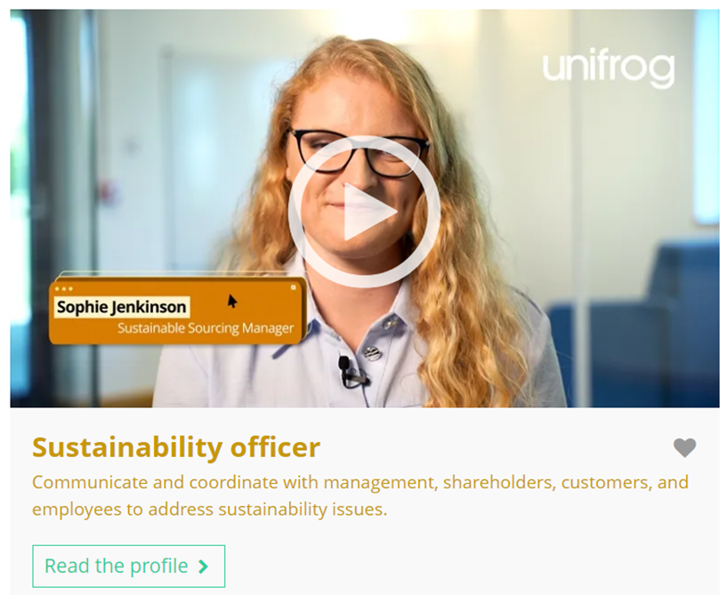


October’s career of the month is…
Sustainability officer
Note down at least one thing you think you know about this career.
Notes:
Teacher’s notes:
Click to reveal the career of the month: Sustainability officer.
Before you’re ready to watch the Careers library video as a class, ask students to note down anything they think they already know about this career.

Slide 5

October’s career of the month is… Sustainability officer
There are lots of roles that fall under the category of sustainability officer. Today we'll be hearing from Sophie, who’s a sustainable sourcing manager.
Whilst you’re watching, think about how this career might link to your school subjects.
Notes:
Teacher’s notes:
Make sure you’re logged into your Unifrog account and click ‘use the platform as a student’. Click the image on the screen to go to the Careers library profile, then click the play button on the video. Alternatively, copy this URL into an internet browser: unifrog.org/student/careers/direct/chief-sustainability-officer
If you have more time available, you could read the career profile text as a class too.

Slide 6
October’s career of the month is… Sustainability officer
If you could ask Sophie anything about her career, what question would you ask?
What skills do you have that could be useful in this career?
Can you think of a link between this career and one of your current school subjects?
What are some steps you could take now to explore this career further?
Notes:
Teacher’s notes:
This slide contains reflection questions about the career of the month. You could ask students to write down their answers, discuss in pairs or small groups, or discuss as a whole class.
The aim of this activity is for students to think about their own preferences, experiences, and skills and how these could relate to the career. Students are encouraged to draw links between skills used in their current school subjects and the career in the video. If students would like to know more about the career, encourage them to read the full career profile, which contains the following sections:
What you’ll do
Working hours and environment
Career path and progression
Skills required
Entry requirements
Related know-how guides
Related university subject profiles
Related career profiles
Explore
Labour Market Information (LMI)
People also liked…
Example answers:
If you could change one thing about your job, what would it be and why?
Problem solving, critical thinking, writing, communication.
English – writing reports. Maths – analysing data. Geography/science – understanding the environment.
Read the Unifrog career profile, research what businesses are doing to support sustainability, get involved in local sustainability initiatives.

Slide 7
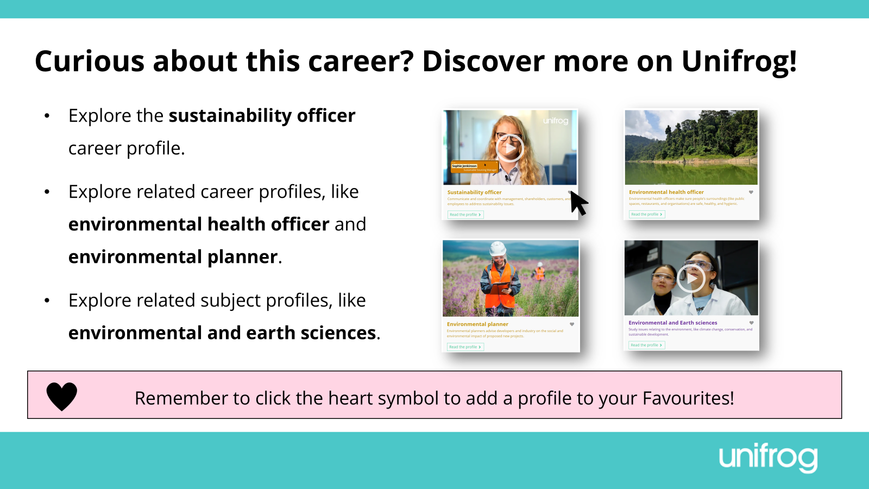
Notes:
Teacher’s notes:
This slide contains career and subject profiles that are relevant to the career of the month.
If you have additional time available and students have computer access, you can direct them to these resources.
Remember to log into the student side of your Unifrog account to access these links and remind students to favourite any careers or subjects they like the look of.
You can track student progress with favouriting careers or subjects by clicking Advanced>Sort by>Library profiles in Favourites.

Slide 8


Slide 9
Subject of the month
Year 7 – October
Notes:
Teacher’s notes:
October’s subject of the month for year 7 is: Fine art.

Slide 10

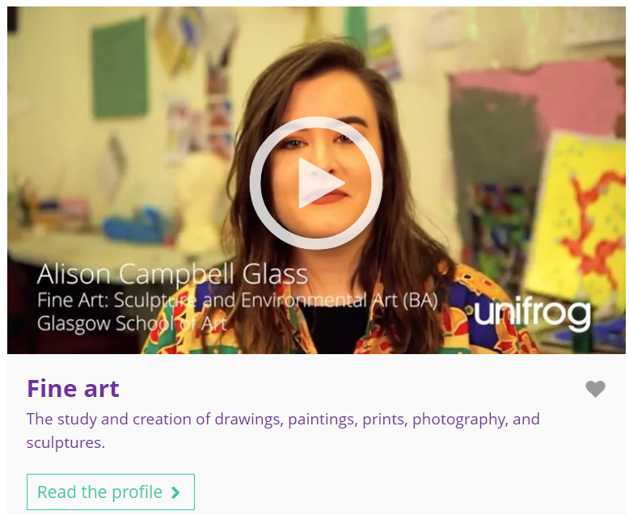

October’s subject of the month is…
Fine art
Note down at least one thing you think you know about this subject.
Notes:
Teacher’s notes:
Click to reveal the subject of the month: Fine art.
Before you’re ready to watch the Subjects library video as a class, ask students to note down anything they think they already know about this subject.

Slide 11
October’s subject of the month is… Fine art
Today we’ll be hearing from Alison, who’s a fine art: sculpture and environmental art student.
Whilst you’re watching, think about the range of skills this degree requires – not just creativity!
Notes:
Teacher’s notes:
Make sure you’re logged into your Unifrog account and click ‘use the platform as a student’. Click the image on the screen to go to the Subjects library profile, then click the play button on the video. Alternatively, copy this URL into an internet browser: unifrog.org/student/subjects/direct/fine-art
If you have more time available, you could read the subject profile text as a class too.

Slide 12
October’s subject of the month is… Fine art
Other than creativity, what skills do you need to study this subject?
What activities or hobbies do you enjoy that could relate to this subject?
Other than art, which school subjects could help to prepare you to study this degree?
What else would you like to know about this subject? Where could you find this information?
Notes:
Teacher’s notes:
This slide contains reflection questions about the subject of the month. You could ask students to write down their answers, discuss in pairs or small groups, or discuss as a whole class.
The aim of this activity is for students to think about their own preferences, experiences, and skills and how these could relate to the subject. Students are encouraged to draw links between skills used in their current school subjects and the subject in the video. If students would like to know more about the subject, encourage them to read the full subject profile, which contains the following sections:
In a nutshell
Getting in
Prospects
Statement
Reference
Geek out
Recommendations: Read
Recommendations: Watch
Recommendations: Listen
Explore
People also liked…
Example answers:
Independence, self-motivation, open-mindedness, organisation.
I enjoy painting Warhammer figures.
English, media studies, drama, dance, DT.
I’d like to know what possible careers fine art could lead to. I could read the Unifrog subject profile and scroll down to ‘explore’.

Slide 13
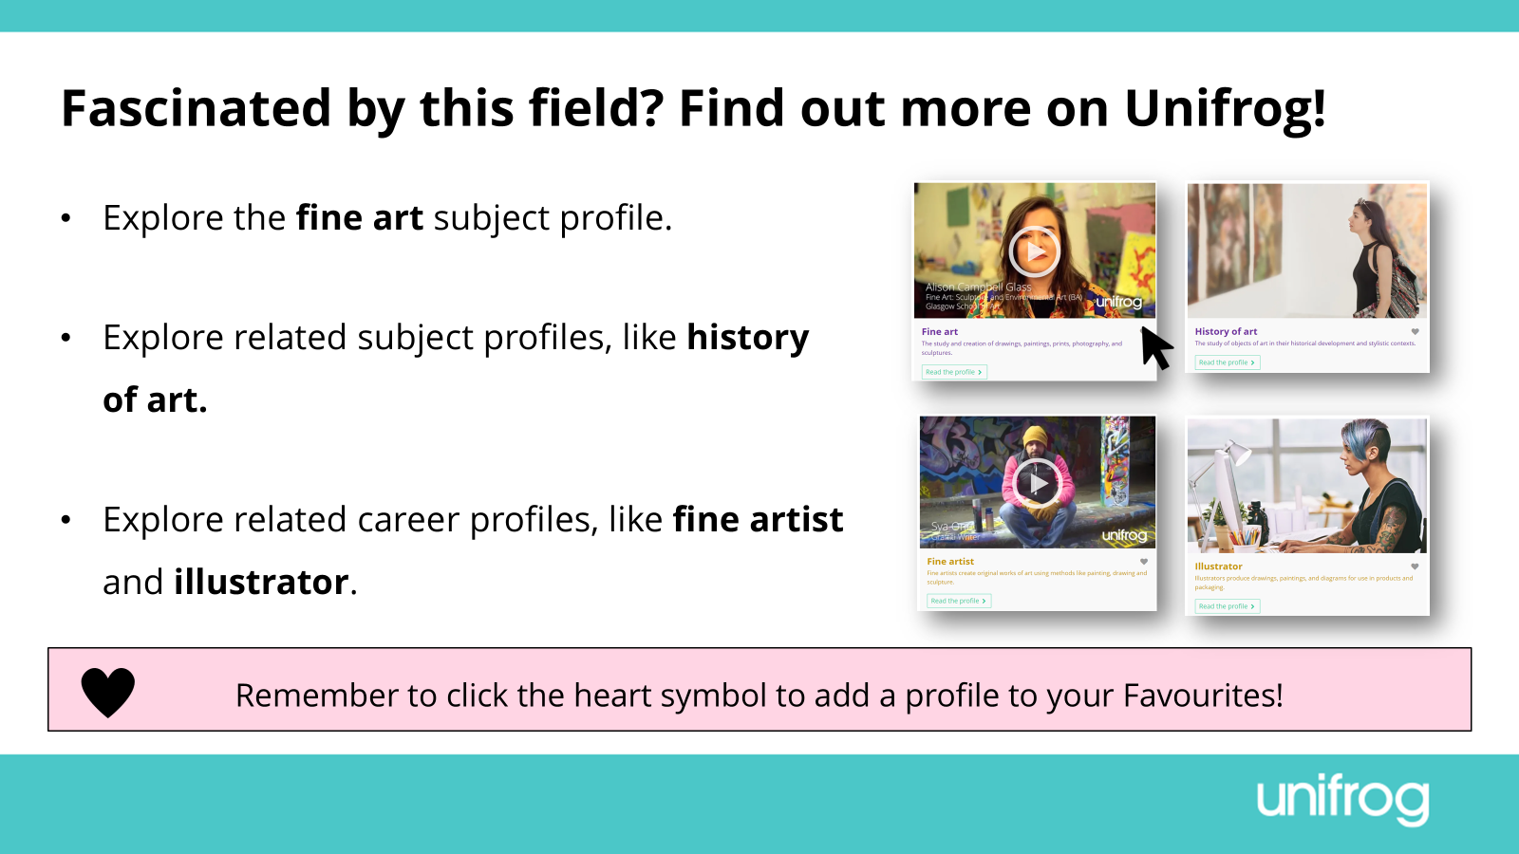
Notes:
Teacher’s notes:
This slide contains career and subject profiles that are relevant to the subject of the month.
If you have additional time available and students have computer access, you can direct them to these resources.
Remember to log into the student side of your Unifrog account to access these links and remind students to favourite any careers or subjects they like the look of.
You can track student progress with favouriting careers or subjects by clicking Advanced>Sort by>Library profiles in Favourites.

Slide 15
Career of the month
Year 8 – October
Notes:
Teacher’s notes:
October’s career of the month for year 8 is: Retail manager.

Slide 16

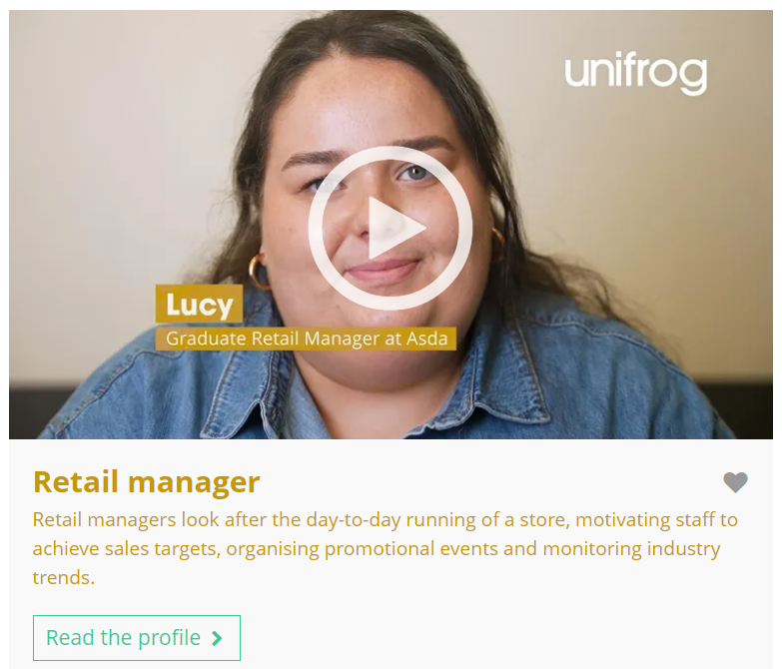

October’s career of the month is…
Retail manager
Note down at least one thing you think you know about this career.
Notes:
Teacher’s notes:
Click to reveal the career of the month: Retail manager.
Before you’re ready to watch the Careers library video as a class, ask students to note down anything they think they already know about this career.

Slide 17
October’s career of the month is… Retail manager
There are lots of roles that fall under the category of retail manager. Today we'll be hearing from Lucy, who’s a graduate retail manager.
Whilst you’re watching, think about the possible routes into this career.
Notes:
Teacher’s notes:
Make sure you’re logged into your Unifrog account and click ‘use the platform as a student’. Click the image on the screen to go to the Careers library profile, then click the play button on the video. Alternatively, copy this URL into an internet browser: unifrog.org/student/careers/direct/retail-manager
If you have more time available, you could read the career profile text as a class too.

Slide 18
October’s career of the month is… Retail manager
What skills do you need in this career?
Lucy enjoys interacting with customers. What do you think you’d enjoy the most about this career?
What school subjects do you think are most important for preparing for this career?
What educational pathways or qualifications does Lucy mention?
Notes:
Teacher’s notes:
This slide contains reflection questions about the career of the month. You could ask students to write down their answers, discuss in pairs or small groups, or discuss as a whole class.
The aim of this activity is for students to think about their own preferences, experiences, and skills and how these could relate to the career. Students are encouraged to draw links between skills used in their current school subjects and the career in the video. If students would like to know more about the career, encourage them to read the full career profile, which contains the following sections:
What you’ll do
Working hours and environment
Career path and progression
Skills required
Entry requirements
Related know-how guides
Related university subject profiles
Related career profiles
Explore
Labour Market Information (LMI)
People also liked…
Example answers:
Ability to lead and motivate a team, communication, working under pressure, confidence, enthusiasm, decision-making, responsibility, etc.
I think I’d enjoy motivating other staff members.
Business studies, maths.
Graduate scheme, degree, apprenticeship, employment.

Slide 19
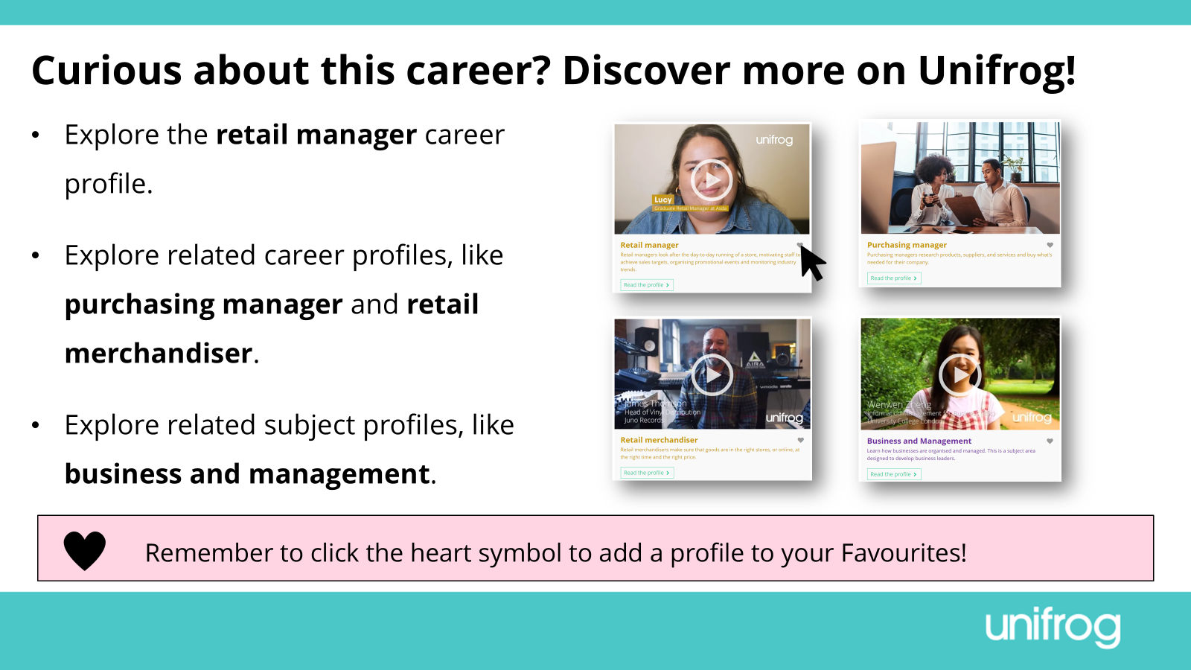
Notes:
Teacher’s notes:
This slide contains career and subject profiles that are relevant to the career of the month.
If you have additional time available and students have computer access, you can direct them to these resources.
Remember to log into the student side of your Unifrog account to access these links and remind students to favourite any careers or subjects they like the look of.
You can track student progress with favouriting careers or subjects by clicking Advanced>Sort by>Library profiles in Favourites.

Slide 21
Subject of the month
Year 8 – October
Notes:
Teacher’s notes:
October’s subject of the month for year 8 is: Horticulture and botany.

Slide 22
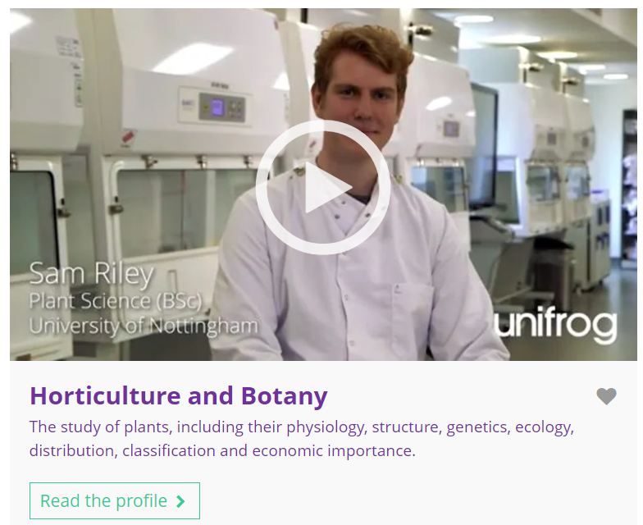


October’s subject of the month is…
Horticulture and botany
Note down at least one thing you think you know about this subject.
Notes:
Teacher’s notes:
Click to reveal the subject of the month: Horticulture and botany.
Before you’re ready to watch the Subjects library video as a class, ask students to note down anything they think they already know about this subject.

Slide 23
October’s subject of the month is… Horticulture and botany
There are lots of degrees that fall under the category of horticulture and botany. Today we'll be hearing from Sam, who’s a plant science student.
Whilst you’re watching, think about how this subject could link to a school subject.
Notes:
Teacher’s notes:
Make sure you’re logged into your Unifrog account and click ‘use the platform as a student’. Click the image on the screen to go to the Subjects library profile, then click the play button on the video. Alternatively, copy this URL into an internet browser: unifrog.org/student/subjects/direct/horticulture-and-botany
If you have more time available, you could read the subject profile text as a class too.

Slide 24
October’s subject of the month is… Horticulture and botany
How could this subject make a positive impact in the world?
How does this subject relate to things you like doing?
Which school subjects are linked to this subject?
What hobbies or activities could you do to help you learn more about this subject?
Notes:
Teacher’s notes:
This slide contains reflection questions about the subject of the month. You could ask students to write down their answers, discuss in pairs or small groups, or discuss as a whole class.
The aim of this activity is for students to think about their own preferences, experiences, and skills and how these could relate to the subject. Students are encouraged to draw links between skills used in their current school subjects and the subject in the video. If students would like to know more about the subject, encourage them to read the full subject profile, which contains the following sections:
In a nutshell
Getting in
Prospects
Statement
Reference
Geek out
Recommendations: Read
Recommendations: Watch
Recommendations: Listen
Explore
People also liked…
Example answers:
It involves studying GM (genetically modified) crops, which can be an unsustainable way of growing crops.
I like doing experiments in science lessons and using technical equipment.
Biology, bioscience, science.
Research related issues like GM crops. Join or start a gardening club at school. Grow some plants at home.

Slide 25
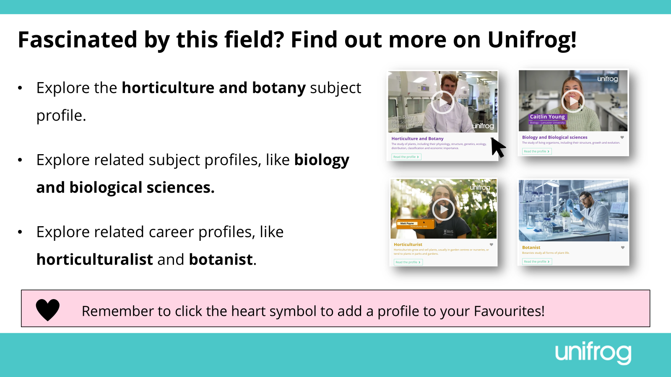
Notes:
Teacher’s notes:
This slide contains career and subject profiles that are relevant to the subject of the month.
If you have additional time available and students have computer access, you can direct them to these resources.
Remember to log into the student side of your Unifrog account to access these links and remind students to favourite any careers or subjects they like the look of.
You can track student progress with favouriting careers or subjects by clicking Advanced>Sort by>Library profiles in Favourites.

Slide 27
Career of the month
Year 9 – October
Notes:
Teacher’s notes:
October’s career of the month for year 9 is: Biochemical engineer.

Slide 28
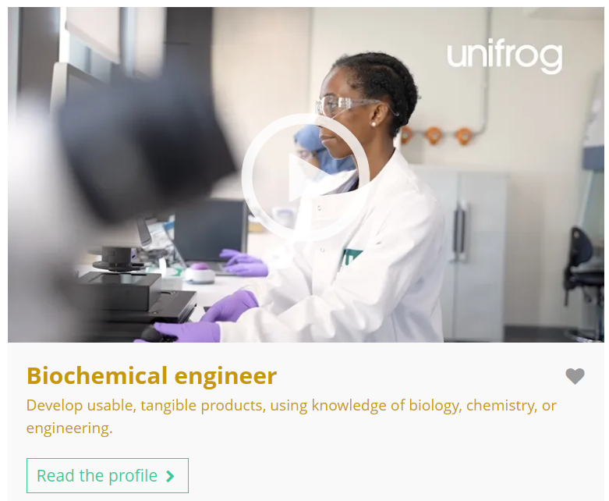


October’s career of the month is…
Biochemical engineer
Note down at least one thing you think you know about this career.
Notes:
Teacher’s notes:
Click to reveal the career of the month: Biochemical engineer.
Before you’re ready to watch the Careers library video as a class, ask students to note down anything they think they already know about this career.

Slide 29
October’s career of the month is… Biochemical engineer
There are lots of roles that fall under the category of biochemical engineer. Today we'll be hearing from Bernice, who’s a research scientist.
Whilst you’re watching, think about whether this career aligns with your interests.
Notes:
Teacher’s notes:
Make sure you’re logged into your Unifrog account and click ‘use the platform as a student’. Click the image on the screen to go to the Careers library profile, then click the play button on the video. Alternatively, copy this URL into an internet browser: unifrog.org/student/careers/direct/biochemical-engineer
If you have more time available, you could read the career profile text as a class too.

Slide 30
October’s career of the month is… Biochemical engineer
What skills would someone need to pursue this career?
In what way does this career align or not align with your interests?
Which school subjects do you think are most important for this career?
If you were interested in this career, what would be the next step for you?
Notes:
Teacher’s notes:
This slide contains reflection questions about the career of the month. You could ask students to write down their answers, discuss in pairs or small groups, or discuss as a whole class.
The aim of this activity is for students to think about their own preferences, experiences, and skills and how these could relate to the career. Students are encouraged to draw links between skills used in their current school subjects and the career in the video. If students would like to know more about the career, encourage them to read the full career profile, which contains the following sections:
What you’ll do
Working hours and environment
Career path and progression
Skills required
Entry requirements
Related know-how guides
Related university subject profiles
Related career profiles
Explore
Labour Market Information (LMI)
People also liked…
Example answers:
Communication, critical thinking, problem solving, teamwork, technical skills.
I’m love science so this career aligns with my interests.
Science, biology, chemistry, engineering, business.
Reading the Unifrog career profile, joining science-related extracurricular clubs, researching similar careers.

Slide 31
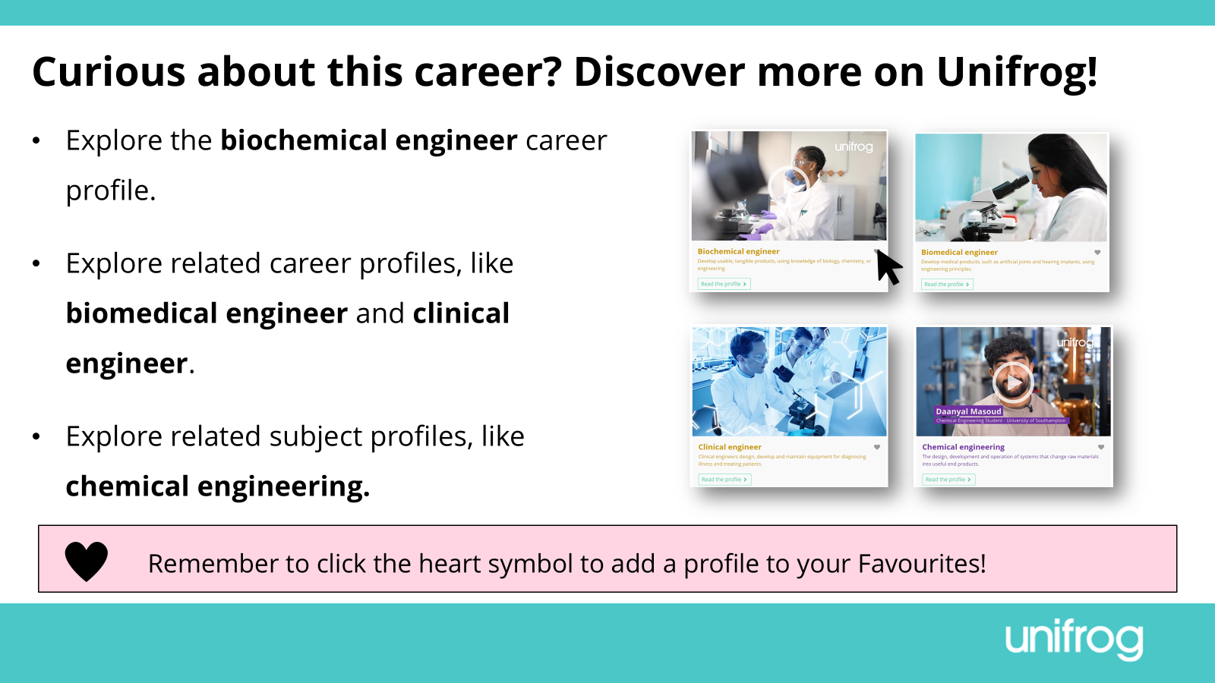
Notes:
Teacher’s notes:
This slide contains career and subject profiles that are relevant to the career of the month.
If you have additional time available and students have computer access, you can direct them to these resources.
Remember to log into the student side of your Unifrog account to access these links and remind students to favourite any careers or subjects they like the look of.
You can track student progress with favouriting careers or subjects by clicking Advanced>Sort by>Library profiles in Favourites.

Slide 33
Subject of the month
Year 9 – October
Notes:
Teacher’s notes:
October’s subject of the month for year 9 is: Computer games design.

Slide 34
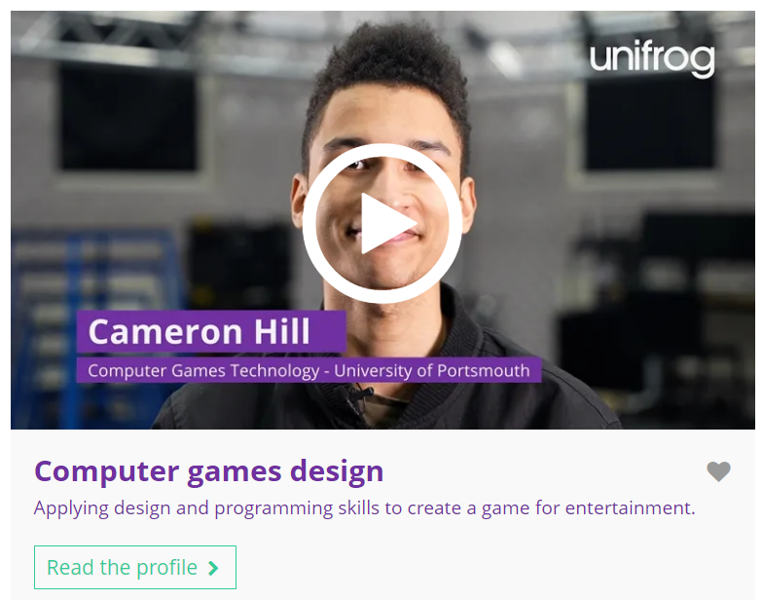


October’s subject of the month is…
Computer games design
Note down at least one thing you think you know about this subject.
Notes:
Teacher’s notes:
Click to reveal the subject of the month: Computer games design.
Before you’re ready to watch the Subjects library video as a class, ask students to note down anything they think they already know about this subject.

Slide 35
October’s subject of the month is… Computer games design
There are lots of degrees that fall under the category of computer games design. Today we'll be hearing from Cameron, who’s a computer games technology student.
Whilst you’re watching, think about how you could prepare for this degree.
Notes:
Teacher’s notes:
Make sure you’re logged into your Unifrog account and click ‘use the platform as a student’. Click the image on the screen to go to the Subjects library profile, then click the play button on the video. Alternatively, copy this URL into an internet browser: unifrog.org/student/subjects/direct/computer-games-design
If you have more time available, you could read the subject profile text as a class too.

Slide 36
October’s subject of the month is… Computer games design
Other than gaming, what hobbies relate to this subject?
What skills do you have that you think could be useful for this subject?
Before university, Cameron studied psychology, media studies, and IT. What other subjects might prepare you well for this degree?
If you wanted to study this subject, what could you do to prepare?
Notes:
Teacher’s notes:
This slide contains reflection questions about the subject of the month. You could ask students to write down their answers, discuss in pairs or small groups, or discuss as a whole class.
The aim of this activity is for students to think about their own preferences, experiences, and skills and how these could relate to the subject. Students are encouraged to draw links between skills used in their current school subjects and the subject in the video. If students would like to know more about the subject, encourage them to read the full subject profile, which contains the following sections:
In a nutshell
Getting in
Prospects
Statement
Reference
Geek out
Recommendations: Read
Recommendations: Watch
Recommendations: Listen
Explore
People also liked…
Example answers:
Coding/programming, art/design, photography/videography.
Digital literacy, attention to detail, problem solving, numeracy, analysis, creativity.
Computer science, maths, physics.
Select relevant GCSE / A level (or equivalent) subjects like IT or computer science, do background reading into game design, complete online courses about game design, download free game-design software, learn how to code, take part in a ‘hackathon’.

Slide 37
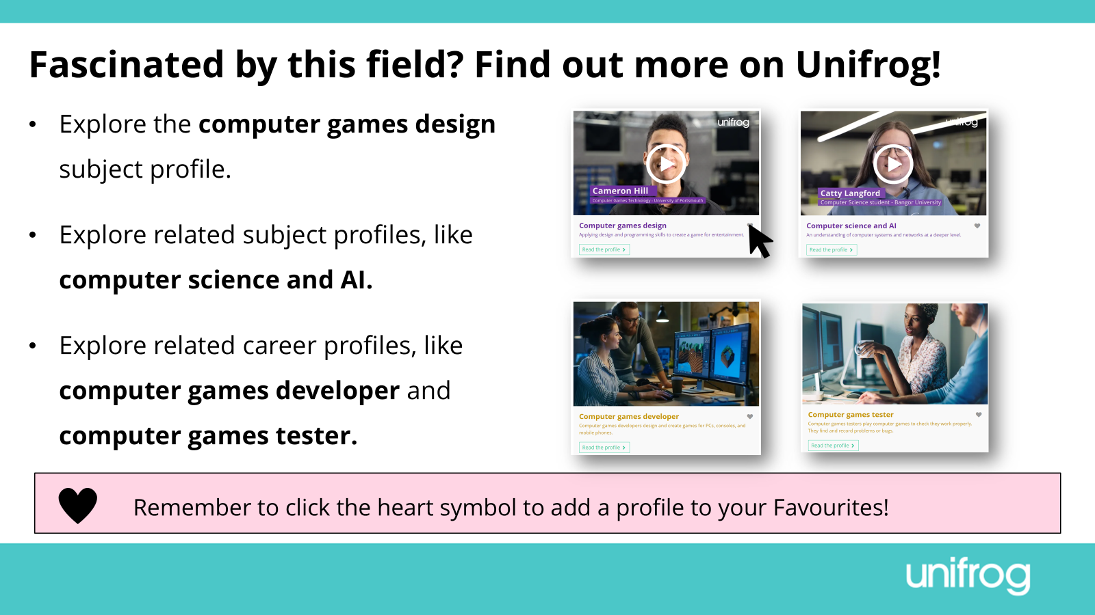
Notes:
Teacher’s notes:
This slide contains career and subject profiles that are relevant to the subject of the month.
If you have additional time available and students have computer access, you can direct them to these resources.
Remember to log into the student side of your Unifrog account to access these links and remind students to favourite any careers or subjects they like the look of.
You can track student progress with favouriting careers or subjects by clicking Advanced>Sort by>Library profiles in Favourites.

Slide 39
Career of the month
Year 10 – October
Notes:
Teacher’s notes:
October’s career of the month for year 10 is: Forestry worker.

Slide 40

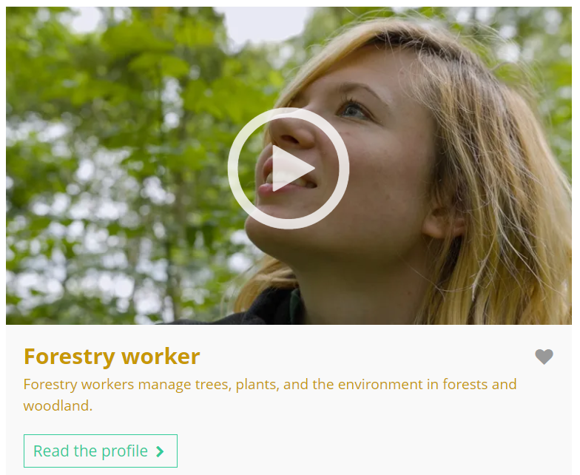

October’s career of the month is…
Forestry worker
Note down at least one thing you think you know about this career.
Notes:
Teacher’s notes:
Click to reveal the career of the month: Forestry worker.
Before you’re ready to watch the Careers library video as a class, ask students to note down anything they think they already know about this career.

Slide 41
October’s career of the month is… Forestry worker
There are lots of roles that fall under the category of forestry worker. Today we'll be hearing from Lucy, who’s an assistant site manager.
Whilst you’re watching, think about what you could do next if you were interested in pursuing this career.
Notes:
Teacher’s notes:
Make sure you’re logged into your Unifrog account and click ‘use the platform as a student’. Click the image on the screen to go to the Careers library profile, then click the play button on the video. Alternatively, copy this URL into an internet browser: unifrog.org/student/careers/direct/forestry-worker
If you have more time available, you could read the career profile text as a class too.

Slide 42
October’s career of the month is… Forestry worker
What advice would you give to someone who wants to enter this career?
What parts of this career seem most interesting to you?
What educational pathways or qualifications does Lucy mention? Do you know of any alternative routes into this career?
What could you do now to help you decide if a career like this is right for you?
Notes:
Teacher’s notes:
This slide contains reflection questions about the career of the month. You could ask students to write down their answers, discuss in pairs or small groups, or discuss as a whole class.
The aim of this activity is for students to think about their own preferences, experiences, and skills and how these could relate to the career. Students are encouraged to draw links between skills used in their current school subjects and the career in the video. If students would like to know more about the career, encourage them to read the full career profile, which contains the following sections:
What you’ll do
Working hours and environment
Career path and progression
Skills required
Entry requirements
Related know-how guides
Related university subject profiles
Related career profiles
Explore
Labour Market Information (LMI)
People also liked…
Example answers:
Do some volunteering and post about wildlife on social media.
Doing on-site woodland condition assessments.
Lucy mentions a degree in earth science and climate change and a forest school leader qualification. You could also do an apprenticeship, college course, volunteering placement, or job.
Work experience in a related field, volunteering for a woodland or wildlife charity, further research.

Slide 43
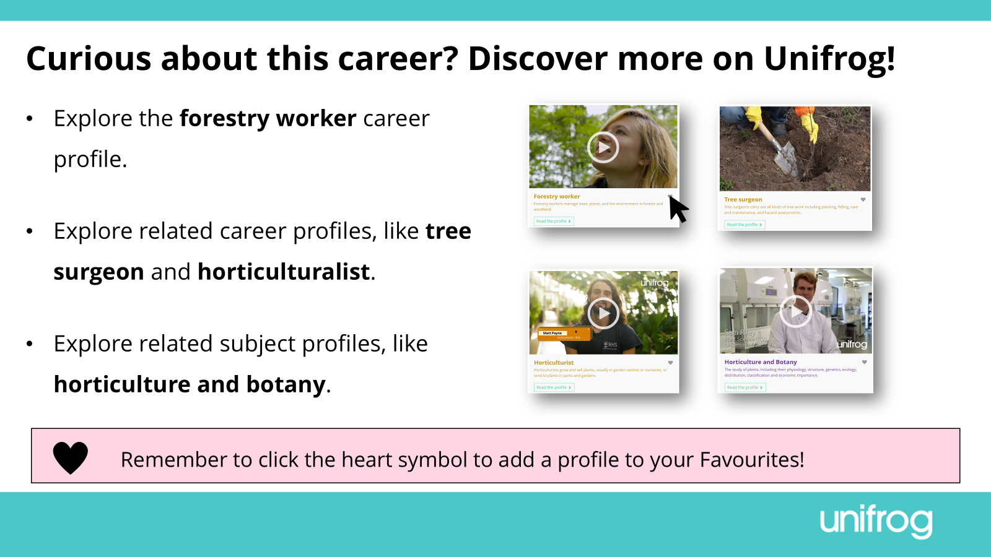
Notes:
Teacher’s notes:
This slide contains career and subject profiles that are relevant to the career of the month.
If you have additional time available and students have computer access, you can direct them to these resources.
Remember to log into the student side of your Unifrog account to access these links and remind students to favourite any careers or subjects they like the look of.
You can track student progress with favouriting careers or subjects by clicking Advanced>Sort by>Library profiles in Favourites.

Slide 45
Subject of the month
Year 10 – October
Notes:
Teacher’s notes:
October’s subject of the month for year 10 is: Aerospace engineering and aviation.

Slide 46

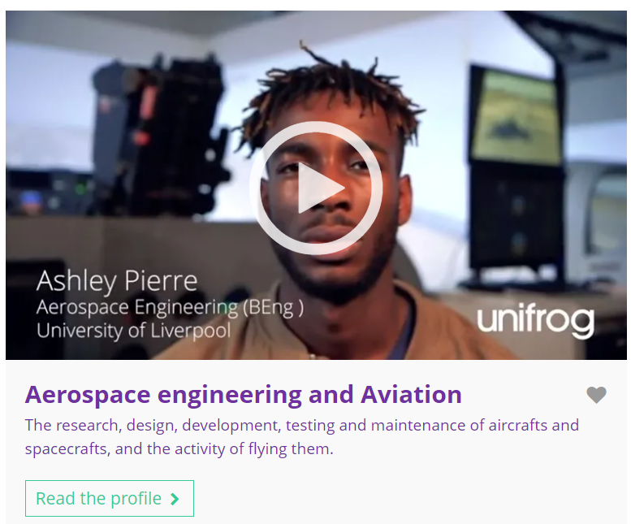

October’s subject of the month is…
Aerospace engineering and aviation
Note down at least one thing you think you know about this subject.
Notes:
Teacher’s notes:
Click to reveal the subject of the month: Aerospace engineering and aviation.
Before you’re ready to watch the Subjects library video as a class, ask students to note down anything they think they already know about this subject.

Slide 47
October’s subject of the month is… Aerospace engineering and aviation
There are lots of degrees that fall under the category of aerospace engineering and aviation. Today we'll be hearing from Ashley, who’s an aerospace engineering student.
Whilst you’re watching, think about the elements of this subject you’d excel in or struggle with.
Notes:
Teacher’s notes:
Make sure you’re logged into your Unifrog account and click ‘use the platform as a student’. Click the image on the screen to go to the Subjects library profile, then click the play button on the video. Alternatively, copy this URL into an internet browser: unifrog.org/student/subjects/direct/aerospace-engineering-and-aviation
If you have more time available, you could read the subject profile text as a class too.

Slide 48
October’s subject of the month is… Aerospace engineering and aviation
What kinds of careers are available in this field, and what do they involve?
Are there any aspects of this subject that you think you'd excel in or struggle with?
How might your current school subjects help someone to prepare for this career in the future?
What else would you like to know about this subject? Where could you find this information?
Notes:
Teacher’s notes:
This slide contains reflection questions about the subject of the month. You could ask students to write down their answers, discuss in pairs or small groups, or discuss as a whole class.
The aim of this activity is for students to think about their own preferences, experiences, and skills and how these could relate to the subject. Students are encouraged to draw links between skills used in their current school subjects and the subject in the video. If students would like to know more about the subject, encourage them to read the full subject profile, which contains the following sections:
In a nutshell
Getting in
Prospects
Statement
Reference
Geek out
Recommendations: Read
Recommendations: Watch
Recommendations: Listen
Explore
People also liked…
Example answers:
Aerospace engineer, airline pilot, astronaut, helicopter pilot, air traffic controller, aviation inspector, airport operations manager. Aerospace engineers research, design, and build aircraft like planes, spacecraft, and satellites.
Like Ashley, I might struggle with coding as I’ve never done that before.
I’d like to know what A levels would be good to study to prepare for this degree. I could find this out within the Unifrog subject profile.

Slide 49
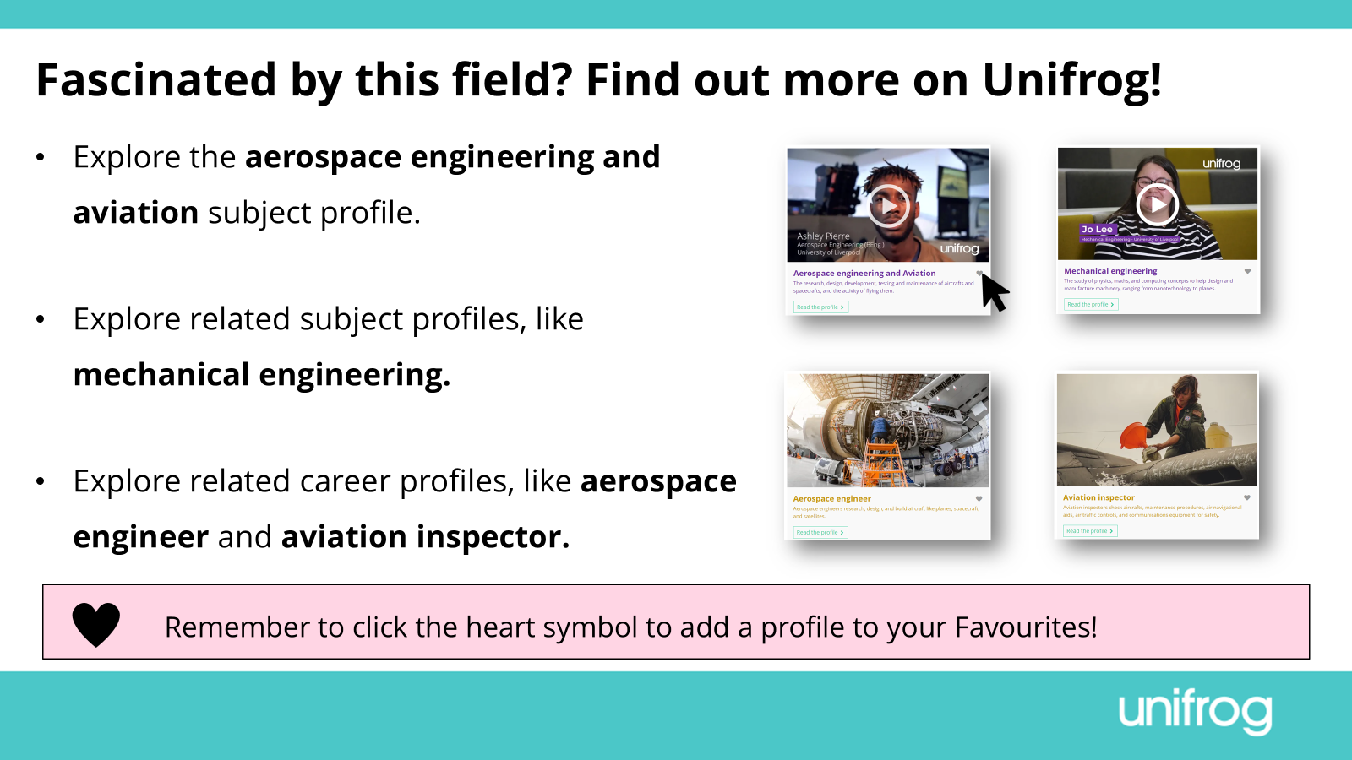
Notes:
Teacher’s notes:
This slide contains career and subject profiles that are relevant to the subject of the month.
If you have additional time available and students have computer access, you can direct them to these resources.
Remember to log into the student side of your Unifrog account to access these links and remind students to favourite any careers or subjects they like the look of.
You can track student progress with favouriting careers or subjects by clicking Advanced>Sort by>Library profiles in Favourites.

Slide 51
Career of the month
Year 11 – October
Notes:
Teacher’s notes:
October’s career of the month for year 11 is: Health play specialist.

Slide 52
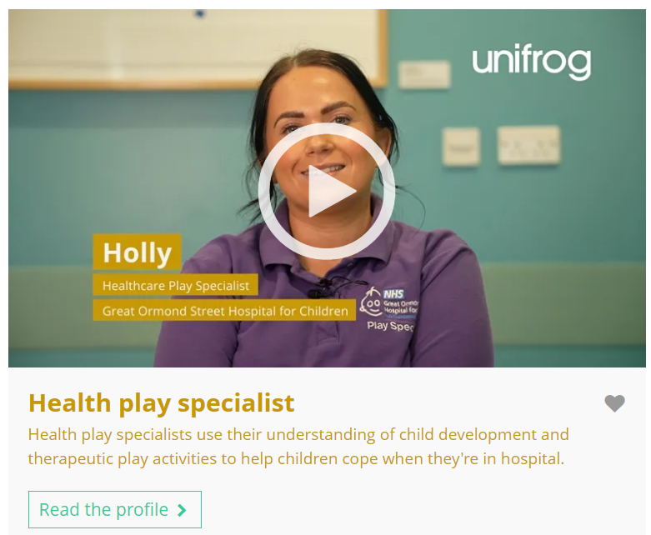


October’s career of the month is…
Health play specialist
Note down at least one thing you think you know about this career.
Notes:
Teacher’s notes:
Click to reveal the career of the month: Health play specialist.
Before you’re ready to watch the Careers library video as a class, ask students to note down anything they think they already know about this career.

Slide 53
October’s career of the month is… Health play specialist
There are lots of roles that fall under the category of health play specialist. Today we'll be hearing from Holly, who’s a healthcare play specialist.
Whilst you’re watching, think about what you’d find rewarding in this career.
Notes:
Teacher’s notes:
Make sure you’re logged into your Unifrog account and click ‘use the platform as a student’. Click the image on the screen to go to the Careers library profile, then click the play button on the video. Alternatively, copy this URL into an internet browser: unifrog.org/student/careers/direct/health-play-specialist
If you have more time available, you could read the career profile text as a class too.

Slide 54
October’s career of the month is… Health play specialist
What work experience or volunteering would help someone prepare for this career?
What do you think the most rewarding part of this career would be?
What skills are essential for this career? Do you use any of those skills in your school subjects?
Holly mentions apprenticeships as one possible route into this career. What are the pros and cons of this pathway?
Notes:
Teacher’s notes:
This slide contains reflection questions about the career of the month. You could ask students to write down their answers, discuss in pairs or small groups, or discuss as a whole class.
The aim of this activity is for students to think about their own preferences, experiences, and skills and how these could relate to the career. Students are encouraged to draw links between skills used in their current school subjects and the career in the video. If students would like to know more about the career, encourage them to read the full career profile, which contains the following sections:
What you’ll do
Working hours and environment
Career path and progression
Skills required
Entry requirements
Related know-how guides
Related university subject profiles
Related career profiles
Explore
Labour Market Information (LMI)
People also liked…
Example answers:
Any experience of working with children, like babysitting, helping out at a dance class or community group.
Seeing children improve in their confidence and happiness whilst receiving healthcare.
Creativity – I use this in art, English, media studies, and drama.
Pros: experience of the workplace, no university fees. Cons: might be competitive to get a vacancy, workplace responsibilities straight away.

Slide 55
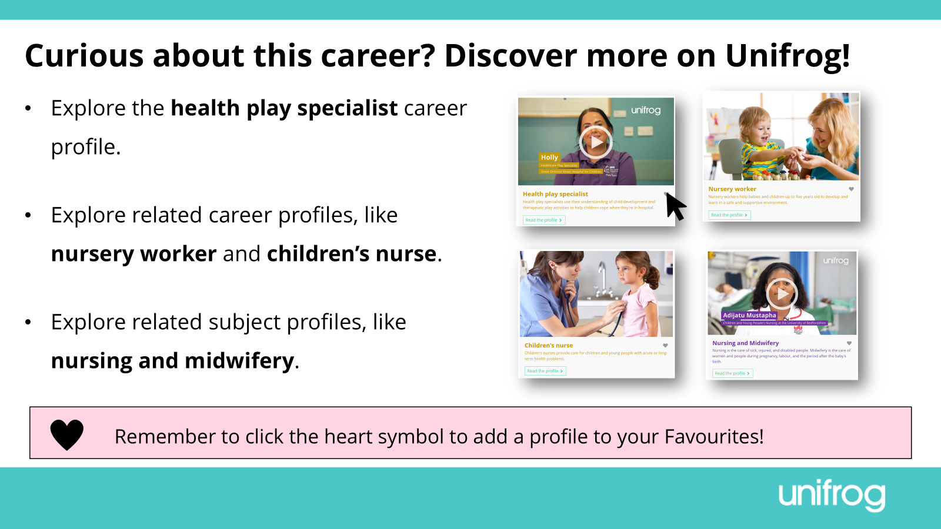
Notes:
Teacher’s notes:
This slide contains career and subject profiles that are relevant to the career of the month.
If you have additional time available and students have computer access, you can direct them to these resources.
Remember to log into the student side of your Unifrog account to access these links and remind students to favourite any careers or subjects they like the look of.
You can track student progress with favouriting careers or subjects by clicking Advanced>Sort by>Library profiles in Favourites.

Slide 57
Subject of the month
Year 11 – October
Notes:
Teacher’s notes:
October’s subject of the month for year 11 is: Theology and religion.

Slide 58



October’s subject of the month is…
Theology and religion
Note down at least one thing you think you know about this subject.
Notes:
Teacher’s notes:
Click to reveal the subject of the month: Theology and religion.
Before you’re ready to watch the Subjects library video as a class, ask students to note down anything they think they already know about this subject.

Slide 59
October’s subject of the month is… Theology and religion
There are lots of degrees that fall under the category of theology and religion. Today we'll be hearing from Sam, who’s a history and study of religions student.
Whilst you’re watching, think about why open-mindedness is an important skill when studying this degree.
Notes:
Teacher’s notes:
Make sure you’re logged into your Unifrog account and click ‘use the platform as a student’. Click the image on the screen to go to the Subjects library profile, then click the play button on the video. Alternatively, copy this URL into an internet browser: unifrog.org/student/subjects/direct/theology-and-religion
If you have more time available, you could read the subject profile text as a class too.

Slide 60
October’s subject of the month is… Theology and religion
What sorts of careers could this subject lead to?
Why is being open-minded important when studying this subject?
Which GCSE (or equivalent) subjects could help someone to prepare for this degree?
What else would you like to know about this subject? Where could you find this information?
Notes:
Teacher’s notes:
This slide contains reflection questions about the subject of the month. You could ask students to write down their answers, discuss in pairs or small groups, or discuss as a whole class.
The aim of this activity is for students to think about their own preferences, experiences, and skills and how these could relate to the subject. Students are encouraged to draw links between skills used in their current school subjects and the subject in the video. If students would like to know more about the subject, encourage them to read the full subject profile, which contains the following sections:
In a nutshell
Getting in
Prospects
Statement
Reference
Geek out
Recommendations: Read
Recommendations: Watch
Recommendations: Listen
Explore
People also liked…
Example answers:
Working for NGOs (non-government organisations), charities, or thinktanks. Working in politics or for the government. Teaching.
Because you’ll learn about a diverse range of religions, beliefs, practices, and cultures. You’ll need to be sensitive and be aware that religion can be a very personal topic.
Religious studies, ethics, history, sociology, English.
I’d like to know what the graduate employment is like. I could find this out on Unifrog’s subject profile, under ‘Prospects’.

Slide 61
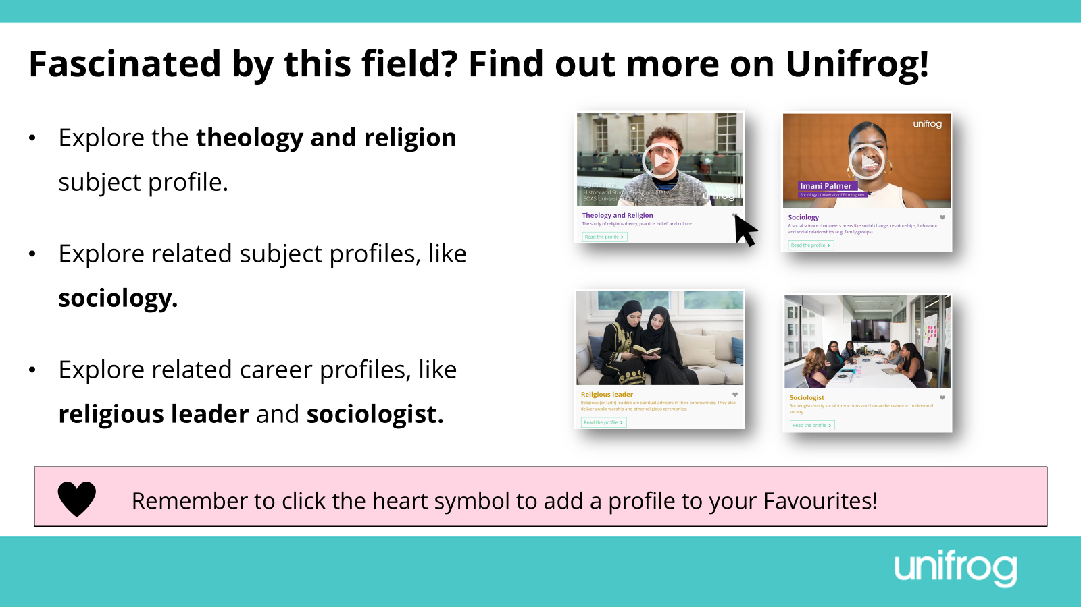
Notes:
Teacher’s notes:
This slide contains career and subject profiles that are relevant to the subject of the month.
If you have additional time available and students have computer access, you can direct them to these resources.
Remember to log into the student side of your Unifrog account to access these links and remind students to favourite any careers or subjects they like the look of.
You can track student progress with favouriting careers or subjects by clicking Advanced>Sort by>Library profiles in Favourites.

Slide 63
Career of the month
Year 12 – October
Notes:
Teacher’s notes:
October’s career of the month for year 12 is: Policy adviser.

Slide 64

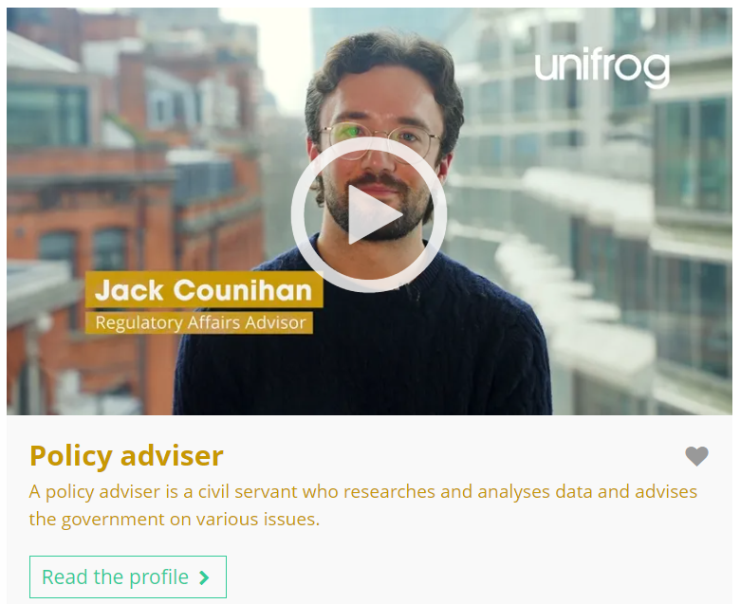

October’s career of the month is…
Policy adviser
Note down at least one thing you think you know about this career.
Notes:
Teacher’s notes:
Click to reveal the career of the month: Policy adviser.
Before you’re ready to watch the Careers library video as a class, ask students to note down anything they think they already know about this career.

Slide 65
October’s career of the month is… Policy adviser
There are lots of roles that fall under the category of policy adviser. Today we'll be hearing from Jack, who’s a regulatory affairs adviser.
Whilst you’re watching, think about the impact of this career on society.
Notes:
Teacher’s notes:
Make sure you’re logged into your Unifrog account and click ‘use the platform as a student’. Click the image on the screen to go to the Careers library profile, then click the play button on the video. Alternatively, copy this URL into an internet browser: unifrog.org/student/careers/direct/policy-adviser
If you have more time available, you could read the career profile text as a class too.

Slide 66
October’s career of the month is… Policy adviser
What impact does Jack's career have on society? How important is it for you to choose a career that contributes positively to society?
Which of your strengths do you think would help you the most in this career?
How do your current studies (e.g. A levels) relate to this career?
What are the next steps you'd need to take to pursue this career after finishing school/college?
Notes:
Teacher’s notes:
This slide contains reflection questions about the career of the month. You could ask students to write down their answers, discuss in pairs or small groups, or discuss as a whole class.
The aim of this activity is for students to think about their own preferences, experiences, and skills and how these could relate to the career. Students are encouraged to draw links between skills used in their current school subjects and the career in the video. If students would like to know more about the career, encourage them to read the full career profile, which contains the following sections:
What you’ll do
Working hours and environment
Career path and progression
Skills required
Entry requirements
Related know-how guides
Related university subject profiles
Related career profiles
Explore
Labour Market Information (LMI)
People also liked…
Example answers:
Jack advises about renewable energy, helping the world to be more sustainable. It’s really important for me that my future career benefits society, like Jack’s does.
Communication, critical thinking, reading.
I’m currently studying maths, which would help me analyse data in this role.
Gain relevant work experience (e.g. local government), study a related subject at university like politic.

Slide 67
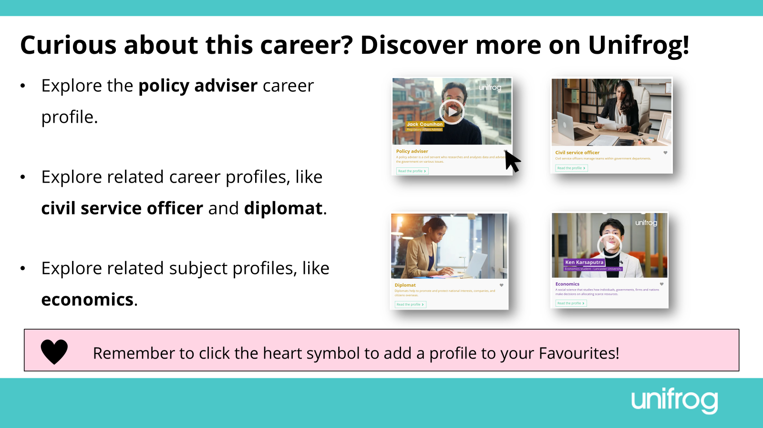
Notes:
Teacher’s notes:
This slide contains career and subject profiles that are relevant to the career of the month.
If you have additional time available and students have computer access, you can direct them to these resources.
Remember to log into the student side of your Unifrog account to access these links and remind students to favourite any careers or subjects they like the look of.
You can track student progress with favouriting careers or subjects by clicking Advanced>Sort by>Library profiles in Favourites.

Slide 69
Subject of the month
Year 12 – October
Notes:
Teacher’s notes:
October’s subject of the month for year 12 is: Building surveying and construction.

Slide 70

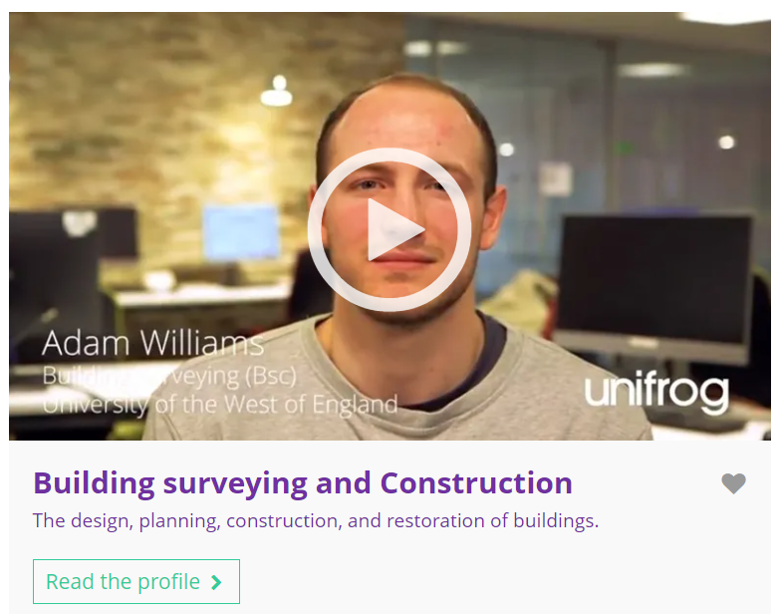

October’s subject of the month is…
Building surveying and construction
Note down at least one thing you think you know about this subject.
Notes:
Teacher’s notes:
Click to reveal the subject of the month: Building surveying and construction.
Before you’re ready to watch the Subjects library video as a class, ask students to note down anything they think they already know about this subject.

Slide 71
October’s subject of the month is… Building surveying and construction
Today we'll be hearing from Adam, who’s a building surveying student.
Whilst you’re watching, think about the career prospects that could come from studying this subject.
Notes:
Teacher’s notes:
Make sure you’re logged into your Unifrog account and click ‘use the platform as a student’. Click the image on the screen to go to the Subjects library profile, then click the play button on the video. Alternatively, copy this URL into an internet browser: unifrog.org/student/subjects/direct/building-surveying-and-construction
If you have more time available, you could read the subject profile text as a class too.

Slide 72
October’s subject of the month is… Building surveying and construction
Where could studying this subject take you in the future?
If you could ask Adam anything about this subject, what question would you ask him?
What skills or knowledge from your school/college subjects are most relevant to this subject?
What challenges did Adam mention about the degree? How do these challenges affect your interest in pursuing this subject?
Notes:
Teacher’s notes:
This slide contains reflection questions about the subject of the month. You could ask students to write down their answers, discuss in pairs or small groups, or discuss as a whole class.
The aim of this activity is for students to think about their own preferences, experiences, and skills and how these could relate to the subject. Students are encouraged to draw links between skills used in their current school subjects and the subject in the video. If students would like to know more about the subject, encourage them to read the full subject profile, which contains the following sections:
In a nutshell
Getting in
Prospects
Statement
Reference
Geek out
Recommendations: Read
Recommendations: Watch
Recommendations: Listen
Explore
People also liked…
Example answers:
Being a building surveyor, specialising in a certain area like thermodynamics / lighting / acoustics.
Did you always know you wanted to study building surveying?
Design and technology – I’m developing my attention to detail.
The set-up of the course being across two days, jumping from module to module. This wouldn’t impact my interest as I like studying varied topics.

Slide 73
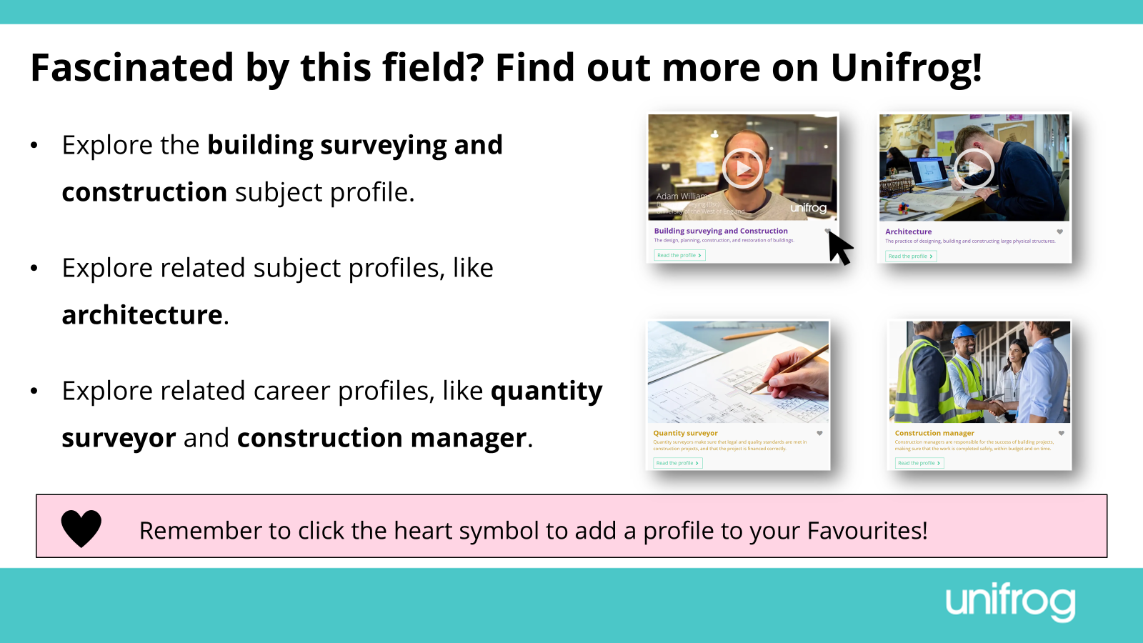
Notes:
Teacher’s notes:
This slide contains career and subject profiles that are relevant to the subject of the month.
If you have additional time available and students have computer access, you can direct them to these resources.
Remember to log into the student side of your Unifrog account to access these links and remind students to favourite any careers or subjects they like the look of.
You can track student progress with favouriting careers or subjects by clicking Advanced>Sort by>Library profiles in Favourites.

Slide 75
Career of the month
Year 13 – October
Notes:
Teacher’s notes:
October’s career of the month for year 13 is: Social researcher.

Slide 76

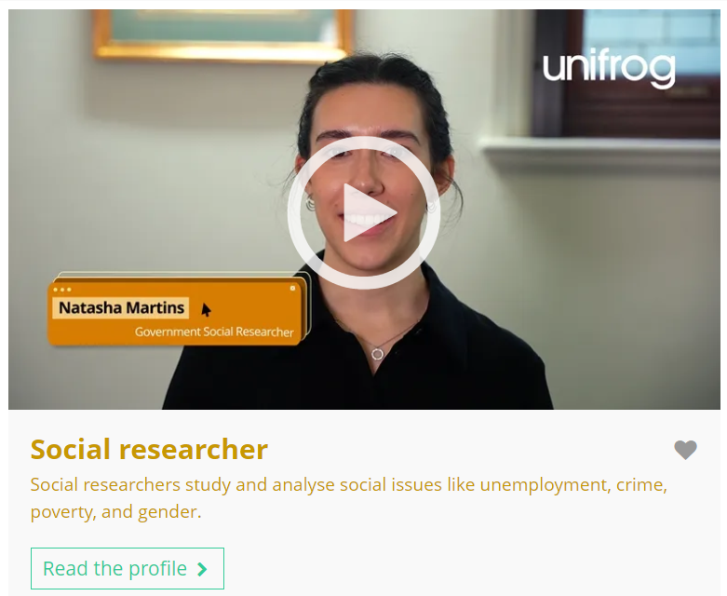
October’s career of the month is…
Social researcher
Note down at least one thing you think you know about this career.
Notes:
Teacher’s notes:
Click to reveal the career of the month: Social researcher.
Before you’re ready to watch the Careers library video as a class, ask students to note down anything they think they already know about this career.

Slide 77
October’s career of the month is… Social researcher
There are lots of roles that fall under the category of social researcher. Today we'll be hearing from Natasha, who’s a government social researcher.
Whilst you’re watching, think about the transferable skills you have that could relate to this career.
Notes:
Teacher’s notes:
Make sure you’re logged into your Unifrog account and click ‘use the platform as a student’. Click the image on the screen to go to the Careers library profile, then click the play button on the video. Alternatively, copy this URL into an internet browser: unifrog.org/student/careers/direct/social-researcher
If you have more time available, you could read the career profile text as a class too.

Slide 78
October’s career of the month is… Social researcher
Do you think this career might change in the future? Could AI impact working in this career?
Did you learn anything about the work environment or culture of this career? Did it make you more or less interested in this career?
What transferable skills could you apply to this career?
What are the next steps you’d take if you decided to pursue this career?
Notes:
Teacher’s notes:
This slide contains reflection questions about the career of the month. You could ask students to write down their answers, discuss in pairs or small groups, or discuss as a whole class.
The aim of this activity is for students to think about their own preferences, experiences, and skills and how these could relate to the career. Students are encouraged to draw links between skills used in their current school subjects and the career in the video. If students would like to know more about the career, encourage them to read the full career profile, which contains the following sections:
What you’ll do
Working hours and environment
Career path and progression
Skills required
Entry requirements
Related know-how guides
Related university subject profiles
Related career profiles
Explore
Labour Market Information (LMI)
People also liked…
Example answers:
The topics you research could change, as society changes. You might be able to use AI to help inform your research, like generating questionnaire ideas.
I learned that everyone on Natasha’s team has flexible working – this really appeals to me.
Organisation, communication, attention to detail, digital literacy, critical thinking, learning/research skills.
Volunteering, work experience, free online courses, exploring research-based degrees and apprenticeships.

Slide 79
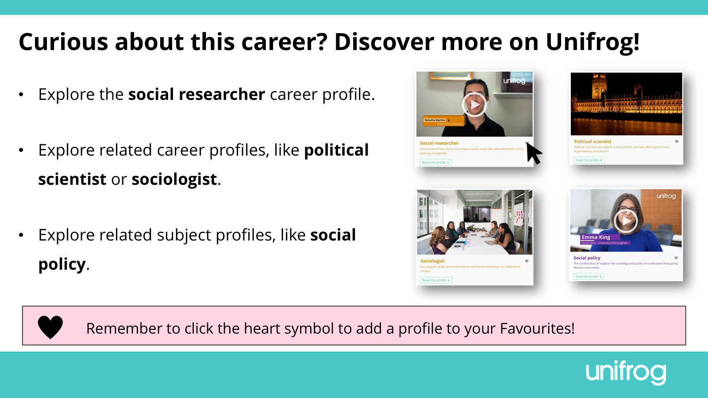
Notes:
Teacher’s notes:
This slide contains career and subject profiles that are relevant to the career of the month.
If you have additional time available and students have computer access, you can direct them to these resources.
Remember to log into the student side of your Unifrog account to access these links and remind students to favourite any careers or subjects they like the look of.
You can track student progress with favouriting careers or subjects by clicking Advanced>Sort by>Library profiles in Favourites.

Slide 81
Subject of the month
Year 13 – October
Notes:
Teacher’s notes:
October’s subject of the month for year 13 is: Nutrition.

Slide 82



October’s subject of the month is…
Nutrition
Note down at least one thing you think you know about this subject.
Notes:
Teacher’s notes:
Click to reveal the subject of the month: Nutrition.
Before you’re ready to watch the Subjects library video as a class, ask students to note down anything they think they already know about this subject.

Slide 83
October’s subject of the month is… Nutrition
There are lots of degrees that fall under the category of nutrition. Today we'll be hearing from Ella, who’s a nutrition and dietetics student.
Whilst you’re watching, think about the progression opportunities leading from this subject.
Notes:
Teacher’s notes:
Make sure you’re logged into your Unifrog account and click ‘use the platform as a student’. Click the image on the screen to go to the Subjects library profile, then click the play button on the video. Alternatively, copy this URL into an internet browser: unifrog.org/student/subjects/direct/nutrition
If you have more time available, you could read the subject profile text as a class too.

Slide 84
October’s subject of the month is… Nutrition
How could you network with professionals or students in this field to learn more about it?
Ella mentions lab work as part of her degree. Is this something that appeals to you? Why or why not?
How could the subjects you’re studying now help you prepare for university study of this subject?
What are some of the progression opportunities after studying this subject?
Notes:
Teacher’s notes:
This slide contains reflection questions about the subject of the month. You could ask students to write down their answers, discuss in pairs or small groups, or discuss as a whole class.
The aim of this activity is for students to think about their own preferences, experiences, and skills and how these could relate to the subject. Students are encouraged to draw links between skills used in their current school subjects and the subject in the video. If students would like to know more about the subject, encourage them to read the full subject profile, which contains the following sections:
In a nutshell
Getting in
Prospects
Statement
Reference
Geek out
Recommendations: Read
Recommendations: Watch
Recommendations: Listen
Explore
People also liked…
Example answers:
Social media like LinkedIn, contacting a local university, seeing if my school/college has an alumni network.
Yes – it sounds useful to apply what you’re learning in lectures to lab work.
Biology – this will help me to understand the impact of different food types and nutrients on the body.
Being a dietician, working with the NHS, working in a hospital, working in public health, working in the community, working in product development, working in food science, working with athletes.

Slide 85
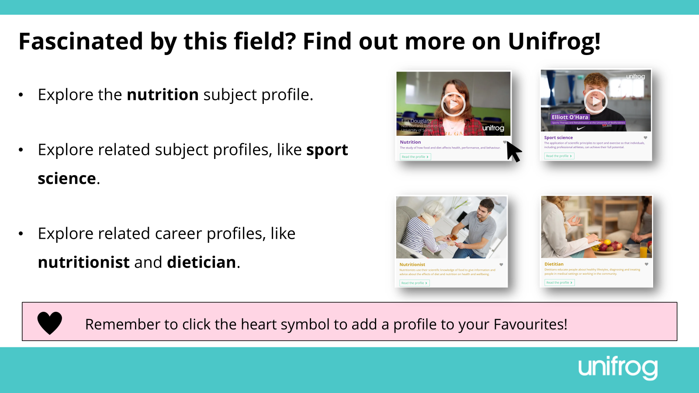
Notes:
Teacher’s notes:
This slide contains career and subject profiles that are relevant to the subject of the month.
If you have additional time available and students have computer access, you can direct them to these resources.
Remember to log into the student side of your Unifrog account to access these links and remind students to favourite any careers or subjects they like the look of.
You can track student progress with favouriting careers or subjects by clicking Advanced>Sort by>Library profiles in Favourites.

