Slide 1
Teacher’s slide: Gatsby Benchmarks
To support you in meeting the Gatsby Benchmarks, we suggest dedicating one day per month to a ‘career of the month' and one day to a ‘subject of the month' for each year group. This can be done during registration or form time, in a 15-minute session. Students will watch a video from the Unifrog platform and answer questions, either through group discussion or written responses.
Delivering these sessions can support the Gatsby Benchmarks as follows:
1. A stable careers programme | 2. Learning from career and labour market information
Regular timetabled sessions to discuss careers and subjects can form part of your stable careers programme. During these sessions you could also make links and remind students of what’s happening in your wider careers programme. | Watching the videos can help students to understand the skills, qualifications, and challenges related to specific jobs. You can support this by exploring the career or subject profile together, including linking to labour market information (LMI) contained in the profiles.
3. Addressing the needs of each pupil | 4. Linking curriculum learning to careers
The questions promote tailored personal reflection. Students could record and upload their reflections to their Unifrog Locker. A range of careers and subjects are used to help students raise aspirations and challenge stereotypes. | The questions help students to reflect on how school subjects connect to real-world careers, helping them see the relevance of their studies to future job opportunities.
5. Encounters with employers and employees | 6. Experiences of workplaces
While these videos don't replace in-person encounters with employers, they provide insights into work environments and cultures, offering students a realistic view of different career paths. | While these videos don't replace in-person work experience, they can broaden students' awareness of different workplaces and help them identify areas they'd like to explore further.
7. Encounters with further and higher education | 8. Personal guidance
While these videos don't replace in-person encounters with further and higher education, they can help students understand the educational pathways needed for various subjects and careers, helping them understand their options for further study or training. | Students can draw on their discussions and reflections of a variety of careers and subjects in their personal guidance 1:1s.
Notes:
Teacher’s notes:
To further support these benchmarks, you could arrange a talk from a former student, FE/HE institution, or employer about a subject/career featured each month.

Slide 2















November
Click a box to go straight to the relevant slides
Year 7 Career of the month
Year 8 Career of the month
Year 9 Career of the month
Year 10 Career of the month
Year 11 Career of the month
Year 12 Career of the month
Year 13 Career of the month
Year 7 Subject of the month
Year 8 Subject of the month
Year 9 Subject of the month
Year 10 Subject of the month
Year 11 Subject of the month
Year 12 Subject of the month
Year 13 Subject of the month
Notes:
Teacher’s notes:
There are separate PowerPoints available for each month of the academic year within the resource profile ‘Career and subject of the month’.
Click the hyperlinked text boxes on this slide to be taken to the slides for the year group selected.

Slide 3

Career of the month
Year 7 – November
Notes:
Teacher’s notes:
November’s career of the month for year 7 is: Headteacher.

Slide 4

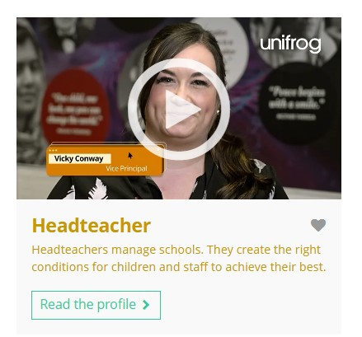


November’s career of the month is…
Headteacher
Note down at least one thing you think you know about this career.
Notes:
Teacher’s notes:
Click to reveal the career of the month: Headteacher.
Before you’re ready to watch the Careers library video as a class, ask students to note down anything they think they already know about this career.

Slide 5

November’s career of the month is… Headteacher
There are lots of roles that fall under the category of headteacher. Today we'll be hearing from Vicky, who’s a vice principal (deputy head teacher).
Whilst you’re watching, think about your experience as a student in school.
Notes:
Teacher’s notes:
Make sure you’re logged into your Unifrog account and click ‘use the platform as a student’. Click the image on the screen to go to the Careers library profile, then click the play button on the video. Alternatively, copy this URL into an internet browser: unifrog.org/student/careers/direct/headteacher
If you have more time available, you could read the career profile text as a class too.

Slide 6
November’s career of the month is… Headteacher
What impact does Vicky's career have on society? How important is it for you to choose a career that contributes positively to society?
In what way does this career align or not align with your interests?
How could your current experience as a student prepare you for this role?
What experiences could you gain now to help you decide if this career is right for you?
Notes:
Teacher’s notes:
This slide contains reflection questions about the career of the month. You could ask students to write down their answers, discuss in pairs or small groups, or discuss as a whole class.
The aim of this activity is for students to think about their own preferences, experiences, and skills and how these could relate to the career. Students are encouraged to draw links between skills used in their current school subjects and the career in the video. If students would like to know more about the career, encourage them to read the full career profile, which contains the following sections:
What you’ll do
Working hours and environment
Career path and progression
Skills required
Entry requirements
Related know-how guides
Related university subject profiles
Related career profiles
Explore
Labour Market Information (LMI)
People also liked…
Example answers:
Vicky’s job as a headteacher helps students learn about themselves and how best to shape their futures, which is important because I want to make a difference too.
This job matches my interest in teaching, leading, and helping others.
I’m learning firsthand about how school leaders can influence the student experience – positively and negatively.
I could try mentoring younger students or helping with school projects to see if this career is right for me.

Slide 7
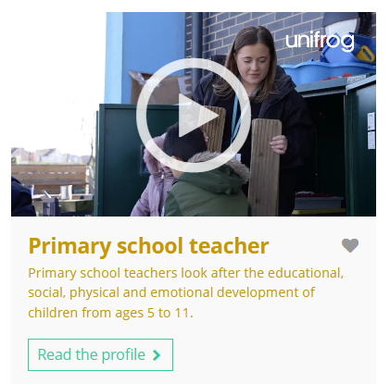
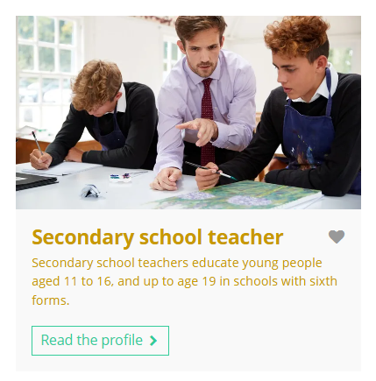
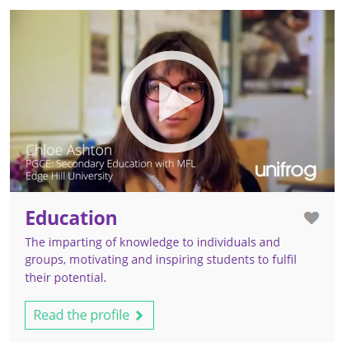

Curious about this career? Discover more on Unifrog!
Explore the headteacher career profile.
Explore related career profiles, like primary school teacher and secondary school teacher.
Explore related subject profiles, like education.
Remember to click the heart symbol to add a profile to your Favourites!
Notes:
Teacher’s notes:
This slide contains career and subject profiles that are relevant to the career of the month.
If you have additional time available and students have computer access, you can direct them to these resources.
Remember to log into the student side of your Unifrog account to access these links and remind students to favourite any careers or subjects they like the look of.
You can track student progress with favouriting careers or subjects by clicking Advanced>Sort by>Library profiles in Favourites.

Slide 8


Slide 9
Subject of the month
Year 7 – November
Notes:
Teacher’s notes:
November’s subject of the month for year 7 is: Materials science.

Slide 10

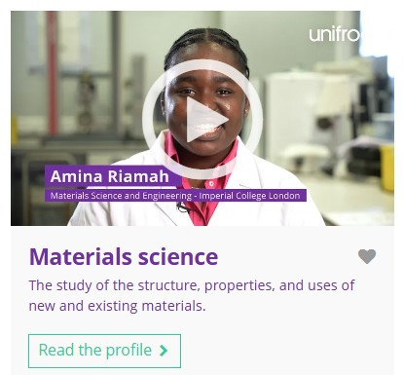

November’s subject of the month is…
Materials science
Note down at least one thing you think you know about this subject.
Notes:
Teacher’s notes:
Click to reveal the subject of the month: Materials science.
Before you’re ready to watch the Subjects library video as a class, ask students to note down anything they think they already know about this subject.

Slide 11
November’s subject of the month is… Materials science
Today we’ll be hearing from Amina, who’s a materials science student.
Whilst you’re watching, think about what other subjects are linked to materials science.
Notes:
Teacher’s notes:
Make sure you’re logged into your Unifrog account and click ‘use the platform as a student’. Click the image on the screen to go to the Subjects library profile, then click the play button on the video. Alternatively, copy this URL into an internet browser: unifrog.org/student/subjects/direct/materials-science
If you have more time available, you could read the subject profile text as a class too.

Slide 12
November’s subject of the month is… Materials science
What other subjects might prepare someone to study this subject at university?
Has anything in this video surprised you?
What have you learned in school that could be useful for this degree?
What are some steps you could take now to explore this subject more?
Notes:
Teacher’s notes:
This slide contains reflection questions about the subject of the month. You could ask students to write down their answers, discuss in pairs or small groups, or discuss as a whole class.
The aim of this activity is for students to think about their own preferences, experiences, and skills and how these could relate to the subject. Students are encouraged to draw links between skills used in their current school subjects and the subject in the video. If students would like to know more about the subject, encourage them to read the full subject profile, which contains the following sections:
In a nutshell
Getting in
Prospects
Statement
Reference
Geek out
Recommendations: Read
Recommendations: Watch
Recommendations: Listen
Explore
People also liked…
Example answers:
Maths, physics, and chemistry.
I was surprised to learn about the different uses for glass (windows, dentistry, and in the body).
I've learned about the properties of materials in science and problem-solving in maths, which could help with this degree.
I could read about materials science online, visit science museums, or try out experiments at home or in science clubs.

Slide 13

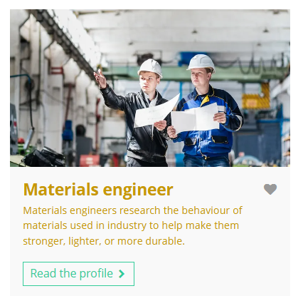

Fascinated by this field? Find out more on Unifrog!
Explore the materials science subject profile.
Explore related subject profiles, like physics.
Explore related career profiles, like materials engineer and nanotechnologist.
Remember to click the heart symbol to add a profile to your Favourites!
Notes:
Teacher’s notes:
This slide contains career and subject profiles that are relevant to the subject of the month.
If you have additional time available and students have computer access, you can direct them to these resources.
Remember to log into the student side of your Unifrog account to access these links and remind students to favourite any careers or subjects they like the look of.
You can track student progress with favouriting careers or subjects by clicking Advanced>Sort by>Library profiles in Favourites.

Slide 15
Career of the month
Year 8 – November
Notes:
Teacher’s notes:
November’s career of the month for year 8 is: Supply chain manager.

Slide 16

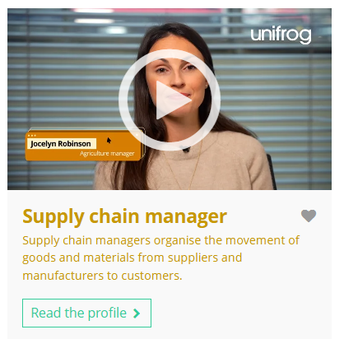

November’s career of the month is…
Supply chain manager
Note down at least one thing you think you know about this career.
Notes:
Teacher’s notes:
Click to reveal the career of the month: Supply chain manager.
Before you’re ready to watch the Careers library video as a class, ask students to note down anything they think they already know about this career.

Slide 17
November’s career of the month is… Supply chain manager
There are lots of roles that fall under the category of supply chain manager. Today we'll be hearing from Jocelyn, who’s an agriculture manager.
Whilst you’re watching, think about why companies need a supply chain manager.
Notes:
Teacher’s notes:
Make sure you’re logged into your Unifrog account and click ‘use the platform as a student’. Click the image on the screen to go to the Careers library profile, then click the play button on the video. Alternatively, copy this URL into an internet browser: unifrog.org/student/careers/direct/supply-chain-manager
If you have more time available, you could read the career profile text as a class too.

Slide 18
November’s career of the month is… Supply chain manager
What skills do you need in this career?
How does this career relate to things you like doing?
Which school subjects are linked to this career?
What hobbies or activities could you do to help you learn more about this career?
Notes:
Teacher’s notes:
This slide contains reflection questions about the career of the month. You could ask students to write down their answers, discuss in pairs or small groups, or discuss as a whole class.
The aim of this activity is for students to think about their own preferences, experiences, and skills and how these could relate to the career. Students are encouraged to draw links between skills used in their current school subjects and the career in the video. If students would like to know more about the career, encourage them to read the full career profile, which contains the following sections:
What you’ll do
Working hours and environment
Career path and progression
Skills required
Entry requirements
Related know-how guides
Related university subject profiles
Related career profiles
Explore
Labour Market Information (LMI)
People also liked…
Example answers:
You need to be organised, good at problem solving, able to communicate well with others, and have strong maths and decision-making skills to manage the flow of products and materials.
I think I’d enjoy organising things, solving problems, and working with others.
Subjects like maths, business studies, and geography are linked because they help with planning, managing costs, understanding logistics, and learning how businesses work across different places.
I could try organising events, like a school fundraiser or a sports day, or join a club that involves planning and coordinating, such as a student council or a project management group.

Slide 19

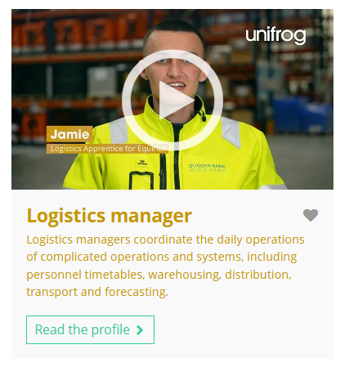
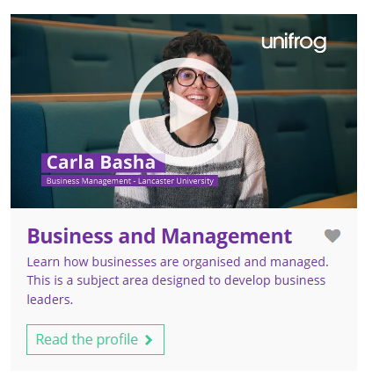
Curious about this career? Discover more on Unifrog!
Explore the supply chain manager career profile.
Explore related career profiles, like purchasing manager and logistics manager.
Explore related subject profiles, like business and management.
Remember to click the heart symbol to add a profile to your Favourites!
Notes:
Teacher’s notes:
This slide contains career and subject profiles that are relevant to the career of the month.
If you have additional time available and students have computer access, you can direct them to these resources.
Remember to log into the student side of your Unifrog account to access these links and remind students to favourite any careers or subjects they like the look of.
You can track student progress with favouriting careers or subjects by clicking Advanced>Sort by>Library profiles in Favourites.

Slide 21
Subject of the month
Year 8 – November
Notes:
Teacher’s notes:
November’s subject of the month for year 8 is: Spanish studies.

Slide 22

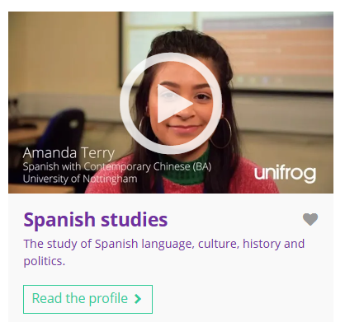

November’s subject of the month is…
Spanish studies
Note down at least one thing you think you know about this subject.
Notes:
Teacher’s notes:
Click to reveal the subject of the month: Spanish studies.
Before you’re ready to watch the Subjects library video as a class, ask students to note down anything they think they already know about this subject.

Slide 23
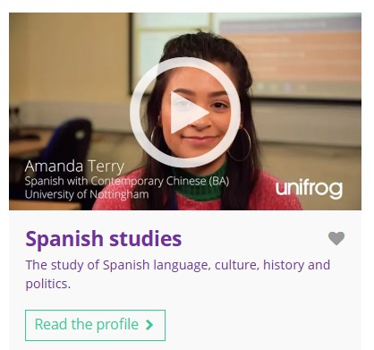
November’s subject of the month is… Spanish studies
There are lots of degrees that fall under the category of Spanish studies. Today we'll be hearing from Amanda, who’s studying Spanish with contemporary Chinese.
Whilst you’re watching, think about the benefits of studying multiple languages.
Notes:
Teacher’s notes:
Make sure you’re logged into your Unifrog account and click ‘use the platform as a student’. Click the image on the screen to go to the Subjects library profile, then click the play button on the video. Alternatively, copy this URL into an internet browser: unifrog.org/student/subjects/direct/spanish-studies
If you have more time available, you could read the subject profile text as a class too.

Slide 24
November’s subject of the month is… Spanish studies
Other than travelling, what hobbies relate to this subject?
What skills do you have that you think could be useful for this subject?
Amanda plans to spend next year in Argentina. What benefits does she give for spending a year abroad?
People sometimes say language degrees only lead to a career as a translator or teacher. Does Amanda agree? What does she believe?
Notes:
Teacher’s notes:
This slide contains reflection questions about the subject of the month. You could ask students to write down their answers, discuss in pairs or small groups, or discuss as a whole class.
The aim of this activity is for students to think about their own preferences, experiences, and skills and how these could relate to the subject. Students are encouraged to draw links between skills used in their current school subjects and the subject in the video. If students would like to know more about the subject, encourage them to read the full subject profile, which contains the following sections:
In a nutshell
Getting in
Prospects
Statement
Reference
Geek out
Recommendations: Read
Recommendations: Watch
Recommendations: Listen
Explore
People also liked…
Example answers:
Hobbies like cooking Spanish food, watching Spanish movies, listening to Spanish music, or reading Spanish books could help me learn more about the language and culture.
I have good listening and speaking skills, which can help me communicate better in Spanish.
To become fluent and explore their world/culture.
Amanda doesn't agree. She believes that studying a language opens up many career options, because language skills are valuable in lots of fields, and knowing another language can help with communication and understanding different cultures.

Slide 25

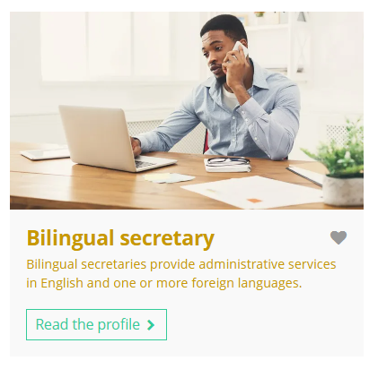
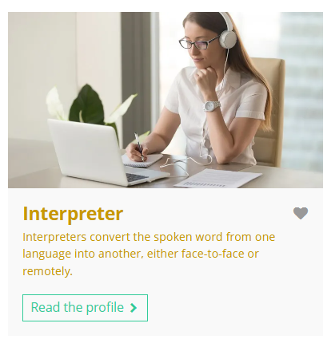
Fascinated by this field? Find out more on Unifrog!
Explore the Spanish studies subject profile.
Explore related subject profiles, like European studies.
Explore related career profiles, like bilingual secretary and interpreter.
Remember to click the heart symbol to add a profile to your Favourites!
Notes:
Teacher’s notes:
This slide contains career and subject profiles that are relevant to the subject of the month.
If you have additional time available and students have computer access, you can direct them to these resources.
Remember to log into the student side of your Unifrog account to access these links and remind students to favourite any careers or subjects they like the look of.
You can track student progress with favouriting careers or subjects by clicking Advanced>Sort by>Library profiles in Favourites.

Slide 27
Career of the month
Year 9 – November
Notes:
Teacher’s notes:
November’s career of the month for year 9 is: Osteopath.

Slide 28
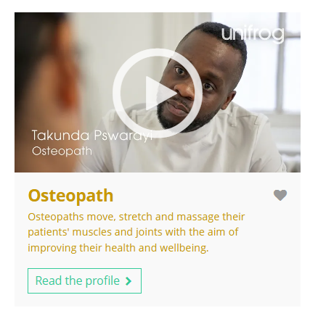


November’s career of the month is…
Osteopath
Note down at least one thing you think you know about this career.
Notes:
Teacher’s notes:
Click to reveal the career of the month: Osteopath.
Before you’re ready to watch the Careers library video as a class, ask students to note down anything they think they already know about this career.

Slide 29
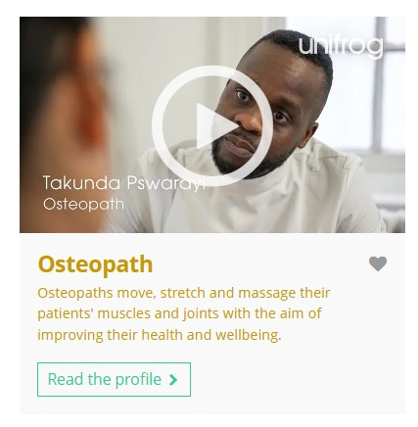
November’s career of the month is… Osteopath
Today we'll be hearing from Takunda, who’s an osteopath.
Whilst you’re watching, think about what qualifications you could gain before pursuing a career in osteopathy.
Notes:
Teacher’s notes:
Make sure you’re logged into your Unifrog account and click ‘use the platform as a student’. Click the image on the screen to go to the Careers library profile, then click the play button on the video. Alternatively, copy this URL into an internet browser: unifrog.org/student/careers/direct/osteopath
If you have more time available, you could read the career profile text as a class too.

Slide 30
November’s career of the month is… Osteopath
Takunda enjoys interacting with customers of all ages and backgrounds. What do you think you’d enjoy the most about this career?
What school subjects do you think are most important for preparing for this career?
What educational pathways or qualifications does Takunda mention?
What skills would someone need to pursue this career?
Notes:
Teacher’s notes:
This slide contains reflection questions about the career of the month. You could ask students to write down their answers, discuss in pairs or small groups, or discuss as a whole class.
The aim of this activity is for students to think about their own preferences, experiences, and skills and how these could relate to the career. Students are encouraged to draw links between skills used in their current school subjects and the career in the video. If students would like to know more about the career, encourage them to read the full career profile, which contains the following sections:
What you’ll do
Working hours and environment
Career path and progression
Skills required
Entry requirements
Related know-how guides
Related university subject profiles
Related career profiles
Explore
Labour Market Information (LMI)
People also liked…
Example answers:
I’d enjoy helping people feel better and improving their health. Meeting and talking to different customers would be fun, too.
Important subjects would be biology and physical education (PE) because they’d help me understand how the body works and how to keep it healthy.
Takunda explains how he completed a BTEC level 5 course in sport and remedial massage, which inspired him to pursue a degree in osteopathy.
You’d need good communication skills to talk with patients, strong problem-solving skills to figure out their issues, and a caring attitude to help people feel comfortable.

Slide 31
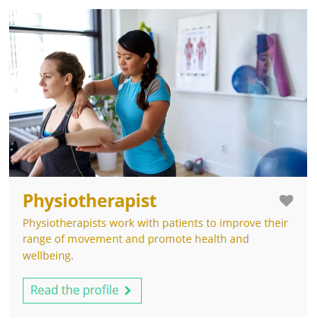
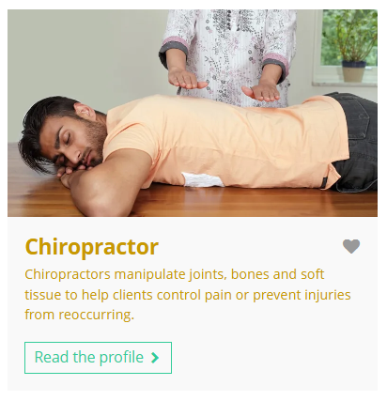
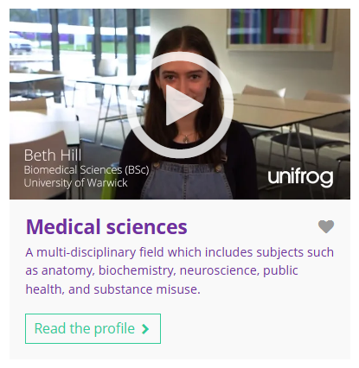
Curious about this career? Discover more on Unifrog!
Explore the osteopath career profile.
Explore related career profiles, like physiotherapist and chiropractor.
Explore related subject profiles, like medical sciences.
Remember to click the heart symbol to add a profile to your Favourites!
Notes:
Teacher’s notes:
This slide contains career and subject profiles that are relevant to the career of the month.
If you have additional time available and students have computer access, you can direct them to these resources.
Remember to log into the student side of your Unifrog account to access these links and remind students to favourite any careers or subjects they like the look of.
You can track student progress with favouriting careers or subjects by clicking Advanced>Sort by>Library profiles in Favourites.

Slide 33
Subject of the month
Year 9 – November
Notes:
Teacher’s notes:
November’s subject of the month for year 9 is: Media and communications.

Slide 34

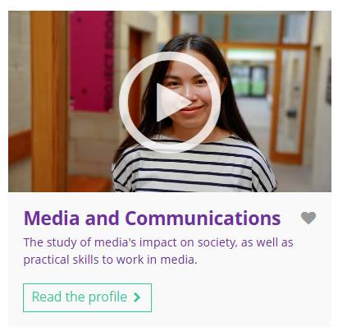

November’s subject of the month is…
Media and communications
Note down at least one thing you think you know about this subject.
Notes:
Teacher’s notes:
Click to reveal the subject of the month: Media and communications.
Before you’re ready to watch the Subjects library video as a class, ask students to note down anything they think they already know about this subject.

Slide 35
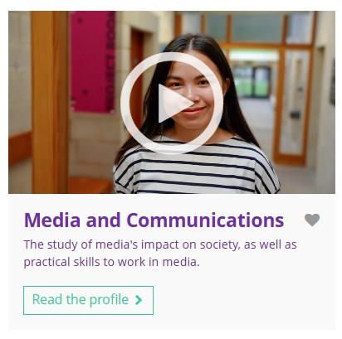
November’s subject of the month is… Media and communications
Today we'll be hearing from Anh, who’s a media and communications student.
Whilst you’re watching, think about how it might feel to be an international student.
Notes:
Teacher’s notes:
Make sure you’re logged into your Unifrog account and click ‘use the platform as a student’. Click the image on the screen to go to the Subjects library profile, then click the play button on the video. Alternatively, copy this URL into an internet browser: unifrog.org/student/subjects/direct/media-and-communications
If you have more time available, you could read the subject profile text as a class too.

Slide 36
November’s subject of the month is… Media and communications
Other than watching TV, what hobbies relate to this subject?
What skills do you have that you think could be useful for this subject?
Ash has studied in other countries. What benefits does she list about UK universities’ focus on independent study?
If you wanted to study this subject, what could you do to prepare?
Notes:
Teacher’s notes:
This slide contains reflection questions about the subject of the month. You could ask students to write down their answers, discuss in pairs or small groups, or discuss as a whole class.
The aim of this activity is for students to think about their own preferences, experiences, and skills and how these could relate to the subject. Students are encouraged to draw links between skills used in their current school subjects and the subject in the video. If students would like to know more about the subject, encourage them to read the full subject profile, which contains the following sections:
In a nutshell
Getting in
Prospects
Statement
Reference
Geek out
Recommendations: Read
Recommendations: Watch
Recommendations: Listen
Explore
People also liked…
Example answers:
Hobbies like blogging, creating videos, photography, or using social media could help me learn more about media and communications.
Digital literacy, attention to detail, problem solving, numeracy, analysis, creativity.
I have strong writing skills for creating articles and scripts, good verbal communication skills for presenting ideas clearly, and creativity to come up with unique content. I’m also good at critical thinking, which could help me analyse media messages and understand their impact.
To prepare, I could start reading more news articles, follow media trends, create my own content, and practice speaking in front of an audience.

Slide 37
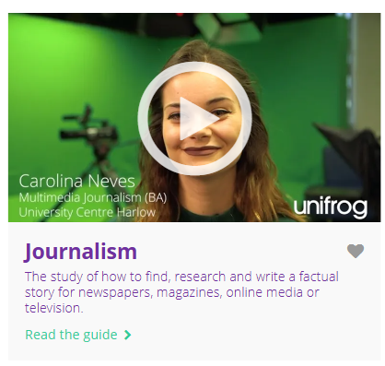


Fascinated by this field? Find out more on Unifrog!
Explore the media and communications subject profile.
Explore related subject profiles, like journalism.
Explore related career profiles, like public relations executive and advertising copywriter.
Remember to click the heart symbol to add a profile to your Favourites!
Notes:
Teacher’s notes:
This slide contains career and subject profiles that are relevant to the subject of the month.
If you have additional time available and students have computer access, you can direct them to these resources.
Remember to log into the student side of your Unifrog account to access these links and remind students to favourite any careers or subjects they like the look of.
You can track student progress with favouriting careers or subjects by clicking Advanced>Sort by>Library profiles in Favourites.

Slide 39
Career of the month
Year 10 – November
Notes:
Teacher’s notes:
November’s career of the month for year 10 is: IT support technician.

Slide 40

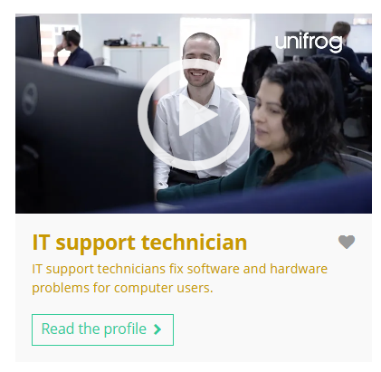

November’s career of the month is…
IT support technician
Note down at least one thing you think you know about this career.
Notes:
Teacher’s notes:
Click to reveal the career of the month: IT support technician.
Before you’re ready to watch the Careers library video as a class, ask students to note down anything they think they already know about this career.

Slide 41

November’s career of the month is… IT support technician
There are lots of roles that fall under the category of IT support technician. Today we'll be hearing from Scott, who’s an infrastructure engineer.
Whilst you’re watching, think about a time when you’ve needed help with a computer-related problem.
Notes:
Teacher’s notes:
Make sure you’re logged into your Unifrog account and click ‘use the platform as a student’. Click the image on the screen to go to the Careers library profile, then click the play button on the video. Alternatively, copy this URL into an internet browser: unifrog.org/student/careers/direct/it-support-technician
If you have more time available, you could read the career profile text as a class too.

Slide 42
November’s career of the month is… IT support technician
How can you gain experience or learn more about this career, such as through work experience or volunteering?
How do values, like teamwork and problem solving fit with this career?
What skills are essential for this career? Do you use any of those skills in your school subjects?
If you could ask Scott anything, what question would you ask him?
Notes:
Teacher’s notes:
This slide contains reflection questions about the career of the month. You could ask students to write down their answers, discuss in pairs or small groups, or discuss as a whole class.
The aim of this activity is for students to think about their own preferences, experiences, and skills and how these could relate to the career. Students are encouraged to draw links between skills used in their current school subjects and the career in the video. If students would like to know more about the career, encourage them to read the full career profile, which contains the following sections:
What you’ll do
Working hours and environment
Career path and progression
Skills required
Entry requirements
Related know-how guides
Related university subject profiles
Related career profiles
Explore
Labour Market Information (LMI)
People also liked…
Example answers:
I could gain experience by doing work experience at a local tech company, volunteering to help friends or family with computer problems, or joining a school club focused on technology.
Values like teamwork and problem solving are important in this career because IT support technicians often work with others to fix issues.
Essential skills include good communication for explaining tech issues, technical knowledge for understanding computers, and patience for helping users. I use my communication skills in subjects like English when presenting ideas and my technical knowledge in computer science.
I would ask him, "What is the most challenging problem you’ve ever solved in your job?"

Slide 43
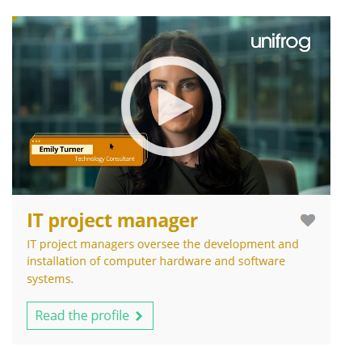
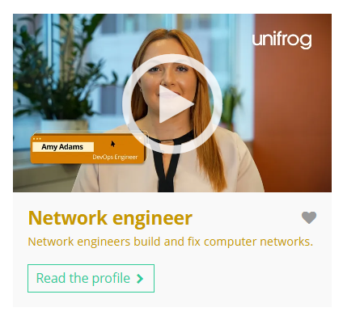
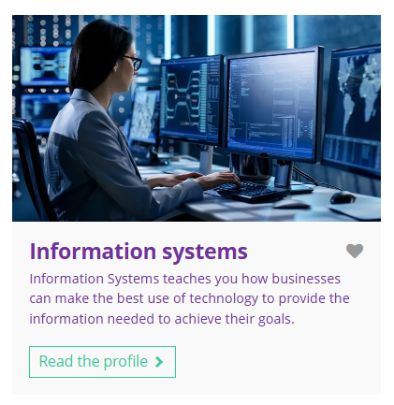
Curious about this career? Discover more on Unifrog!
Explore the IT support technician career profile.
Explore related career profiles, like IT project manager and network engineer.
Explore related subject profiles, like information systems.
Remember to click the heart symbol to add a profile to your Favourites!
Notes:
Teacher’s notes:
This slide contains career and subject profiles that are relevant to the career of the month.
If you have additional time available and students have computer access, you can direct them to these resources.
Remember to log into the student side of your Unifrog account to access these links and remind students to favourite any careers or subjects they like the look of.
You can track student progress with favouriting careers or subjects by clicking Advanced>Sort by>Library profiles in Favourites.

Slide 45
Subject of the month
Year 10 – November
Notes:
Teacher’s notes:
November’s subject of the month for year 10 is: Portuguese studies.

Slide 46
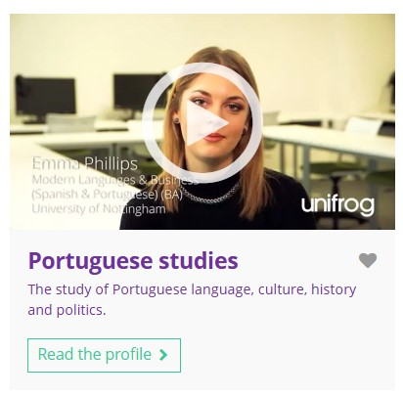

November’s subject of the month is…
Portuguese studies
Note down at least one thing you think you know about this subject.
Notes:
Teacher’s notes:
Click to reveal the subject of the month: Portuguese studies.
Before you’re ready to watch the Subjects library video as a class, ask students to note down anything they think they already know about this subject.

Slide 47
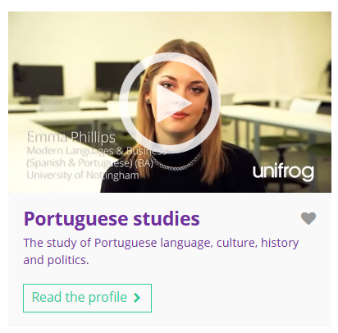
November’s subject of the month is… Portuguese studies
There are lots of degrees that fall under the category of Portuguese studies. Today we'll be hearing from Emma, who’s studying modern languages and business (Spanish and Portuguese).
Whilst you’re watching, think about how it might feel to be in a country where you can’t speak the language.
Notes:
Teacher’s notes:
Make sure you’re logged into your Unifrog account and click ‘use the platform as a student’. Click the image on the screen to go to the Subjects library profile, then click the play button on the video. Alternatively, copy this URL into an internet browser: unifrog.org/student/subjects/direct/portuguese-studies
If you have more time available, you could read the subject profile text as a class too.

Slide 48
November’s subject of the month is… Portuguese studies
What sorts of careers could this subject lead to?
Why is being open-minded important when studying this subject?
Which GCSE (or equivalent) subjects could help someone to prepare for this degree?
What else would you like to know about this subject? Where could you find this information?
Notes:
Teacher’s notes:
This slide contains reflection questions about the subject of the month. You could ask students to write down their answers, discuss in pairs or small groups, or discuss as a whole class.
The aim of this activity is for students to think about their own preferences, experiences, and skills and how these could relate to the subject. Students are encouraged to draw links between skills used in their current school subjects and the subject in the video. If students would like to know more about the subject, encourage them to read the full subject profile, which contains the following sections:
In a nutshell
Getting in
Prospects
Statement
Reference
Geek out
Recommendations: Read
Recommendations: Watch
Recommendations: Listen
Explore
People also liked…
Example answers:
This subject could lead to careers in translation, teaching, tourism, international relations, or working for businesses that operate in Portuguese-speaking countries.
Being open-minded is important because it would help me understand and appreciate different cultures, ideas, and perspectives that come with studying the language and its speakers.
Useful subjects include languages, history, geography, and literature, as they can provide context and enhance my understanding of Portuguese-speaking cultures.
I would like to know about study opportunities and experiences in Portuguese-speaking countries. I could find this information within the Unifrog subject profile and by using the university search tools.

Slide 49

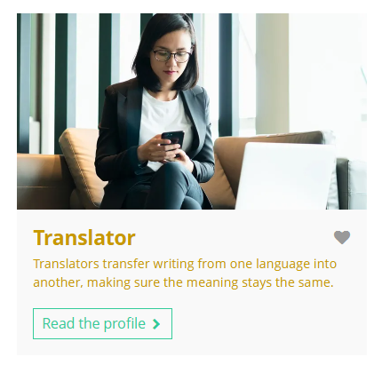
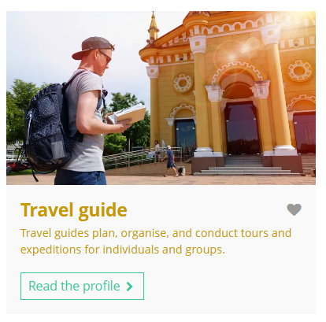
Fascinated by this field? Find out more on Unifrog!
Explore the Portuguese studies subject profile.
Explore related subject profiles, like linguistics and translation.
Explore related career profiles, like translator and travel guide.
Remember to click the heart symbol to add a profile to your Favourites!
Notes:
Teacher’s notes:
This slide contains career and subject profiles that are relevant to the subject of the month.
If you have additional time available and students have computer access, you can direct them to these resources.
Remember to log into the student side of your Unifrog account to access these links and remind students to favourite any careers or subjects they like the look of.
You can track student progress with favouriting careers or subjects by clicking Advanced>Sort by>Library profiles in Favourites.

Slide 51
Career of the month
Year 11 – November
Notes:
Teacher’s notes:
November’s career of the month for year 11 is: Lighting technician

Slide 52

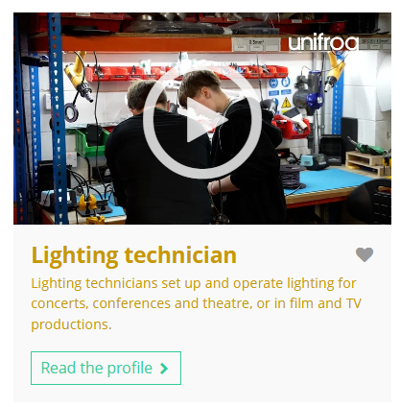

November’s career of the month is…
Lighting technician
Note down at least one thing you think you know about this career.
Notes:
Teacher’s notes:
Click to reveal the career of the month: Lighting technician
Before you’re ready to watch the Careers library video as a class, ask students to note down anything they think they already know about this career.

Slide 53
November’s career of the month is… Lighting technician
There are lots of roles that fall under the category of lighting technician. Today we'll be hearing from Sophie, who’s a creative venue technician
Whilst you’re watching, think about any shows or performances you’ve seen.
Notes:
Teacher’s notes:
Make sure you’re logged into your Unifrog account and click ‘use the platform as a student’. Click the image on the screen to go to the Careers library profile, then click the play button on the video. Alternatively, copy this URL into an internet browser: unifrog.org/student/careers/direct/lighting-technician
If you have more time available, you could read the career profile text as a class too.

Slide 54
November’s career of the month is… Lighting technician
What work experience or volunteering would help someone prepare for this career?
What do you think the most rewarding part of this career would be?
What skills are essential for this career? Do you use any of those skills in your school subjects?
Sophie mentions apprenticeships as one possible route into this career. How did her subjects at school help her get her apprenticeship?
Notes:
Teacher’s notes:
This slide contains reflection questions about the career of the month. You could ask students to write down their answers, discuss in pairs or small groups, or discuss as a whole class.
The aim of this activity is for students to think about their own preferences, experiences, and skills and how these could relate to the career. Students are encouraged to draw links between skills used in their current school subjects and the career in the video. If students would like to know more about the career, encourage them to read the full career profile, which contains the following sections:
What you’ll do
Working hours and environment
Career path and progression
Skills required
Entry requirements
Related know-how guides
Related university subject profiles
Related career profiles
Explore
Labour Market Information (LMI)
People also liked…
Example answers:
Work experience as a stage crew member for school plays or volunteering with local theatre groups would help someone prepare for this career.
I think the most rewarding part of being a lighting technician would be seeing how my work enhances performances and creates the right atmosphere for the audience.
Essential skills for this career include technical knowledge of lighting equipment, attention to detail, and teamwork. I use my teamwork skills in group projects at school and my attention to detail in subjects like art and design.
Sophie says she studied film and drama and theatre at college, including lighting control. She also put herself out there, doing anything she could to contribute to her portfolio: lighting for shows, making short films, and script writing.

Slide 55
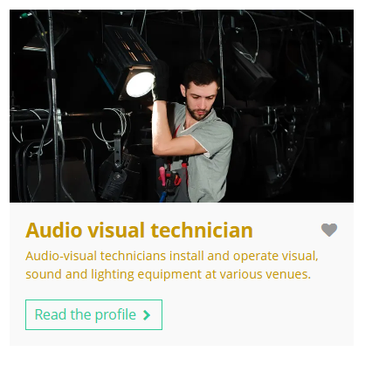
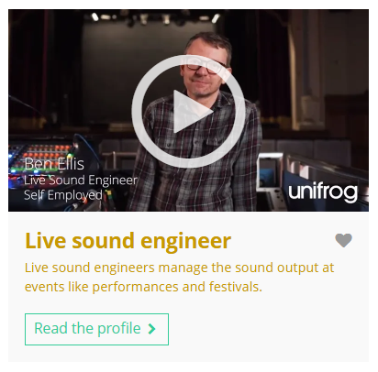

Curious about this career? Discover more on Unifrog!
Explore the lighting technician career profile.
Explore related career profiles, like audio visual technician and live sound engineer.
Explore related subject profiles, like drama and theatre studies.
Remember to click the heart symbol to add a profile to your Favourites!
Notes:
Teacher’s notes:
This slide contains career and subject profiles that are relevant to the career of the month.
If you have additional time available and students have computer access, you can direct them to these resources.
Remember to log into the student side of your Unifrog account to access these links and remind students to favourite any careers or subjects they like the look of.
You can track student progress with favouriting careers or subjects by clicking Advanced>Sort by>Library profiles in Favourites.

Slide 57
Subject of the month
Year 11 – November
Notes:
Teacher’s notes:
November’s subject of the month for year 11 is: Accounting.

Slide 58

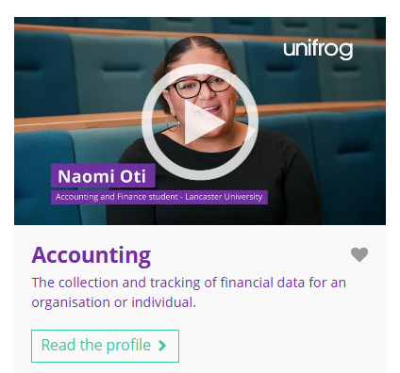

November’s subject of the month is…
Accounting
Note down at least one thing you think you know about this subject.
Notes:
Teacher’s notes:
Click to reveal the subject of the month: Accounting.
Before you’re ready to watch the Subjects library video as a class, ask students to note down anything they think they already know about this subject.

Slide 59
November’s subject of the month is… Accounting
There are lots of degrees that fall under the category of accounting. Today we'll be hearing from Naomi, who’s an accounting and finance student.
Whilst you’re watching, think about why companies need accountants.
Notes:
Teacher’s notes:
Make sure you’re logged into your Unifrog account and click ‘use the platform as a student’. Click the image on the screen to go to the Subjects library profile, then click the play button on the video. Alternatively, copy this URL into an internet browser: unifrog.org/student/subjects/direct/accounting
Please note, there are two videos available on this subject profile: Naomi and Daniel.
If you have more time available, you could read the subject profile text as a class too.

Slide 60
November’s subject of the month is… Accounting
What other subjects might you need to study this subject?
Has anything in this video surprised you?
What have you learned in school that could be useful for this degree?
What are some steps you could take now to explore this subject more?
Notes:
Teacher’s notes:
This slide contains reflection questions about the subject of the month. You could ask students to write down their answers, discuss in pairs or small groups, or discuss as a whole class.
The aim of this activity is for students to think about their own preferences, experiences, and skills and how these could relate to the subject. Students are encouraged to draw links between skills used in their current school subjects and the subject in the video. If students would like to know more about the subject, encourage them to read the full subject profile, which contains the following sections:
In a nutshell
Getting in
Prospects
Statement
Reference
Geek out
Recommendations: Read
Recommendations: Watch
Recommendations: Listen
Explore
People also liked…
Example answers:
Other subjects that might be helpful include mathematics, economics, business studies, and statistics, as they provide essential skills for understanding financial concepts.
I was surprised to learn about companies who are playing tricks to avoid paying tax!
I’ve learned how to use Excel, which is a useful skills for studying accounting.
I could explore this subject by reading books or articles about accounting, joining a business or finance club at school, or talking to a professional accountant about their work.

Slide 61

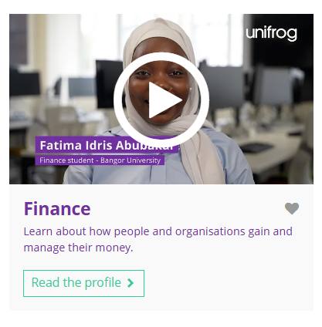
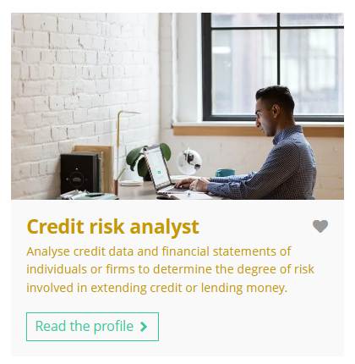
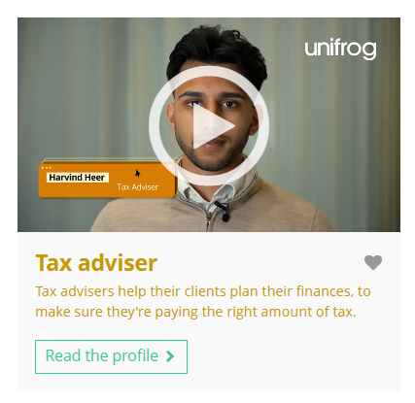
Fascinated by this field? Find out more on Unifrog!
Explore the accounting subject profile and watch Daniel’s video.
Explore related subject profiles, like finance.
Explore related career profiles, like credit risk analyst and tax adviser.
Remember to click the heart symbol to add a profile to your Favourites!
Notes:
Teacher’s notes:
This slide contains career and subject profiles that are relevant to the subject of the month.
If you have additional time available and students have computer access, you can direct them to these resources.
Remember to log into the student side of your Unifrog account to access these links and remind students to favourite any careers or subjects they like the look of.
You can track student progress with favouriting careers or subjects by clicking Advanced>Sort by>Library profiles in Favourites.

Slide 63
Career of the month
Year 12 – November
Notes:
Teacher’s notes:
November’s career of the month for year 12 is: Activist.

Slide 64

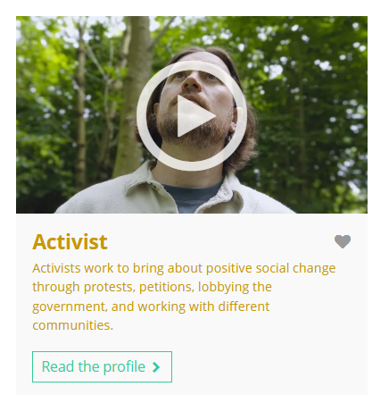

November’s career of the month is…
Activist
Note down at least one thing you think you know about this career.
Notes:
Teacher’s notes:
Click to reveal the career of the month: Activist.
Before you’re ready to watch the Careers library video as a class, ask students to note down anything they think they already know about this career.

Slide 65
November’s career of the month is… Activist
There are lots of roles that fall under the category of activist. Today we'll be hearing from Jack, who’s a programme lead for Woods Under Threat.
Whilst you’re watching, think about the issues and causes you are interested in or passionate about.
Notes:
Teacher’s notes:
Make sure you’re logged into your Unifrog account and click ‘use the platform as a student’. Click the image on the screen to go to the Careers library profile, then click the play button on the video. Alternatively, copy this URL into an internet browser: unifrog.org/student/careers/direct/freelance-activist
If you have more time available, you could read the career profile text as a class too.

Slide 66
November’s career of the month is… Activist
What advice would you give to someone who wants to enter this career?
What parts of this career seem most interesting to you?
What educational pathways or qualifications does Jack mention? Do you know of any alternative routes into this career?
What could you do now to help you decide if a career like this is right for you?
Notes:
Teacher’s notes:
This slide contains reflection questions about the career of the month. You could ask students to write down their answers, discuss in pairs or small groups, or discuss as a whole class.
The aim of this activity is for students to think about their own preferences, experiences, and skills and how these could relate to the career. Students are encouraged to draw links between skills used in their current school subjects and the career in the video. If students would like to know more about the career, encourage them to read the full career profile, which contains the following sections:
What you’ll do
Working hours and environment
Career path and progression
Skills required
Entry requirements
Related know-how guides
Related university subject profiles
Related career profiles
Explore
Labour Market Information (LMI)
People also liked…
Example answers:
I would advise someone to stay informed about social issues, volunteer with causes they care about, and connect with other activists to learn from their experiences.
The parts of this career that seem most interesting to me are raising awareness about important issues, working with different communities, and making a real impact on society.
Jack studied environmental sciences at university, then he started volunteering at the Woodland Trust. There are no official entry requirements for this role, but studies in social policy, public policy, politics, law, or community development could give a better understanding of the industry.
To help decide if a career like this is right for me, I could volunteer for local organisations, attend community meetings, or participate in campaigns to see if I enjoy the work and the impact it has.

Slide 67
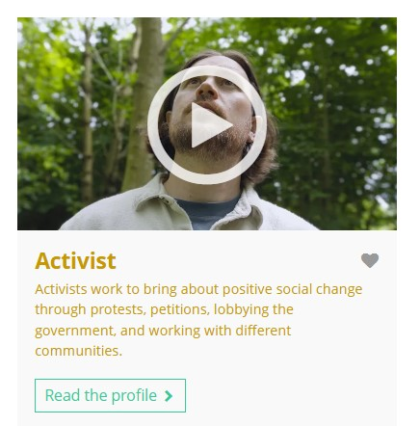
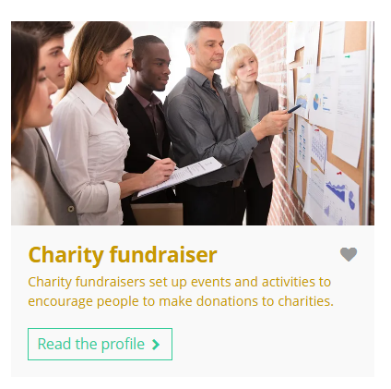
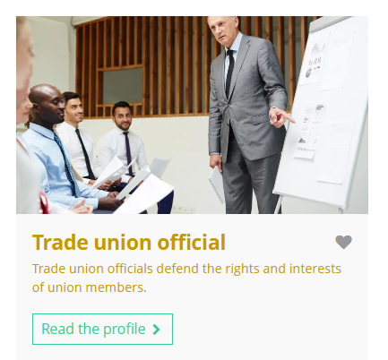
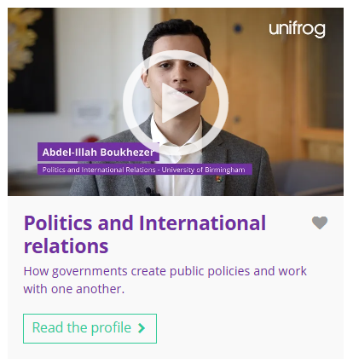
Curious about this career? Discover more on Unifrog!
Explore the activist career profile.
Explore related career profiles, like charity fundraiser and trade union official.
Explore related subject profiles, like politics and international relations.
Remember to click the heart symbol to add a profile to your Favourites!
Notes:
Teacher’s notes:
This slide contains career and subject profiles that are relevant to the career of the month.
If you have additional time available and students have computer access, you can direct them to these resources.
Remember to log into the student side of your Unifrog account to access these links and remind students to favourite any careers or subjects they like the look of.
You can track student progress with favouriting careers or subjects by clicking Advanced>Sort by>Library profiles in Favourites.

Slide 69
Subject of the month
Year 12 – November
Notes:
Teacher’s notes:
November’s subject of the month for year 12 is: Textiles and fashion.

Slide 70



November’s subject of the month is…
Textiles and fashion
Note down at least one thing you think you know about this subject.
Notes:
Teacher’s notes:
Click to reveal the subject of the month: Textiles and fashion.
Before you’re ready to watch the Subjects library video as a class, ask students to note down anything they think they already know about this subject.

Slide 71
November’s subject of the month is… Textiles and fashion
Today we'll be hearing from Laura, who’s a textiles and fashion student.
Whilst you’re watching, think about the things you like to wear and what may have been done to create them.
Notes:
Teacher’s notes:
Make sure you’re logged into your Unifrog account and click ‘use the platform as a student’. Click the image on the screen to go to the Subjects library profile, then click the play button on the video. Alternatively, copy this URL into an internet browser: unifrog.org/student/subjects/direct/textiles-and-fashion
If you have more time available, you could read the subject profile text as a class too.

Slide 72
November’s subject of the month is… Textiles and fashion
How could you network with professionals or students in this field to learn more about it?
Laura mentions workshops, pitches, and competitions as part of her degree. Are these things that appeal to you? Why or why not?
How could the subjects you’re studying now help you prepare for university study of this subject?
What are some of the progression opportunities after studying this subject?
Notes:
Teacher’s notes:
This slide contains reflection questions about the subject of the month. You could ask students to write down their answers, discuss in pairs or small groups, or discuss as a whole class.
The aim of this activity is for students to think about their own preferences, experiences, and skills and how these could relate to the subject. Students are encouraged to draw links between skills used in their current school subjects and the subject in the video. If students would like to know more about the subject, encourage them to read the full subject profile, which contains the following sections:
In a nutshell
Getting in
Prospects
Statement
Reference
Geek out
Recommendations: Read
Recommendations: Watch
Recommendations: Listen
Explore
People also liked…
Example answers:
I could network with professionals or students in this field by attending fashion shows, joining textile and fashion clubs, participating in workshops, or connecting with people on social media platforms like LinkedIn.
Workshops, pitches, and competitions appeal to me because they let me gain hands-on experience, work with others, and show my skills. I enjoy being creative and pushing myself.
The subjects I’m studying now, such as art and design and business studies, could help me prepare for university by developing my creativity, technical skills, and understanding of the fashion industry.
Some progression opportunities after studying this subject include working as a fashion designer, textile technologist, fashion buyer, or in marketing and merchandising within the fashion industry.

Slide 73
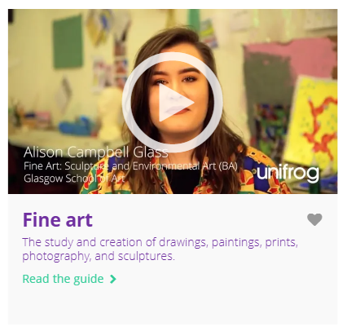
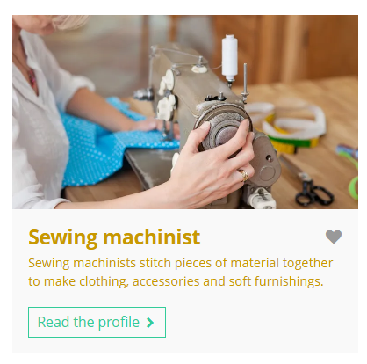
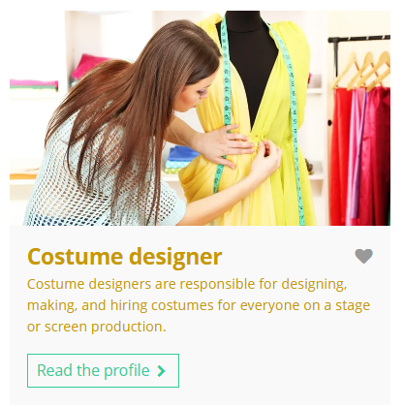
Fascinated by this field? Find out more on Unifrog!
Explore the textiles and fashion subject profile.
Explore related subject profiles, like fine art.
Explore related career profiles, like sewing machinist and costume designer.
Remember to click the heart symbol to add a profile to your Favourites!
Notes:
Teacher’s notes:
This slide contains career and subject profiles that are relevant to the subject of the month.
If you have additional time available and students have computer access, you can direct them to these resources.
Remember to log into the student side of your Unifrog account to access these links and remind students to favourite any careers or subjects they like the look of.
You can track student progress with favouriting careers or subjects by clicking Advanced>Sort by>Library profiles in Favourites.

Slide 75
Career of the month
Year 13 – November
Notes:
Teacher’s notes:
November’s career of the month for year 13 is: Tax adviser.

Slide 76

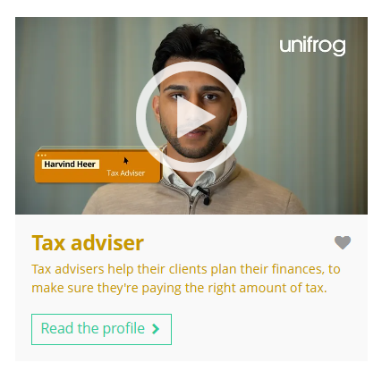

November’s career of the month is…
Tax adviser
Note down at least one thing you think you know about this career.
Notes:
Teacher’s notes:
Click to reveal the career of the month: Tax adviser.
Before you’re ready to watch the Careers library video as a class, ask students to note down anything they think they already know about this career.

Slide 77
November’s career of the month is… Tax adviser
Today we'll be hearing from Harvind, who’s a tax adviser.
Whilst you’re watching, think about why people and companies have to pay tax.
Notes:
Teacher’s notes:
Make sure you’re logged into your Unifrog account and click ‘use the platform as a student’. Click the image on the screen to go to the Careers library profile, then click the play button on the video. Alternatively, copy this URL into an internet browser: unifrog.org/student/careers/direct/tax-adviser
Please note, there are two videos available on this subject profile: Harvind and Iona.
If you have more time available, you could read the career profile text as a class too.

Slide 78
November’s career of the month is… Tax adviser
What impact does Harvind’s career have on society? How important is it for you to choose a career that contributes positively to society?
Which of your strengths do you think would help you the most in this career?
How do your current studies (e.g. A levels or equivalent) relate to this career?
What are the next steps you'd need to take to pursue this career after finishing school/college?
Notes:
Teacher’s notes:
This slide contains reflection questions about the career of the month. You could ask students to write down their answers, discuss in pairs or small groups, or discuss as a whole class.
The aim of this activity is for students to think about their own preferences, experiences, and skills and how these could relate to the career. Students are encouraged to draw links between skills used in their current school subjects and the career in the video. If students would like to know more about the career, encourage them to read the full career profile, which contains the following sections:
What you’ll do
Working hours and environment
Career path and progression
Skills required
Entry requirements
Related know-how guides
Related university subject profiles
Related career profiles
Explore
Labour Market Information (LMI)
People also liked…
Example answers:
Harvind’s career helps society by making sure people and businesses pay the right amount of tax, which supports public services. It’s important for me to choose a career that contributes positively to society because I want to make a difference.
My strengths in problem solving and attention to detail would help me the most in this career, as tax advisers need to analyse financial information carefully.
My current studies in subjects like mathematics and business relate to this career because they provide essential skills for understanding finances and tax laws.
The next steps to pursue this career after finishing school would be to study accounting or finance at university, then consider gaining relevant work experience and professional qualifications in tax advisory.

Slide 79
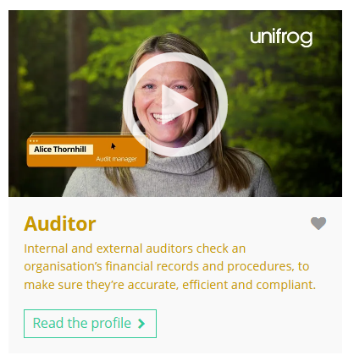
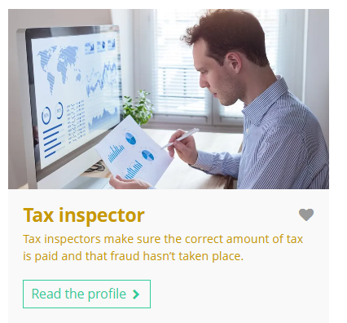
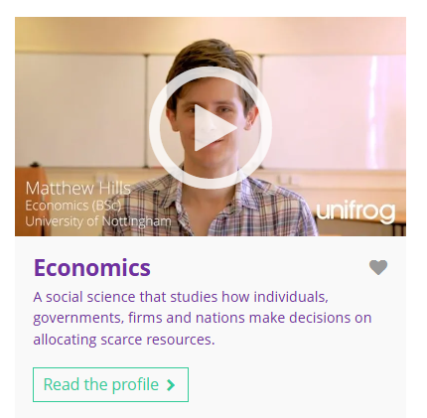
Curious about this career? Discover more on Unifrog!
Explore the tax adviser career profile and watch Iona’s interview.
Explore related career profiles, like auditor and tax inspector.
Explore related subject profiles, like economics.
Remember to click the heart symbol to add a profile to your Favourites!
Notes:
Teacher’s notes:
This slide contains career and subject profiles that are relevant to the career of the month.
If you have additional time available and students have computer access, you can direct them to these resources.
Remember to log into the student side of your Unifrog account to access these links and remind students to favourite any careers or subjects they like the look of.
You can track student progress with favouriting careers or subjects by clicking Advanced>Sort by>Library profiles in Favourites.

Slide 81
Subject of the month
Year 13 – November
Notes:
Teacher’s notes:
November’s subject of the month for year 13 is: Agriculture.

Slide 82

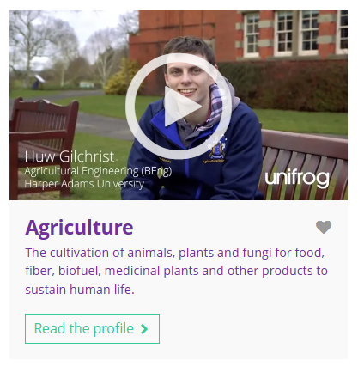
November’s subject of the month is…
Agriculture
Note down at least one thing you think you know about this subject.
Notes:
Teacher’s notes:
Click to reveal the subject of the month: Agriculture.
Before you’re ready to watch the Subjects library video as a class, ask students to note down anything they think they already know about this subject.

Slide 83
November’s subject of the month is… Agriculture
There are lots of degrees that fall under the category of agriculture. Today we'll be hearing from Huw, who’s an agricultural engineering student.
Whilst you’re watching, think about how modern technology can be used in agriculture.
Notes:
Teacher’s notes:
Make sure you’re logged into your Unifrog account and click ‘use the platform as a student’. Click the image on the screen to go to the Subjects library profile, then click the play button on the video. Alternatively, copy this URL into an internet browser: unifrog.org/student/subjects/direct/agriculture
If you have more time available, you could read the subject profile text as a class too.

Slide 84
November’s subject of the month is… Agriculture
Where could studying this subject take you in the future?
If you could ask Huw anything about this subject, what question would you ask him?
What skills or knowledge from your school/college subjects are most relevant to this subject?
What challenges did Huw mention about the degree? How do these challenges affect your interest in pursuing this subject?
Notes:
Teacher’s notes:
This slide contains reflection questions about the subject of the month. You could ask students to write down their answers, discuss in pairs or small groups, or discuss as a whole class.
The aim of this activity is for students to think about their own preferences, experiences, and skills and how these could relate to the subject. Students are encouraged to draw links between skills used in their current school subjects and the subject in the video. If students would like to know more about the subject, encourage them to read the full subject profile, which contains the following sections:
In a nutshell
Getting in
Prospects
Statement
Reference
Geek out
Recommendations: Read
Recommendations: Watch
Recommendations: Listen
Explore
People also liked…
Example answers:
Studying agriculture could take me to careers in farming, agricultural engineering, food production, environmental management, or research in sustainable practices.
I would ask Huw, "How do you see technology changing the future of agriculture?"
The skills or knowledge from my school subjects that are most relevant include biology for understanding plant and animal science, geography for learning about land use, and chemistry for studying soil and nutrients.
Huw mentioned challenges like using maths and applying the maths to everything. These challenges make me more/less interested in this subject because…

Slide 85
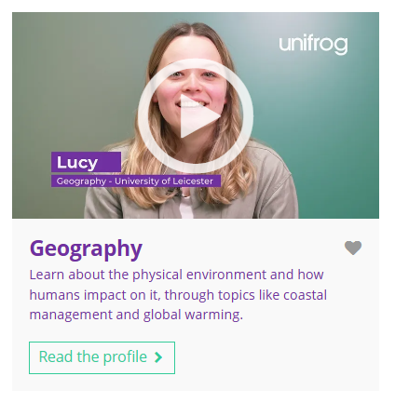


Fascinated by this field? Find out more on Unifrog!
Explore the agriculture subject profile.
Explore related subject profiles, like geography.
Explore related career profiles, like farmer and rural surveyor.
Remember to click the heart symbol to add a profile to your Favourites!
Notes:
Teacher’s notes:
This slide contains career and subject profiles that are relevant to the subject of the month.
If you have additional time available and students have computer access, you can direct them to these resources.
Remember to log into the student side of your Unifrog account to access these links and remind students to favourite any careers or subjects they like the look of.
You can track student progress with favouriting careers or subjects by clicking Advanced>Sort by>Library profiles in Favourites.

