Slide 1
Teacher’s slide: Gatsby Benchmarks
To support you in meeting the Gatsby Benchmarks, we suggest dedicating one day per month to a ‘career of the month' and one day to a ‘subject of the month' for each year group. This can be done during registration or form time, in a 15-minute session. Students will watch a video from the Unifrog platform and answer questions, either through group discussion or written responses.
Delivering these sessions can support the Gatsby Benchmarks as follows:
1. A stable careers programme | 2. Learning from career and labour market information
Regular timetabled sessions to discuss careers and subjects can form part of your stable careers programme. During these sessions you could also make links and remind students of what’s happening in your wider careers programme. | Watching the videos can help students to understand the skills, qualifications, and challenges related to specific jobs. You can support this by exploring the career or subject profile together, including linking to labour market information (LMI) contained in the profiles.
3. Addressing the needs of each pupil | 4. Linking curriculum learning to careers
The questions promote tailored personal reflection. Students could record and upload their reflections to their Unifrog Locker. A range of careers and subjects are used to help students raise aspirations and challenge stereotypes. | The questions help students to reflect on how school subjects connect to real-world careers, helping them see the relevance of their studies to future job opportunities.
5. Encounters with employers and employees | 6. Experiences of workplaces
While these videos don't replace in-person encounters with employers, they provide insights into work environments and cultures, offering students a realistic view of different career paths. | While these videos don't replace in-person work experience, they can broaden students' awareness of different workplaces and help them identify areas they'd like to explore further.
7. Encounters with further and higher education | 8. Personal guidance
While these videos don't replace in-person encounters with further and higher education, they can help students understand the educational pathways needed for various subjects and careers, helping them understand their options for further study or training. | Students can draw on their discussions and reflections of a variety of careers and subjects in their personal guidance 1:1s.
Notes:
Teacher’s notes:
To further support these benchmarks, you could arrange a talk from a former student, FE/HE institution, or employer about a subject/career featured each month.

Slide 2















January
Click a box to go straight to the relevant slides
Year 7 Career of the month
Year 8 Career of the month
Year 9 Career of the month
Year 10 Career of the month
Year 11 Career of the month
Year 12 Career of the month
Year 13 Career of the month
Year 7 Subject of the month
Year 8 Subject of the month
Year 9 Subject of the month
Year 10 Subject of the month
Year 11 Subject of the month
Year 12 Subject of the month
Year 13 Subject of the month
Notes:
Teacher’s notes:
There are separate PowerPoints available for each month of the academic year within the resource profile ‘Career and subject of the month’.
Click the hyperlinked text boxes on this slide to be taken to the slides for the year group selected.

Slide 3

Career of the month
Year 7 – January
Notes:
Teacher’s notes:
January’s career of the month for year 7 is: Chemical technician.

Slide 4

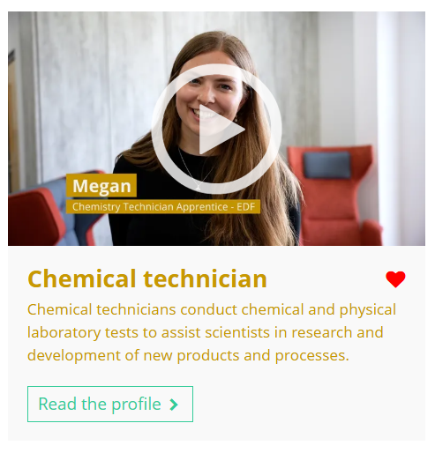


January’s career of the month is…
Chemical technician
Note down at least one thing you think you know about this career.
Notes:
Teacher’s notes:
Click to reveal the career of the month: Chemical technician.
Before you’re ready to watch the Careers library video as a class, ask students to note down anything they think they already know about this career.

Slide 5

January’s career of the month is… Chemical technician
There are lots of roles that fall under the category of chemical technician. Today we'll be hearing from Megan, who’s a chemistry technician apprentice at EDF.
Whilst you’re watching, think about the types of experiments a chemical technician might carry out.
Notes:
Teacher’s notes:
Make sure you’re logged into your Unifrog account and click ‘use the platform as a student’. Click the image on the screen to go to the Careers library profile, then click the play button on the video. Alternatively, copy this URL into an internet browser: unifrog.org/student/careers/direct/chemical-technician
If you have more time available, you could read the career profile text as a class too.

Slide 6
January’s career of the month is… Chemical technician
What skills are important for a chemical technician, and how do you use them in your life?
Which task would you find most exciting as a chemical technician, and why?
When might teamwork be really important for a chemical technician?
What hobbies or interests could help you build skills for becoming a chemical technician?
Notes:
Teacher’s notes:
This slide contains reflection questions about the career of the month. You could ask students to write down their answers, discuss in pairs or small groups, or discuss as a whole class.
The aim of this activity is for students to think about their own preferences, experiences, and skills and how these could relate to the career. Students are encouraged to draw links between skills used in their current school subjects and the career in the video. If students would like to know more about the career, encourage them to read the full career profile, which contains the following sections:
What you’ll do
Working hours and environment
Career path and progression
Skills required
Entry requirements
Related know-how guides
Related university subject profiles
Related career profiles
Explore
Labour Market Information (LMI)
People also liked…
Example answers:
Problem solving is important because they need to fix issues during experiments. I practise it when solving tricky maths problems. Organisation is also key, like when I plan my homework.
I’d enjoy designing experiments because it sounds creative and fun to test new ideas.
Teamwork is important in labs, like when testing materials, so everyone’s part is done right, just like a group project.
I like doing science experiments and building Lego sets because they help me practise testing ideas and following instructions.

Slide 7

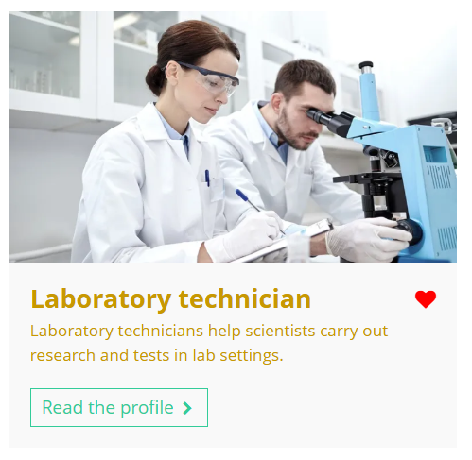


Curious about this career? Discover more on Unifrog!
Explore the chemical technician career profile.
Explore related career profiles, like chemical engineer and laboratory technician.
Explore related subject profiles, like chemical engineering.
Remember to click the heart symbol to add a profile to your Favourites!
Notes:
Teacher’s notes:
This slide contains career and subject profiles that are relevant to the career of the month.
If you have additional time available and students have computer access, you can direct them to these resources.
Remember to log into the student side of your Unifrog account to access these links and remind students to favourite any careers or subjects they like the look of.
You can track student progress with favouriting careers or subjects by clicking Advanced>Sort by>Library profiles in Favourites.

Slide 8
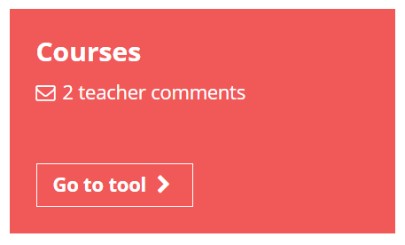

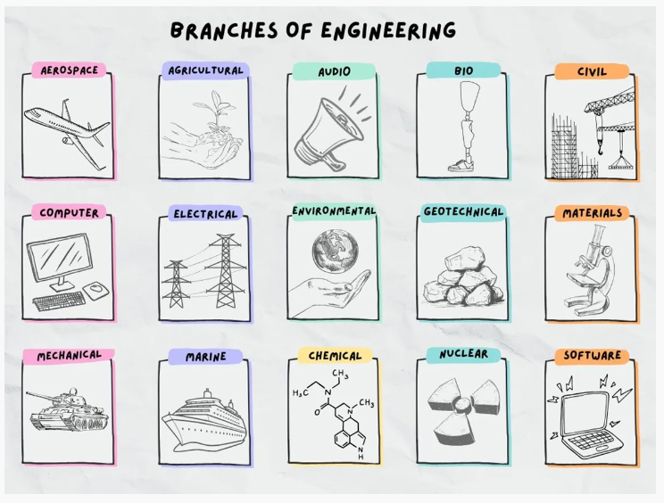

Further exploration
Visit the Courses tool to join courses relating to the career of the month:
Building a brighter future: the world of engineering.
Notes:
Teacher’s notes:
This slide contains a Unifrog course that’s relevant to the career of the month.
If you have additional time available and students have computer access, you can direct them to the Courses tool.
Remember to log into the student side of your Unifrog account to access these links and remind students to join any courses they like the look of.
You can track student progress with courses by clicking Advanced>Sort by>Courses.

Slide 9


Slide 10
Subject of the month
Year 7 – January
Notes:
Teacher’s notes:
January’s subject of the month for year 7 is: Japanese studies.

Slide 11



January’s subject of the month is…
Japanese studies
Note down at least one thing you think you know about this subject.
Notes:
Teacher’s notes:
Click to reveal the subject of the month: Japanese studies.
Before you’re ready to watch the Subjects library video as a class, ask students to note down anything they think they already know about this subject.

Slide 12
January’s subject of the month is… Japanese studies
There are lots of subjects that fall under the category of Japanese studies. Today we’ll be hearing from Maria, who’s a Japanese student.
Whilst you’re watching, think about the different challenges Maria faces in her Japanese course.
Notes:
Teacher’s notes:
Make sure you’re logged into your Unifrog account and click ‘use the platform as a student’. Click the image on the screen to go to the Subjects library profile, then click the play button on the video. Alternatively, copy this URL into an internet browser: unifrog.org/student/subjects/direct/japanese-studies
If you have more time available, you could read the subject profile text as a class too.

Slide 13
January’s subject of the month is… Japanese studies
Maria studies Japanese language, literature, history, and politics. Which of these areas interests you the most, and why?
What skills would be helpful for succeeding in a Japanese course?
What advice does Maria give for managing the challenges of studying Japanese?
What extracurricular activities could you do to prepare to study Japanese?
Notes:
Teacher’s notes:
This slide contains reflection questions about the subject of the month. You could ask students to write down their answers, discuss in pairs or small groups, or discuss as a whole class.
The aim of this activity is for students to think about their own preferences, experiences, and skills and how these could relate to the subject. Students are encouraged to draw links between skills used in their current school subjects and the subject in the video. If students would like to know more about the subject, encourage them to read the full subject profile, which contains the following sections:
In a nutshell
Getting in
Prospects
Statement
Reference
Geek out
Recommendations: Read
Recommendations: Watch
Recommendations: Listen
Explore
People also liked…
Example answers:
I find Japanese language the most interesting because I like learning new languages and figuring out how words sound and look.
You’d need good memory to remember Kanji and be organised to keep up with all the lessons and homework.
Maria says it’s important to manage your time well and practice regularly to get better at Kanji.
Joining a language club or watching Japanese movies could help improve my understanding and listening skills.

Slide 14
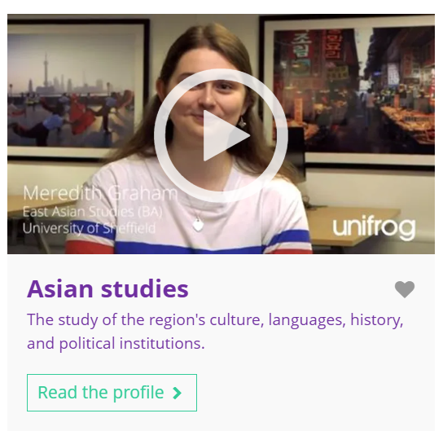
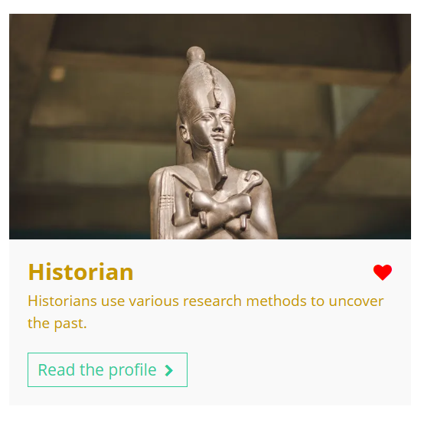

Fascinated by this field? Find out more on Unifrog!
Explore the Japanese studies subject profile.
Explore related subject profiles, like Asian studies.
Explore related career profiles, like historian and bilingual secretary.
Remember to click the heart symbol to add a profile to your Favourites!
Notes:
Teacher’s notes:
This slide contains career and subject profiles that are relevant to the subject of the month.
If you have additional time available and students have computer access, you can direct them to these resources.
Remember to log into the student side of your Unifrog account to access these links and remind students to favourite any careers or subjects they like the look of.
You can track student progress with favouriting careers or subjects by clicking Advanced>Sort by>Library profiles in Favourites.

Slide 16
Career of the month
Year 8 – January
Notes:
Teacher’s notes:
January’s career of the month for year 8 is: Biotechnologist.

Slide 17

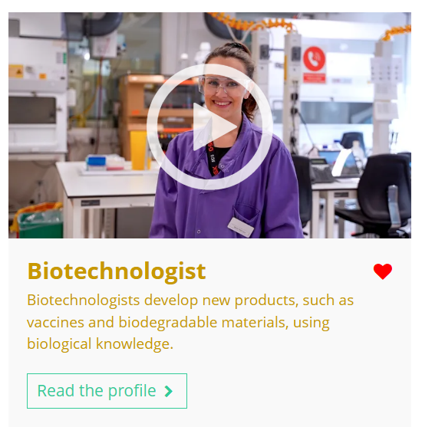

January’s career of the month is…
Biotechnologist
Note down at least one thing you think you know about this career.
Notes:
Teacher’s notes:
Click to reveal the career of the month: Biotechnologist.
Before you’re ready to watch the Careers library video as a class, ask students to note down anything they think they already know about this career.

Slide 18
January’s subject of the month is… Biotechnologist
There are lots of roles that fall under the category of biotechnologist. Today we'll be hearing from Molly, who’s a scientist at GSK.
Whilst you’re watching, think about the tasks a biotechnologist does in the lab and how they solve problems with teams.
Notes:
Teacher’s notes:
Make sure you’re logged into your Unifrog account and click ‘use the platform as a student’. Click the image on the screen to go to the Careers library profile, then click the play button on the video. Alternatively, copy this URL into an internet browser: unifrog.org/student/careers/direct/biotechnologist
If you have more time available, you could read the career profile text as a class too.

Slide 19
January’s subject of the month is… Biotechnologist
Molly works in medical biotechnology. Which area of biotechnology would you find most interesting: environmental, industrial, or medical? Why?
What skills would be helpful for a career as a biotechnologist?
How does Molly’s job require creativity and problem solving?
What are some ways Molly’s work might make a difference in medicine?
Notes:
Teacher’s notes:
This slide contains reflection questions about the career of the month. You could ask students to write down their answers, discuss in pairs or small groups, or discuss as a whole class.
The aim of this activity is for students to think about their own preferences, experiences, and skills and how these could relate to the career. Students are encouraged to draw links between skills used in their current school subjects and the career in the video. If students would like to know more about the career, encourage them to read the full career profile, which contains the following sections:
What you’ll do
Working hours and environment
Career path and progression
Skills required
Entry requirements
Related know-how guides
Related university subject profiles
Related career profiles
Explore
Labour Market Information (LMI)
People also liked…
Example answers:
I find medical biotechnology most interesting because I like the idea of helping people by finding new treatments and cures for diseases.
You’d need attention to detail, problem-solving skills, creativity, and the ability to work well with others to handle complex tasks, solve issues, and collaborate effectively in the lab.
Molly’s job needs creativity to try new methods and problem solving to fix issues that come up in the lab.
Molly’s work can help develop new medicines and treatments that could save lives and improve health.

Slide 20
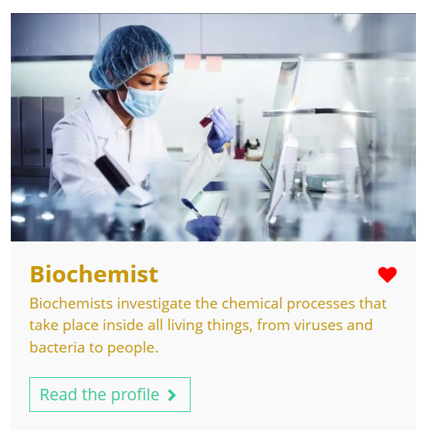


Curious about this career? Discover more on Unifrog!
Explore the biotechnologist career profile.
Explore related career profiles, like biochemist and biologist.
Explore related subject profiles, like biomedical engineering and biotechnology.
Remember to click the heart symbol to add a profile to your Favourites!
Notes:
Teacher’s notes:
This slide contains career and subject profiles that are relevant to the career of the month.
If you have additional time available and students have computer access, you can direct them to these resources.
Remember to log into the student side of your Unifrog account to access these links and remind students to favourite any careers or subjects they like the look of.
You can track student progress with favouriting careers or subjects by clicking Advanced>Sort by>Library profiles in Favourites.

Slide 21
Further exploration
Visit the Courses tool to join courses relating to the career of the month:
Building a brighter future: the world of engineering.
Notes:
Teacher’s notes:
This slide contains a Unifrog course that’s relevant to the career of the month.
If you have additional time available and students have computer access, you can direct them to the Courses tool.
Remember to log into the student side of your Unifrog account to access these links and remind students to join any courses they like the look of.
You can track student progress with courses by clicking Advanced>Sort by>Courses.

Slide 23
Subject of the month
Year 8 – January
Notes:
Teacher’s notes:
January’s subject of the month for year 8 is: Business and management.

Slide 24

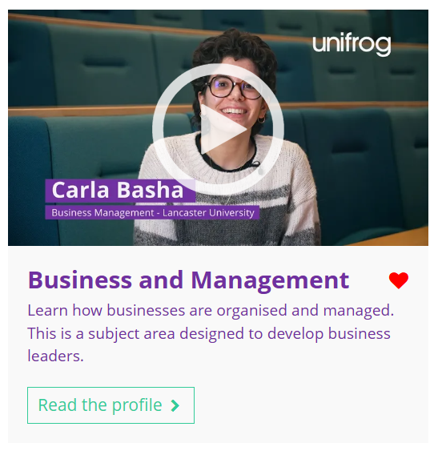

January’s subject of the month is…
Business and management
Note down at least one thing you think you know about this subject.
Notes:
Teacher’s notes:
Click to reveal the subject of the month: Business and management.
Before you’re ready to watch the Subjects library video as a class, ask students to note down anything they think they already know about this subject.

Slide 25
January’s subject of the month is… Business and management
Today we'll be hearing from Carla, who’s studying business management.
Whilst you’re watching, think about the different roles in business and how they work together to solve problems.
Notes:
Teacher’s notes:
Make sure you’re logged into your Unifrog account and click ‘use the platform as a student’. Click the image on the screen to go to the Subjects library profile, then click the play button on the video. Alternatively, copy this URL into an internet browser: unifrog.org/student/subjects/direct/business-and-management
If you have more time available, you could read the subject profile text as a class too.

Slide 26
January’s subject of the month is… Business and management
What skills do you think are important for studying business and management?
How can understanding business help you in everyday life?
What are some challenges businesses face, and how can managers solve them?
How do you think business and management can affect the economy?
Notes:
Teacher’s notes:
This slide contains reflection questions about the subject of the month. You could ask students to write down their answers, discuss in pairs or small groups, or discuss as a whole class.
The aim of this activity is for students to think about their own preferences, experiences, and skills and how these could relate to the subject. Students are encouraged to draw links between skills used in their current school subjects and the subject in the video. If students would like to know more about the subject, encourage them to read the full subject profile, which contains the following sections:
In a nutshell
Getting in
Prospects
Statement
Reference
Geek out
Recommendations: Read
Recommendations: Watch
Recommendations: Listen
Explore
People also liked…
Example answers:
You need communication, organisation, and problem-solving skills because they help you work well with others, manage tasks, and find solutions to challenges.
Understanding business helps you make smarter decisions when shopping, saving money, or planning your future.
Businesses face problems like poor sales or unhappy customers, and managers solve them by making plans, changing strategies, or improving customer service.
Business and management can create jobs, improve products, and help the economy grow.

Slide 27
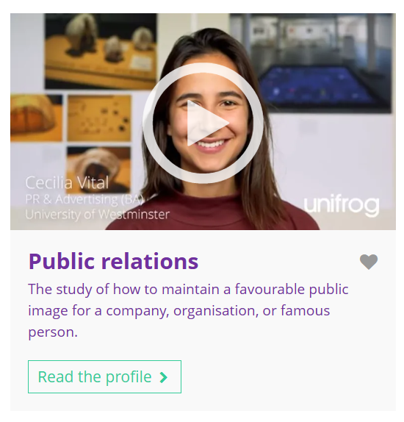

Fascinated by this field? Find out more on Unifrog!
Explore the business and management subject profile.
Explore related subject profiles, like public relations.
Explore related career profiles, like business development manager and business analyst.
Remember to click the heart symbol to add a profile to your Favourites!
Notes:
Teacher’s notes:
This slide contains career and subject profiles that are relevant to the subject of the month.
If you have additional time available and students have computer access, you can direct them to these resources.
Remember to log into the student side of your Unifrog account to access these links and remind students to favourite any careers or subjects they like the look of.
You can track student progress with favouriting careers or subjects by clicking Advanced>Sort by>Library profiles in Favourites.

Slide 29
Career of the month
Year 9 – January
Notes:
Teacher’s notes:
January’s career of the month for year 9 is: Ecologist.

Slide 30

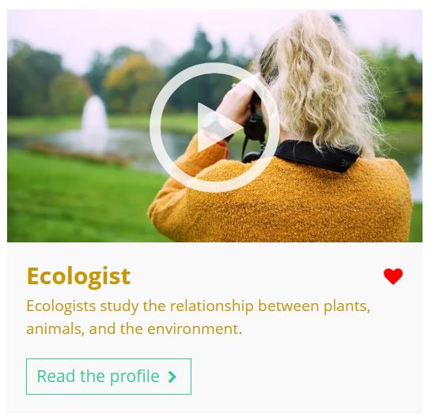

January’s career of the month is…
Ecologist
Note down at least one thing you think you know about this career.
Notes:
Teacher’s notes:
Click to reveal the career of the month: Ecologist.
Before you’re ready to watch the Careers library video as a class, ask students to note down anything they think they already know about this career.

Slide 31
January’s career of the month is… Ecologist
Today we'll be hearing from Gemma, who’s a senior ecologist for the RHS (Royal Horticultural Society).
Whilst you’re watching, think about how ecologists can balance protecting wildlife as humanity develops.
Notes:
Teacher’s notes:
Make sure you’re logged into your Unifrog account and click ‘use the platform as a student’. Click the image on the screen to go to the Careers library profile, then click the play button on the video. Alternatively, copy this URL into an internet browser: unifrog.org/student/careers/direct/ecologist
If you have more time available, you could read the career profile text as a class too.

Slide 32
January’s career of the month is… Ecologist
What school subjects or skills might help you prepare for a career as an ecologist?
What steps could you take now to explore a career in ecology?
Which part of an ecologist's job do you think would be the most interesting, and why?
What might be challenging about working as an ecologist, and how could you prepare for it?
Notes:
Teacher’s notes:
This slide contains reflection questions about the career of the month. You could ask students to write down their answers, discuss in pairs or small groups, or discuss as a whole class.
The aim of this activity is for students to think about their own preferences, experiences, and skills and how these could relate to the career. Students are encouraged to draw links between skills used in their current school subjects and the career in the video. If students would like to know more about the career, encourage them to read the full career profile, which contains the following sections:
What you’ll do
Working hours and environment
Career path and progression
Skills required
Entry requirements
Related know-how guides
Related university subject profiles
Related career profiles
Explore
Labour Market Information (LMI)
People also liked…
Example answers:
Biology, geography, and data analysis skills could be helpful for studying ecosystems and interpreting research.
I could volunteer with conservation groups, join local wildlife surveys, or visit nature reserves to observe biodiversity.
Carrying out fieldwork to study specific animals or plants seems exciting because it involves working directly with nature.
Long hours outdoors in varying weather could be tough, so building resilience and gaining practical experience could help.

Slide 33
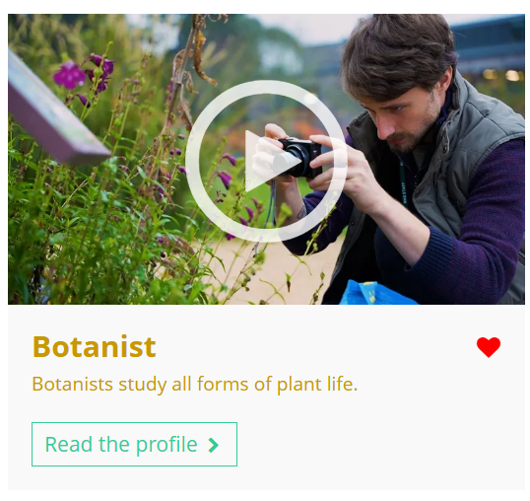
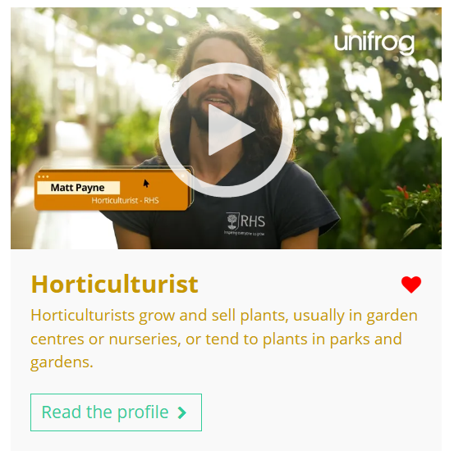
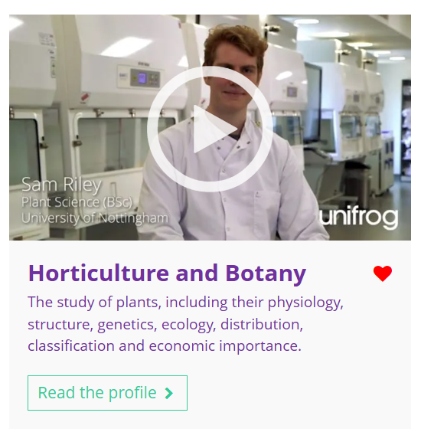
Curious about this career? Discover more on Unifrog!
Explore the ecologist career profile.
Explore related career profiles, like botanist and horticulturist.
Explore related subject profiles, like horticulture and botany.
Remember to click the heart symbol to add a profile to your Favourites!
Notes:
Teacher’s notes:
This slide contains career and subject profiles that are relevant to the career of the month.
If you have additional time available and students have computer access, you can direct them to these resources.
Remember to log into the student side of your Unifrog account to access these links and remind students to favourite any careers or subjects they like the look of.
You can track student progress with favouriting careers or subjects by clicking Advanced>Sort by>Library profiles in Favourites.

Slide 35
Subject of the month
Year 9 – January
Notes:
Teacher’s notes:
January’s subject of the month for year 9 is: North and South American studies.

Slide 36



January’s subject of the month is…
North and South American studies
Note down at least one thing you think you know about this subject.
Notes:
Teacher’s notes:
Click to reveal the subject of the month: North and South American studies.
Before you’re ready to watch the Subjects library video as a class, ask students to note down anything they think they already know about this subject.

Slide 37
January’s subject of the month is… North and South American studies
There are lots of subjects that fall under the category of North and South American studies. Today we'll be hearing from Aodhbha, who’s an American and Canadian studies student.
Whilst you’re watching, think about the different careers linked to this subject.
Notes:
Teacher’s notes:
Make sure you’re logged into your Unifrog account and click ‘use the platform as a student’. Click the image on the screen to go to the Subjects library profile, then click the play button on the video. Alternatively, copy this URL into an internet browser: unifrog.org/student/subjects/direct/north-and-south-american-studies
If you have more time available, you could read the subject profile text as a class too.

Slide 38
January’s subject of the month is… North and South American studies
What other subjects might you need to study this subject?
Has anything in this video surprised you?
What have you learned in school that could be useful for this degree?
What are some steps you could take now to explore this subject more?
Notes:
Teacher’s notes:
This slide contains reflection questions about the subject of the month. You could ask students to write down their answers, discuss in pairs or small groups, or discuss as a whole class.
The aim of this activity is for students to think about their own preferences, experiences, and skills and how these could relate to the subject. Students are encouraged to draw links between skills used in their current school subjects and the subject in the video. If students would like to know more about the subject, encourage them to read the full subject profile, which contains the following sections:
In a nutshell
Getting in
Prospects
Statement
Reference
Geek out
Recommendations: Read
Recommendations: Watch
Recommendations: Listen
Explore
People also liked…
Example answers:
History, geography, politics, and languages like Spanish or Portuguese might be useful.
I was surprised to learn that part of the year abroad for this course (at Nottingham University) is to spend time in Berlin!
Learning about colonial history and global trade in history class could help understand the region's development.
I could read books or articles about American cultures, watch documentaries, or follow current events in the Americas.

Slide 39

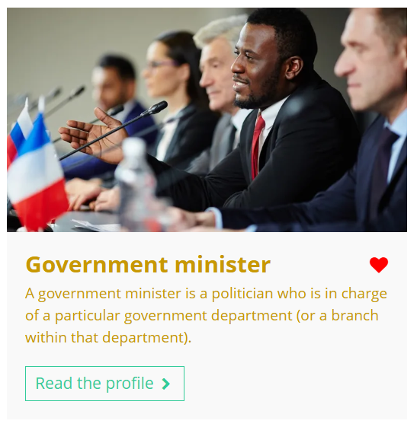
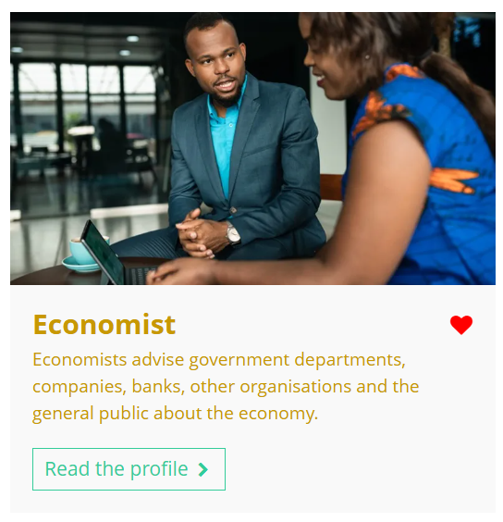
Fascinated by this field? Find out more on Unifrog!
Explore the North and South American studies subject profile.
Explore related subject profiles, like journalism.
Explore related career profiles, like government minister and economist.
Remember to click the heart symbol to add a profile to your Favourites!
Notes:
Teacher’s notes:
This slide contains career and subject profiles that are relevant to the subject of the month.
If you have additional time available and students have computer access, you can direct them to these resources.
Remember to log into the student side of your Unifrog account to access these links and remind students to favourite any careers or subjects they like the look of.
You can track student progress with favouriting careers or subjects by clicking Advanced>Sort by>Library profiles in Favourites.

Slide 41
Career of the month
Year 10 – January
Notes:
Teacher’s notes:
January’s career of the month for year 10 is: Armed forces personnel.

Slide 42

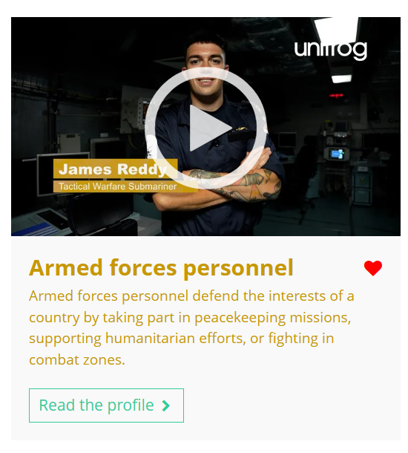

January’s career of the month is…
Armed forces personnel
Note down at least one thing you think you know about this career.
Notes:
Teacher’s notes:
Click to reveal the career of the month: Armed forces personnel.
Before you’re ready to watch the Careers library video as a class, ask students to note down anything they think they already know about this career.

Slide 43
January’s career of the month is… Armed forces personnel
There are several roles that fall under the category of armed forces personnel. Today we'll be hearing from James, who’s a tactical warfare submariner.
Whilst you’re watching, think about how the armed forces require teamwork, adaptability, and problem-solving skills.
Notes:
Teacher’s notes:
Make sure you’re logged into your Unifrog account and click ‘use the platform as a student’. Click the image on the screen to go to the Careers library profile, then click the play button on the video. Alternatively, copy this URL into an internet browser: unifrog.org/student/careers/direct/soldier
If you have more time available, you could read the career profile text as a class too.

Slide 44
January’s career of the month is… Armed forces personnel
What about James’ role interests you most?
What might be challenging about a career on a submarine?
What skills are important for armed forces personnel?
What can you do now to explore a career in the armed forces?
Notes:
Teacher’s notes:
This slide contains reflection questions about the career of the month. You could ask students to write down their answers, discuss in pairs or small groups, or discuss as a whole class.
The aim of this activity is for students to think about their own preferences, experiences, and skills and how these could relate to the career. Students are encouraged to draw links between skills used in their current school subjects and the career in the video. If students would like to know more about the career, encourage them to read the full career profile, which contains the following sections:
What you’ll do
Working hours and environment
Career path and progression
Skills required
Entry requirements
Related know-how guides
Related university subject profiles
Related career profiles
Explore
Labour Market Information (LMI)
People also liked…
Example answers:
His focus on teamwork and solving real-world problems as part of a larger mission is inspiring.
Spending long periods in confined spaces away from family could be tough.
Adaptability, problem solving, teamwork, and clear communication are key.
Joining cadet groups like Sea Cadets or Air Cadets is a great way to get started. I could also complete the British Army course on Unifrog!

Slide 45
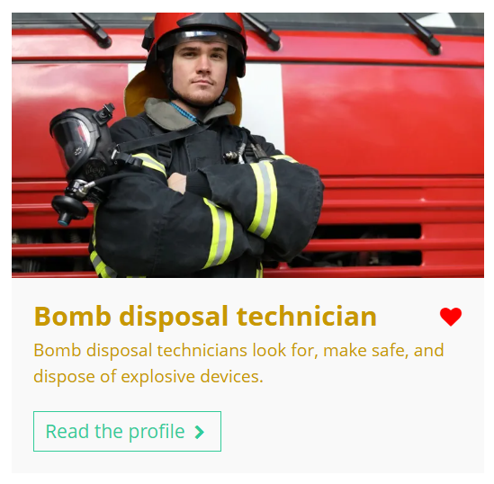
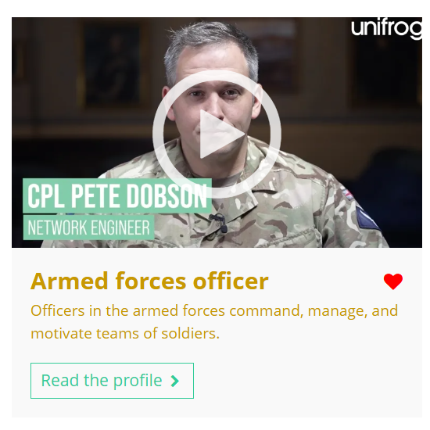

Curious about this career? Discover more on Unifrog!
Explore the armed forces personnel career profile.
Explore related career profiles, like bomb disposal technician and armed forces officer.
Explore related subject profiles, like sports science.
Remember to click the heart symbol to add a profile to your Favourites!
Notes:
Teacher’s notes:
This slide contains career and subject profiles that are relevant to the career of the month.
If you have additional time available and students have computer access, you can direct them to these resources.
Remember to log into the student side of your Unifrog account to access these links and remind students to favourite any careers or subjects they like the look of.
You can track student progress with favouriting careers or subjects by clicking Advanced>Sort by>Library profiles in Favourites.

Slide 46
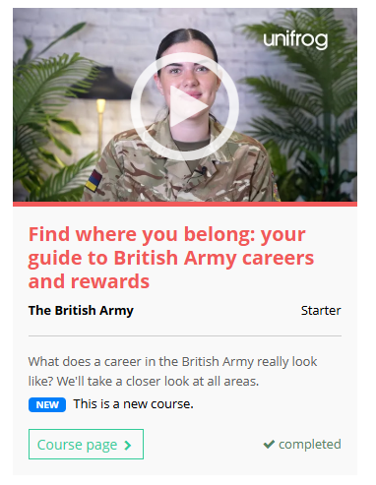
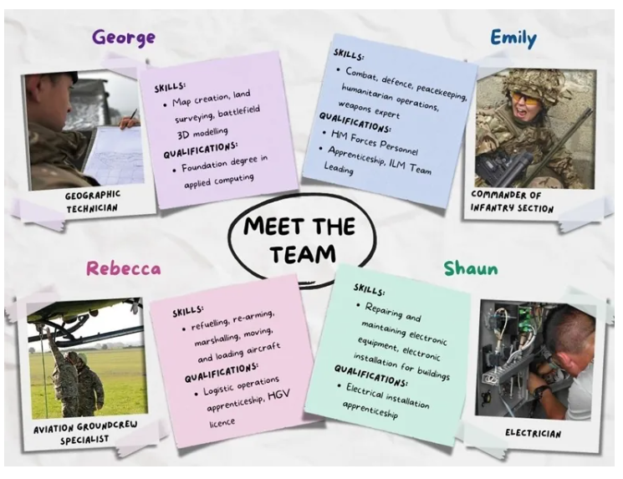
Further exploration
Visit the Courses tool to join courses relating to the career of the month:
Find where you belong: your guide to British Army careers and rewards
Notes:
Teacher’s notes:
This slide contains a Unifrog course that’s relevant to the career of the month.
If you have additional time available and students have computer access, you can direct them to the Courses tool.
Remember to log into the student side of your Unifrog account to access these links and remind students to join any courses they like the look of.
You can track student progress with courses by clicking Advanced>Sort by>Courses.

Slide 48
Subject of the month
Year 10 – January
Notes:
Teacher’s notes:
January’s subject of the month for year 10 is: Chinese studies.

Slide 49

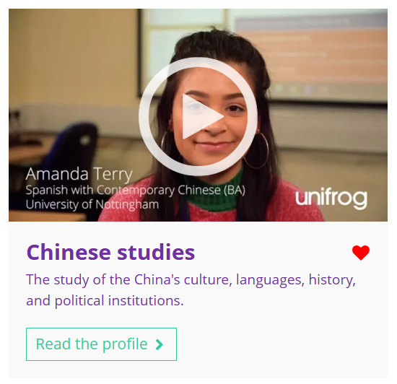

January’s subject of the month is…
Chinese studies
Note down at least one thing you think you know about this subject.
Notes:
Teacher’s notes:
Click to reveal the subject of the month: Chinese studies.
Before you’re ready to watch the Subjects library video as a class, ask students to note down anything they think they already know about this subject.

Slide 50
January’s subject of the month is… Chinese studies
There are lots of degrees that fall under the category of Chinese studies. Today we'll be hearing from Amanda, who’s studying Spanish with Contemporary Chinese.
Whilst you’re watching, think about the differences between Chinese and English.
Notes:
Teacher’s notes:
Make sure you’re logged into your Unifrog account and click ‘use the platform as a student’. Click the image on the screen to go to the Subjects library profile, then click the play button on the video. Alternatively, copy this URL into an internet browser: unifrog.org/student/subjects/direct/chinese-studies
If you have more time available, you could read the subject profile text as a class too.

Slide 51
January’s subject of the month is… Chinese studies
What sorts of careers could this subject lead to?
Why is being open-minded important when studying this subject?
Which GCSE (or equivalent) subjects could help someone to prepare for this degree?
What else would you like to know about this subject? Where could you find this information?
Notes:
Teacher’s notes:
This slide contains reflection questions about the subject of the month. You could ask students to write down their answers, discuss in pairs or small groups, or discuss as a whole class.
The aim of this activity is for students to think about their own preferences, experiences, and skills and how these could relate to the subject. Students are encouraged to draw links between skills used in their current school subjects and the subject in the video. If students would like to know more about the subject, encourage them to read the full subject profile, which contains the following sections:
In a nutshell
Getting in
Prospects
Statement
Reference
Geek out
Recommendations: Read
Recommendations: Watch
Recommendations: Listen
Explore
People also liked…
Example answers:
Jobs like translator, diplomat, or international business manager could come from studying Chinese.
Being open-minded is important because it would help me understand and appreciate different cultures, ideas, and perspectives that come with studying the language and its speakers.
Subjects like Mandarin, history, or geography would be useful.
I would like to know about study opportunities and experiences in China. I could find this information within the Unifrog subject profile and by using the university search tools.

Slide 52

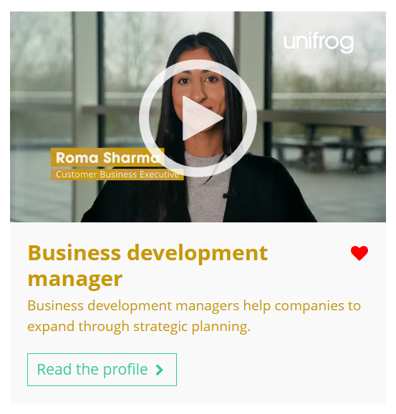

Fascinated by this field? Find out more on Unifrog!
Explore the Chinese studies subject profile.
Explore related subject profiles, like linguistics and translation.
Explore related career profiles, like business development manager and diplomat.
Remember to click the heart symbol to add a profile to your Favourites!
Notes:
Teacher’s notes:
This slide contains career and subject profiles that are relevant to the subject of the month.
If you have additional time available and students have computer access, you can direct them to these resources.
Remember to log into the student side of your Unifrog account to access these links and remind students to favourite any careers or subjects they like the look of.
You can track student progress with favouriting careers or subjects by clicking Advanced>Sort by>Library profiles in Favourites.

Slide 54
Career of the month
Year 11 – January
Notes:
Teacher’s notes:
January’s career of the month for year 11 is: Audiologist.

Slide 55

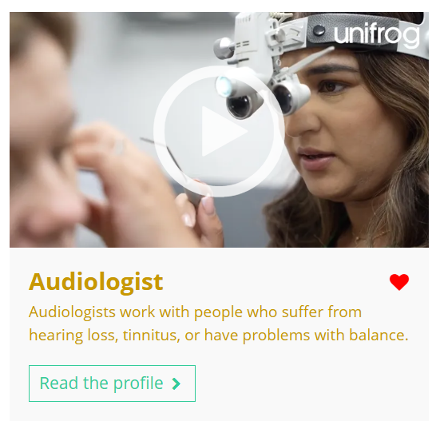

January’s career of the month is…
Audiologist
Note down at least one thing you think you know about this career.
Notes:
Teacher’s notes:
Click to reveal the career of the month: Audiologist.
Before you’re ready to watch the Careers library video as a class, ask students to note down anything they think they already know about this career.

Slide 56
January’s career of the month is… Audiologist
Today we'll be hearing from Sandeep, who’s an audiologist at Specsavers.
Whilst you’re watching, think about who you’d first contact if you were experiencing hearing difficulty.
Notes:
Teacher’s notes:
Make sure you’re logged into your Unifrog account and click ‘use the platform as a student’. Click the image on the screen to go to the Careers library profile, then click the play button on the video. Alternatively, copy this URL into an internet browser: unifrog.org/student/careers/direct/audiologist
If you have more time available, you could read the career profile text as a class too.

Slide 57
January’s career of the month is… Audiologist
How could working in a shop or café prepare you for this career?
Why do you think managing admin tasks might be a challenge for an audiologist?
How could subjects like science and maths give you the knowledge and skills needed to understand hearing loss and treatments?
Why is teamwork and clear communication important for audiologists when working with GPs and ENT specialists?
Notes:
Teacher’s notes:
This slide contains reflection questions about the career of the month. You could ask students to write down their answers, discuss in pairs or small groups, or discuss as a whole class.
The aim of this activity is for students to think about their own preferences, experiences, and skills and how these could relate to the career. Students are encouraged to draw links between skills used in their current school subjects and the career in the video. If students would like to know more about the career, encourage them to read the full career profile, which contains the following sections:
What you’ll do
Working hours and environment
Career path and progression
Skills required
Entry requirements
Related know-how guides
Related university subject profiles
Related career profiles
Explore
Labour Market Information (LMI)
People also liked…
Example answers:
Working in a shop or café could help you learn how to deal with different types of people, handle complaints, and provide good customer service, which are all important in this career.
Managing admin tasks might be a challenge because it takes time, requires attention to detail, and needs to be done alongside seeing patients.
Science could help you understand how the ear works and how to test for hearing loss, while maths could be useful for analysing results or measuring for hearing aids.
Teamwork and clear communication are important because audiologists need to share accurate information with other professionals to make sure patients get the right care.

Slide 58


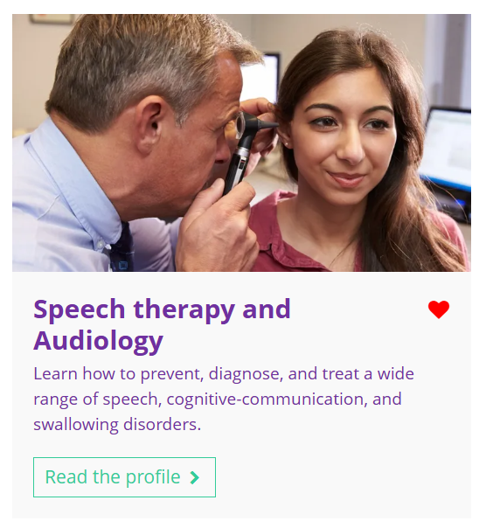
Curious about this career? Discover more on Unifrog!
Explore the audiologist career profile.
Explore related career profiles, like speech and language therapist and sign language support worker.
Explore related subject profiles, like speech therapy and audiology.
Remember to click the heart symbol to add a profile to your Favourites!
Notes:
Teacher’s notes:
This slide contains career and subject profiles that are relevant to the career of the month.
If you have additional time available and students have computer access, you can direct them to these resources.
Remember to log into the student side of your Unifrog account to access these links and remind students to favourite any careers or subjects they like the look of.
You can track student progress with favouriting careers or subjects by clicking Advanced>Sort by>Library profiles in Favourites.

Slide 60
Subject of the month
Year 11 – January
Notes:
Teacher’s notes:
January’s subject of the month for year 11 is: Criminology.

Slide 61



January’s subject of the month is…
Criminology
Note down at least one thing you think you know about this subject.
Notes:
Teacher’s notes:
Click to reveal the subject of the month: Criminology.
Before you’re ready to watch the Subjects library video as a class, ask students to note down anything they think they already know about this subject.

Slide 62
January’s subject of the month is… Criminology
There are lots of degrees that fall under the category of criminology. Today we'll be hearing from Nat, who’s a criminology and forensics student.
Whilst you’re watching, think about why people might commit crimes.
Notes:
Teacher’s notes:
Make sure you’re logged into your Unifrog account and click ‘use the platform as a student’. Click the image on the screen to go to the Subjects library profile, then click the play button on the video. Alternatively, copy this URL into an internet browser: unifrog.org/student/subjects/direct/criminology
If you have more time available, you could read the subject profile text as a class too.

Slide 63
January’s subject of the month is… Criminology
What kind of part-time job or volunteering could help you gain experience for a career in criminology?
What do you think would be the most rewarding part of studying criminology?
How could subjects like English or history help you prepare for this degree?
Why do criminologists need to work closely with other professionals like police officers and lawyers?
Notes:
Teacher’s notes:
This slide contains reflection questions about the subject of the month. You could ask students to write down their answers, discuss in pairs or small groups, or discuss as a whole class.
The aim of this activity is for students to think about their own preferences, experiences, and skills and how these could relate to the subject. Students are encouraged to draw links between skills used in their current school subjects and the subject in the video. If students would like to know more about the subject, encourage them to read the full subject profile, which contains the following sections:
In a nutshell
Getting in
Prospects
Statement
Reference
Geek out
Recommendations: Read
Recommendations: Watch
Recommendations: Listen
Explore
People also liked…
Example answers:
Volunteering with community organisations, youth centres, or the police cadets could help you understand social issues and crime prevention.
Learning how to understand why crimes happen and finding ways to prevent them could feel really rewarding.
English helps you analyse information and communicate clearly, while history can help you understand how crime and laws have changed over time.
Criminologists need to share evidence and research with professionals like police officers and lawyers to make sure investigations and decisions are based on facts.

Slide 64

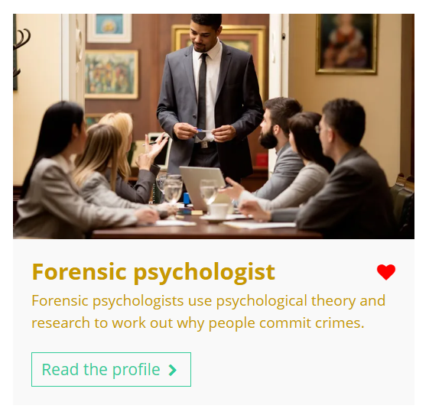
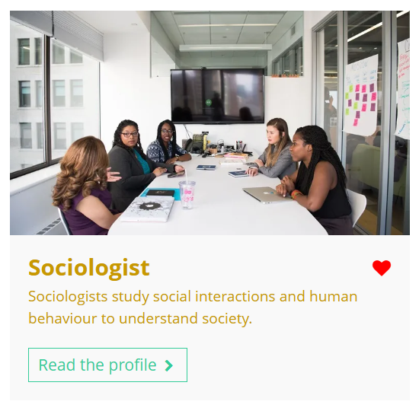
Fascinated by this field? Find out more on Unifrog!
Explore the criminology subject profile.
Explore related subject profiles, like psychology.
Explore related career profiles, like forensic psychologist and sociologist.
Remember to click the heart symbol to add a profile to your Favourites!
Notes:
Teacher’s notes:
This slide contains career and subject profiles that are relevant to the subject of the month.
If you have additional time available and students have computer access, you can direct them to these resources.
Remember to log into the student side of your Unifrog account to access these links and remind students to favourite any careers or subjects they like the look of.
You can track student progress with favouriting careers or subjects by clicking Advanced>Sort by>Library profiles in Favourites.

Slide 65

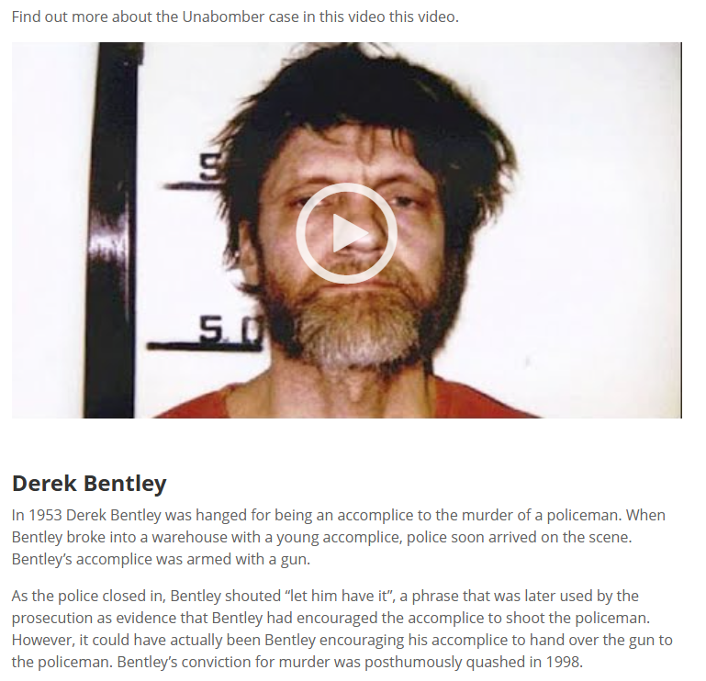
Further exploration
Visit the Courses tool to join courses relating to the career of the month:
Catching a criminal: forensics and language
Notes:
Teacher’s notes:
This slide contains a Unifrog course that’s relevant to the career of the month.
If you have additional time available and students have computer access, you can direct them to the Courses tool.
Remember to log into the student side of your Unifrog account to access these links and remind students to join any courses they like the look of.
You can track student progress with courses by clicking Advanced>Sort by>Courses.

Slide 67
Career of the month
Year 12 – January
Notes:
Teacher’s notes:
January’s career of the month for year 12 is: Broadcast journalist.

Slide 68

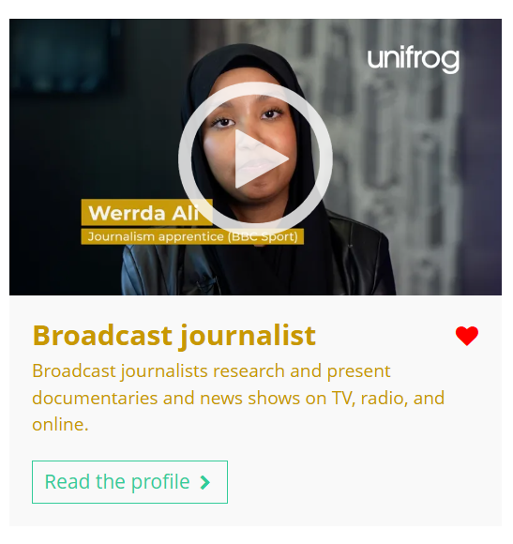

January’s career of the month is…
Broadcast journalist
Note down at least one thing you think you know about this career.
Notes:
Teacher’s notes:
Click to reveal the career of the month: Broadcast journalist.
Before you’re ready to watch the Careers library video as a class, ask students to note down anything they think they already know about this career.

Slide 69
January’s career of the month is… Broadcast journalist
There are lots of roles that fall under the category of broadcast journalist. Today we'll be hearing from Werrda, who’s a journalism apprentice for the BBC.
Whilst you’re watching, think about the issues and causes you are interested in or passionate about.
Notes:
Teacher’s notes:
Make sure you’re logged into your Unifrog account and click ‘use the platform as a student’. Click the image on the screen to go to the Careers library profile, then click the play button on the video. Alternatively, copy this URL into an internet browser: unifrog.org/student/careers/direct/broadcast-journalist
If you have more time available, you could read the career profile text as a class too.

Slide 70
January’s career of the month is… Broadcast journalist
What part-time jobs or experiences could help you develop the skills needed for a career in journalism?
What do you think would be the most exciting part of working as a broadcast journalist?
How could studying subjects like law, business, or sociology prepare you for this role?
Why is it important for journalists to be open to feedback on their work?
Notes:
Teacher’s notes:
This slide contains reflection questions about the career of the month. You could ask students to write down their answers, discuss in pairs or small groups, or discuss as a whole class.
The aim of this activity is for students to think about their own preferences, experiences, and skills and how these could relate to the career. Students are encouraged to draw links between skills used in their current school subjects and the career in the video. If students would like to know more about the career, encourage them to read the full career profile, which contains the following sections:
What you’ll do
Working hours and environment
Career path and progression
Skills required
Entry requirements
Related know-how guides
Related university subject profiles
Related career profiles
Explore
Labour Market Information (LMI)
People also liked…
Example answers:
Jobs in busy environments, like working in a shop or café, could help with time management, multitasking, and communication skills.
Writing about topics you’re passionate about and seeing your name on published work would be really exciting.
Law helps with understanding rights and ethics, sociology helps you understand people and society, and business could help with media management.
Feedback helps journalists improve their writing and storytelling skills, making their work more engaging and professional.

Slide 71
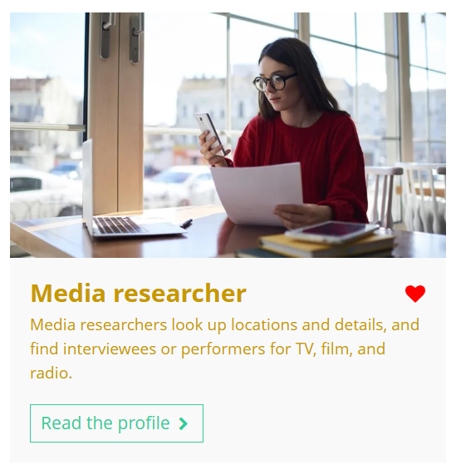
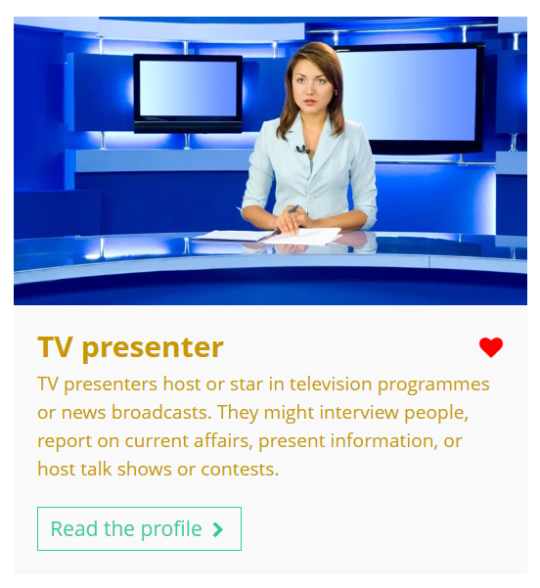

Curious about this career? Discover more on Unifrog!
Explore the broadcast journalist career profile.
Explore related career profiles, like media researcher and TV presenter.
Explore related subject profiles, like media and communications.
Remember to click the heart symbol to add a profile to your Favourites!
Notes:
Teacher’s notes:
This slide contains career and subject profiles that are relevant to the career of the month.
If you have additional time available and students have computer access, you can direct them to these resources.
Remember to log into the student side of your Unifrog account to access these links and remind students to favourite any careers or subjects they like the look of.
You can track student progress with favouriting careers or subjects by clicking Advanced>Sort by>Library profiles in Favourites.

Slide 72
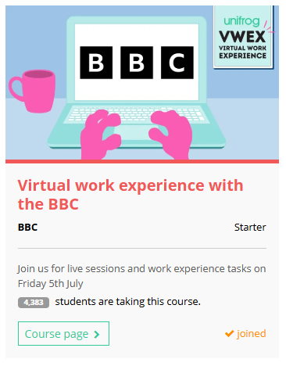
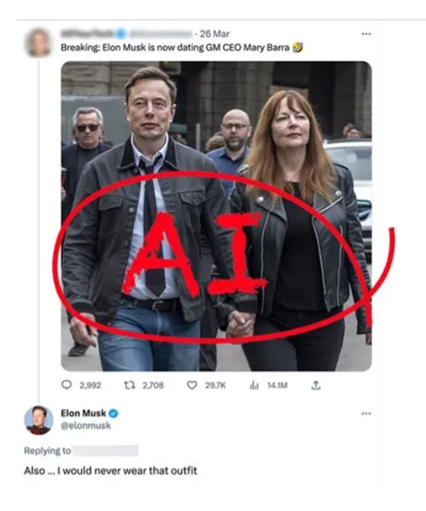
Further exploration
Visit the Courses tool to join courses relating to the career of the month:
Virtual work experience with the BBC
Notes:
Teacher’s notes:
This slide contains a Unifrog course that’s relevant to the career of the month.
If you have additional time available and students have computer access, you can direct them to the Courses tool.
Remember to log into the student side of your Unifrog account to access these links and remind students to join any courses they like the look of.
You can track student progress with courses by clicking Advanced>Sort by>Courses.

Slide 74
Subject of the month
Year 12 – January
Notes:
Teacher’s notes:
January’s subject of the month for year 12 is: Chemical engineering.

Slide 75


January’s subject of the month is…
Chemical engineering
Note down at least one thing you think you know about this subject.
Notes:
Teacher’s notes:
Click to reveal the subject of the month: Chemical engineering.
Before you’re ready to watch the Subjects library video as a class, ask students to note down anything they think they already know about this subject.

Slide 76
January’s subject of the month is… Chemical engineering
Today we'll be hearing from Melissa, who’s a chemical engineering student.
Whilst you’re watching, think about how chemical engineers solve real-world problems and what skills they might need to do this.
Notes:
Teacher’s notes:
Make sure you’re logged into your Unifrog account and click ‘use the platform as a student’. Click the image on the screen to go to the Subjects library profile, then click the play button on the video. Alternatively, copy this URL into an internet browser: unifrog.org/student/subjects/direct/chemical-engineering
Please note, there are two videos available on this career profile: Melissa and Daanyal.
If you have more time available, you could read the subject profile text as a class too.

Slide 77
January’s subject of the month is… Chemical engineering
How can getting involved in STEM* activities or projects help you prepare for a career in chemical engineering?
What skills do you think would be most important for a chemical engineer when working on large-scale projects?
Why is it essential for chemical engineers to understand environmental issues when designing new processes or products?
How might working in a team help a chemical engineer solve problems more effectively than working alone?
*STEM = science, technology, engineering, and maths
Notes:
Teacher’s notes:
This slide contains reflection questions about the subject of the month. You could ask students to write down their answers, discuss in pairs or small groups, or discuss as a whole class.
The aim of this activity is for students to think about their own preferences, experiences, and skills and how these could relate to the subject. Students are encouraged to draw links between skills used in their current school subjects and the subject in the video. If students would like to know more about the subject, encourage them to read the full subject profile, which contains the following sections:
In a nutshell
Getting in
Prospects
Statement
Reference
Geek out
Recommendations: Read
Recommendations: Watch
Recommendations: Listen
Explore
People also liked…
Example answers:
Participating in STEM activities or projects helps you build problem-solving skills, creativity, and teamwork, which are all essential for chemical engineers when tackling complex challenges.
Attention to detail, critical thinking, and the ability to manage complex calculations and processes are vital for engineers working on large projects.
Understanding environmental issues is crucial to designing processes that minimise waste, energy use, and harmful emissions, promoting sustainability.
Teamwork allows chemical engineers to combine their expertise with others, leading to more innovative solutions and sharing of diverse perspectives.

Slide 78

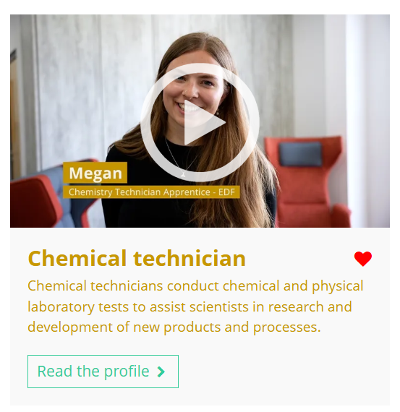

Fascinated by this field? Find out more on Unifrog!
Explore the chemical engineering subject profile and watch Daanyal’s interview.
Explore related subject profiles, like materials science.
Explore related career profiles, like chemical technician and agronomist.
Remember to click the heart symbol to add a profile to your Favourites!
Notes:
Teacher’s notes:
This slide contains career and subject profiles that are relevant to the subject of the month.
If you have additional time available and students have computer access, you can direct them to these resources.
Remember to log into the student side of your Unifrog account to access these links and remind students to favourite any careers or subjects they like the look of.
You can track student progress with favouriting careers or subjects by clicking Advanced>Sort by>Library profiles in Favourites.

Slide 79
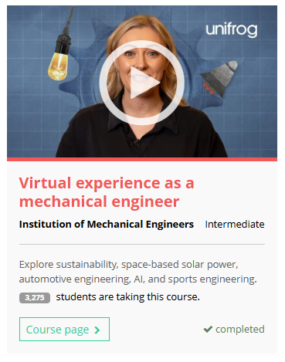

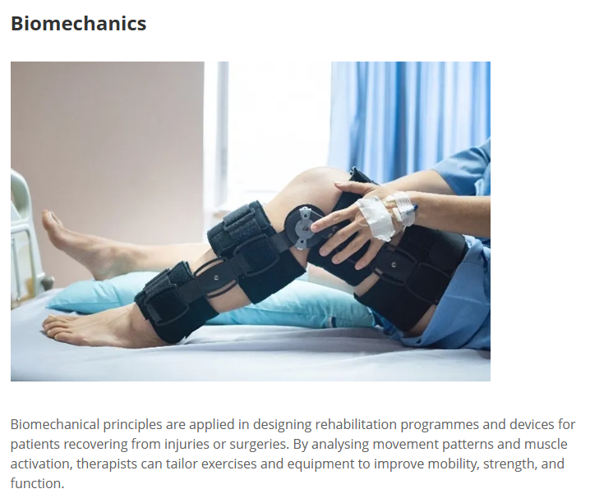

Further exploration
Visit the Courses tool to join courses relating to the career of the month:
Notes:
Teacher’s notes:
This slide contains Unifrog courses that are relevant to the career of the month.
If you have additional time available and students have computer access, you can direct them to the Courses tool.
Remember to log into the student side of your Unifrog account to access these links and remind students to join any courses they like the look of.
You can track student progress with courses by clicking Advanced>Sort by>Courses.

Slide 81
Career of the month
Year 13 – January
Notes:
Teacher’s notes:
January’s career of the month for year 13 is: Early years practitioner.

Slide 82

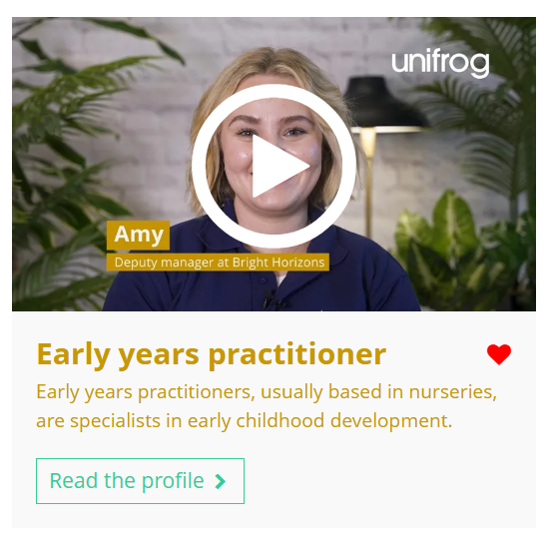

January’s career of the month is…
Early years practitioner
Note down at least one thing you think you know about this career.
Notes:
Teacher’s notes:
Click to reveal the career of the month: Early years practitioner.
Before you’re ready to watch the Careers library video as a class, ask students to note down anything they think they already know about this career.

Slide 83
January’s career of the month is… Early years practitioner
There are lots of roles that fall under the category of early years practitioner. Today we'll be hearing from Amy, who’s a deputy manager at Bright Horizons nursery.
Whilst you’re watching, think about what young children need to develop healthily.
Notes:
Teacher’s notes:
Make sure you’re logged into your Unifrog account and click ‘use the platform as a student’. Click the image on the screen to go to the Careers library profile, then click the play button on the video. Alternatively, copy this URL into an internet browser: unifrog.org/student/careers/direct/nursery-worker
Please note, there are two videos available on this subject profile: Amy and Nawal.
If you have more time available, you could read the career profile text as a class too.

Slide 84
January’s career of the month is… Early years practitioner
What types of tasks does an early years practitioner perform on a typical day?
Why is working with children in early years so rewarding, according Amy?
What is the role of play in early years education?
How did Amy progress in her career, and what advice does she have for someone interested in the field?
Notes:
Teacher’s notes:
This slide contains reflection questions about the career of the month. You could ask students to write down their answers, discuss in pairs or small groups, or discuss as a whole class.
The aim of this activity is for students to think about their own preferences, experiences, and skills and how these could relate to the career. Students are encouraged to draw links between skills used in their current school subjects and the career in the video. If students would like to know more about the career, encourage them to read the full career profile, which contains the following sections:
What you’ll do
Working hours and environment
Career path and progression
Skills required
Entry requirements
Related know-how guides
Related university subject profiles
Related career profiles
Explore
Labour Market Information (LMI)
People also liked…
Example answers:
An early years practitioner supports children’s development through activities like messy play, helps with daily routines such as mealtimes and naps, and communicates with parents/carers about the children’s progress.
Amy finds working with children rewarding because of the special relationships they form, witnessing milestones like a child’s first steps or words, and the joy these moments bring.
Play is crucial in early years education because it helps children develop essential skills, like fine motor skills, while allowing them to have fun and engage in learning in a natural way.
Amy started as a Level 3 apprentice after working in hospitality, and through promotions and further training, advanced to the role of deputy manager. Her advice is to gain work experience in a nursery and consider various career paths within early years education.

Slide 85
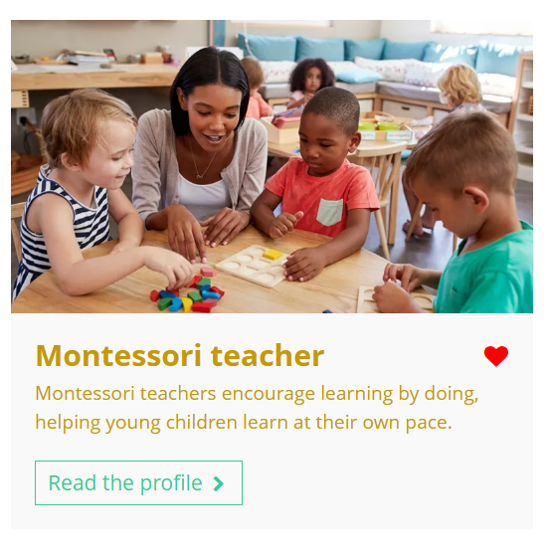

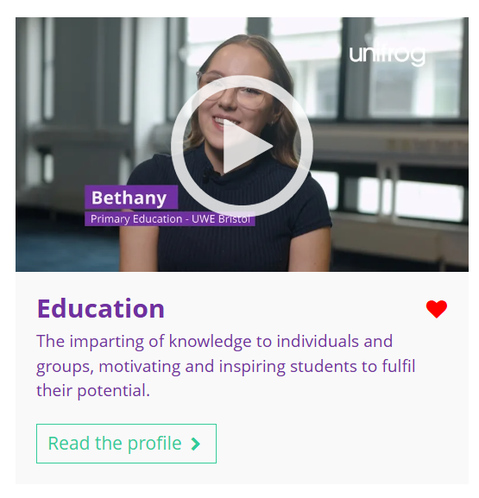
Curious about this career? Discover more on Unifrog!
Explore the early years practitioner career profile and watch Nawal’s interview.
Explore related career profiles, like Montessori teacher and health play specialist.
Explore related subject profiles, like education.
Remember to click the heart symbol to add a profile to your Favourites!
Notes:
Teacher’s notes:
This slide contains career and subject profiles that are relevant to the career of the month.
If you have additional time available and students have computer access, you can direct them to these resources.
Remember to log into the student side of your Unifrog account to access these links and remind students to favourite any careers or subjects they like the look of.
You can track student progress with favouriting careers or subjects by clicking Advanced>Sort by>Library profiles in Favourites.

Slide 86
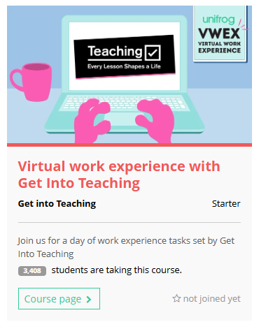
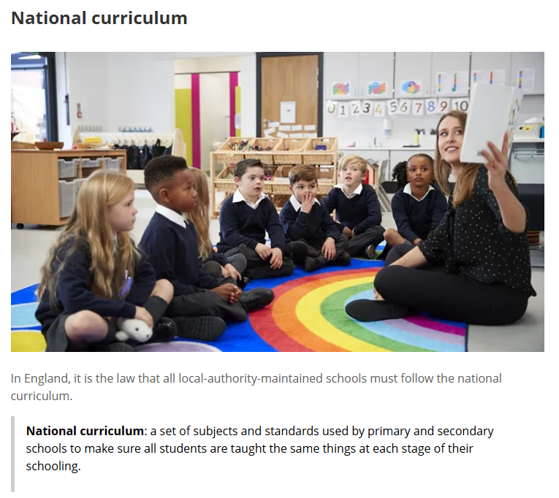
Further exploration
Visit the Courses tool to join courses relating to the career of the month:
Virtual work experience with Get Into Teaching
Notes:
Teacher’s notes:
This slide contains a Unifrog course that’s relevant to the career of the month.
If you have additional time available and students have computer access, you can direct them to the Courses tool.
Remember to log into the student side of your Unifrog account to access these links and remind students to join any courses they like the look of.
You can track student progress with courses by clicking Advanced>Sort by>Courses.

Slide 88
Subject of the month
Year 13 – January
Notes:
Teacher’s notes:
January’s subject of the month for year 13 is: Nursing and midwifery.

Slide 89

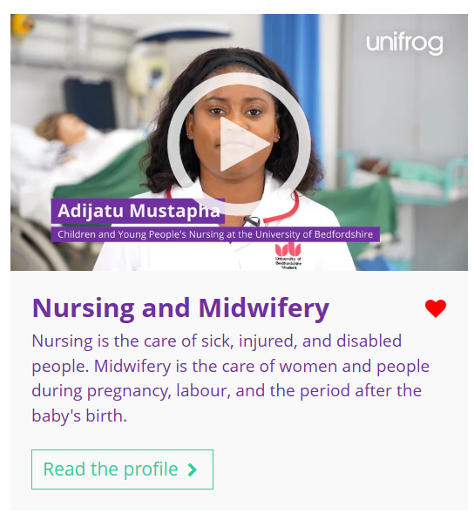

January’s subject of the month is…
Nursing and
midwifery
Note down at least one thing you think you know about this subject.
Notes:
Teacher’s notes:
Click to reveal the subject of the month: Nursing and midwifery.
Before you’re ready to watch the Subjects library video as a class, ask students to note down anything they think they already know about this subject.

Slide 90
January’s subject of the month is… Nursing and midwifery
There are lots of degrees that fall under the category of nursing and midwifery. Today we'll be hearing from Adijatu, who’s studying children and young people’s nursing.
Whilst you’re watching, think about the rewards and challenges of working with sick children.
Notes:
Teacher’s notes:
Make sure you’re logged into your Unifrog account and click ‘use the platform as a student’. Click the image on the screen to go to the Subjects library profile, then click the play button on the video. Alternatively, copy this URL into an internet browser: unifrog.org/student/subjects/direct/nursing-and-midwifery.
If you have more time available, you could read the subject profile text as a class too.

Slide 91
January’s subject of the month is… Nursing and midwifery
What do children’s nurses do during their placements and practical training?
Why are self-care and resilience important for a career in children’s nursing?
What kind of skills or experiences are helpful when applying for a nursing degree?
How is studying children’s nursing at university different from school or college?
Notes:
Teacher’s notes:
This slide contains reflection questions about the subject of the month. You could ask students to write down their answers, discuss in pairs or small groups, or discuss as a whole class.
The aim of this activity is for students to think about their own preferences, experiences, and skills and how these could relate to the subject. Students are encouraged to draw links between skills used in their current school subjects and the subject in the video. If students would like to know more about the subject, encourage them to read the full subject profile, which contains the following sections:
In a nutshell
Getting in
Prospects
Statement
Reference
Geek out
Recommendations: Read
Recommendations: Watch
Recommendations: Listen
Explore
People also liked…
Example answers:
Children’s nurses provide care, practise clinical skills like giving injections or managing wounds, and work with children and families in wards, schools, or emergency settings.
Nurses deal with long hours and emotional challenges, so self-care and resilience help them stay healthy and perform well, especially during tough days.
Useful skills include empathy, teamwork, and communication, plus experiences like working as a healthcare assistant or studying biology.
At university, there’s a mix of hands-on practice and classroom learning, while school and college are more theory-based and focused on exams.

Slide 92
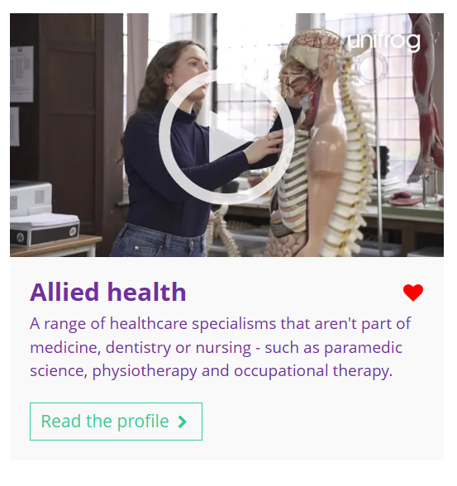
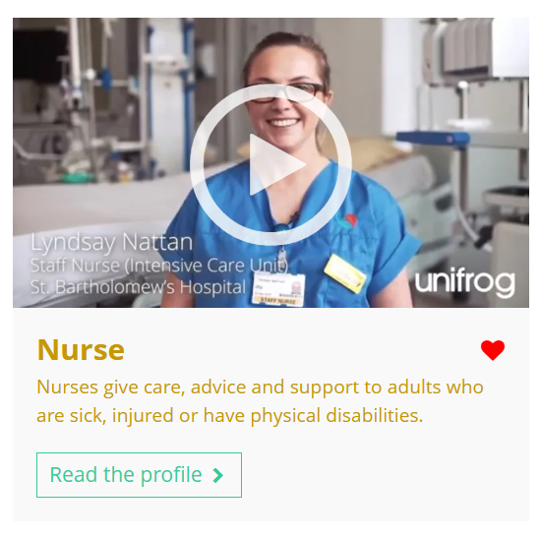
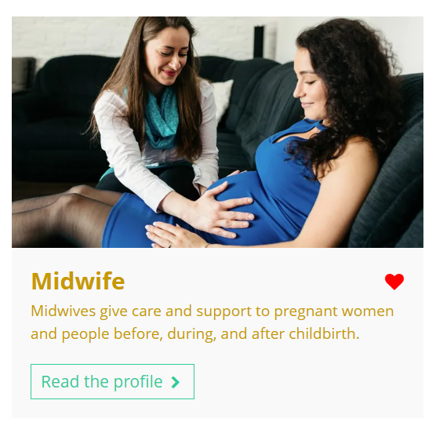
Fascinated by this field? Find out more on Unifrog!
Explore the nursing and midwifery subject profile.
Explore related subject profiles, like allied health.
Explore related career profiles, like nurse and midwife.
Remember to click the heart symbol to add a profile to your Favourites!
Notes:
Teacher’s notes:
This slide contains career and subject profiles that are relevant to the subject of the month.
If you have additional time available and students have computer access, you can direct them to these resources.
Remember to log into the student side of your Unifrog account to access these links and remind students to favourite any careers or subjects they like the look of.
You can track student progress with favouriting careers or subjects by clicking Advanced>Sort by>Library profiles in Favourites.

