Slide 1
Teacher’s slide: Gatsby Benchmarks
To support you in meeting the Gatsby Benchmarks, we suggest dedicating one day per month to a ‘career of the month' and one day to a ‘subject of the month' for each year group. This can be done during registration or form time, in a 15-minute session. Students will watch a video from the Unifrog platform and answer questions, either through group discussion or written responses.
Delivering these sessions can support the Gatsby Benchmarks as follows:
1. A stable careers programme | 2. Learning from career and labour market information
Regular timetabled sessions to discuss careers and subjects can form part of your stable careers programme. During these sessions you could also make links and remind students of what’s happening in your wider careers programme. | Watching the videos can help students to understand the skills, qualifications, and challenges related to specific jobs. You can support this by exploring the career or subject profile together, including linking to labour market information (LMI) contained in the profiles.
3. Addressing the needs of each pupil | 4. Linking curriculum learning to careers
The questions promote tailored personal reflection. Students could record and upload their reflections to their Unifrog Locker. A range of careers and subjects are used to help students raise aspirations and challenge stereotypes. | The questions help students to reflect on how school subjects connect to real-world careers, helping them see the relevance of their studies to future job opportunities.
5. Encounters with employers and employees | 6. Experiences of workplaces
While these videos don't replace in-person encounters with employers, they provide insights into work environments and cultures, offering students a realistic view of different career paths. | While these videos don't replace in-person work experience, they can broaden students' awareness of different workplaces and help them identify areas they'd like to explore further.
7. Encounters with further and higher education | 8. Personal guidance
While these videos don't replace in-person encounters with further and higher education, they can help students understand the educational pathways needed for various subjects and careers, helping them understand their options for further study or training. | Students can draw on their discussions and reflections of a variety of careers and subjects in their personal guidance 1:1s.
Notes:
Teacher’s notes:
To further support these benchmarks, you could arrange a talk from a former student, FE/HE institution, or employer about a subject/career featured each month.

Slide 2















February
Click a box to go straight to the relevant slides
Year 7 Career of the month
Year 8 Career of the month
Year 9 Career of the month
Year 10 Career of the month
Year 11 Career of the month
Year 12 Career of the month
Year 13 Career of the month
Year 7 Subject of the month
Year 8 Subject of the month
Year 9 Subject of the month
Year 10 Subject of the month
Year 11 Subject of the month
Year 12 Subject of the month
Year 13 Subject of the month
Notes:
Teacher’s notes:
There are separate PowerPoints available for each month of the academic year within the resource profile ‘Career and subject of the month’.
Click the hyperlinked text boxes on this slide to be taken to the slides for the year group selected.

Slide 3

Career of the month
Year 7 – February
Notes:
Teacher’s notes:
February’s career of the month for year 7 is: Multi-skilled engineer.

Slide 4

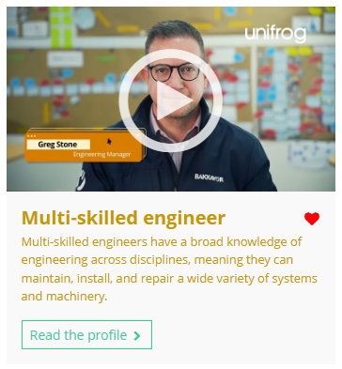


February’s career of the month is…
Multi-skilled engineer
Note down at least one thing you think you know about this career.
Notes:
Teacher’s notes:
Click to reveal the career of the month: Multi-skilled engineer.
Before you’re ready to watch the Careers library video as a class, ask students to note down anything they think they already know about this career.

Slide 5

February’s career of the month is… Multi-skilled engineer
There are lots of roles that fall under the category of multi-skilled engineer. Today we'll be hearing from Greg, who’s an engineering manager at IGD.
Whilst you’re watching, think about the different types of engineering roles.
Notes:
Teacher’s notes:
Please note, there are two videos for this profile: Greg and Brook Eves.
Make sure you’re logged into your Unifrog account and click ‘use the platform as a student’. Click the image on the screen to go to the Careers library profile, then click the play button on the video. Alternatively, copy this URL into an internet browser: unifrog.org/student/careers/direct/multi-skilled-engineer
If you have more time available, you could read the career profile text as a class too.

Slide 6
February’s career of the month is… Multi-skilled engineer
What skills do you think are important for being a good engineer?
How can understanding machines and systems help in everyday life?
What are some problems engineers might face, and how can they solve them?
How do you think engineering can help make the world a better place?
Notes:
Teacher’s notes:
This slide contains reflection questions about the career of the month. You could ask students to write down their answers, discuss in pairs or small groups, or discuss as a whole class.
The aim of this activity is for students to think about their own preferences, experiences, and skills and how these could relate to the career. Students are encouraged to draw links between skills used in their current school subjects and the career in the video. If students would like to know more about the career, encourage them to read the full career profile, which contains the following sections:
What you’ll do
Working hours and environment
Career path and progression
Skills required
Entry requirements
Related know-how guides
Related university subject profiles
Related career profiles
Explore
Labour Market Information (LMI)
People also liked…
Example answers:
Good engineers need to be good at solving problems and paying attention to small details. They also need to work well with others and be able to explain their ideas clearly. Being good with tools and technology is really important too.
If you understand how machines work, you can fix simple things when they break, like a bike chain or a printer. It also helps you figure out how to use gadgets and technology better, like setting up a new phone or computer.
Engineers might have to fix a machine that’s broken or design something new that works better. To solve these problems, they can test different ideas, work with a team, or learn new skills to find the best solution.
Engineering can help by making new inventions, like electric cars, to protect the planet. It can also help build safer homes, cleaner energy, and better medical equipment to improve people’s lives.

Slide 7
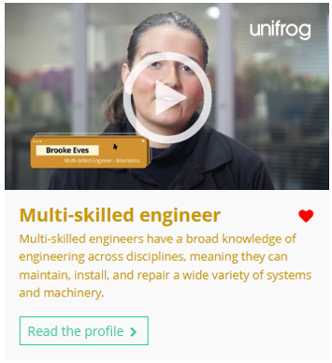
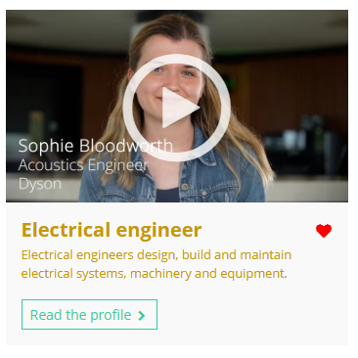
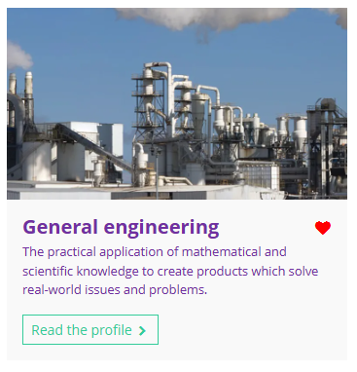

Curious about this career? Discover more on Unifrog!
Learn about both Greg and Brook Eves’ stories on the multi-skilled engineer career profile.
Explore related career profiles, like electrical engineer.
Explore related subject profiles, like general engineering.
Remember to click the heart symbol to add a profile to your Favourites!
Notes:
Teacher’s notes:
This slide contains career and subject profiles that are relevant to the career of the month.
If you have additional time available and students have computer access, you can direct them to these resources.
Remember to log into the student side of your Unifrog account to access these links and remind students to favourite any careers or subjects they like the look of.
You can track student progress with favouriting careers or subjects by clicking Advanced>Sort by>Library profiles in Favourites.

Slide 8
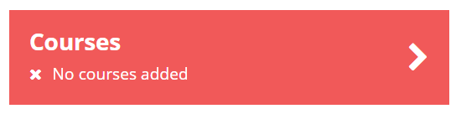
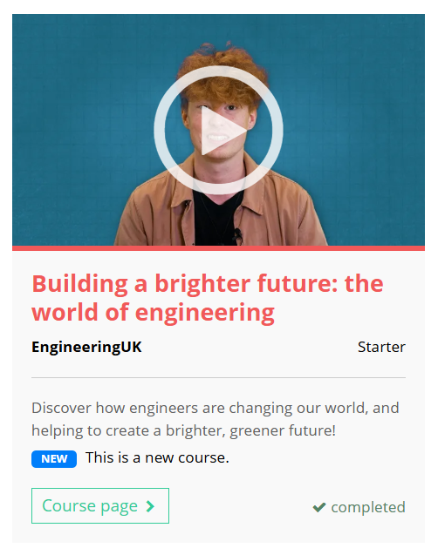
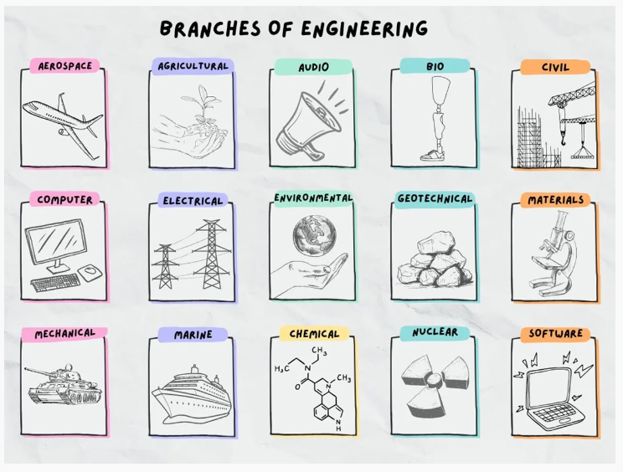

Further exploration
Visit the Courses tool to join courses relating to the career of the month:
Building a brighter future: the world of engineering.
Notes:
Teacher’s notes:
This slide contains a Unifrog course that’s relevant to the career of the month.
If you have additional time available and students have computer access, you can direct them to the Courses tool.
Remember to log into the student side of your Unifrog account to access these links and remind students to join any courses they like the look of.
You can track student progress with courses by clicking Advanced>Sort by>Courses.

Slide 9


Slide 10
Subject of the month
Year 7 – February
Notes:
Teacher’s notes:
February’s subject of the month for year 7 is: Classical studies.

Slide 11

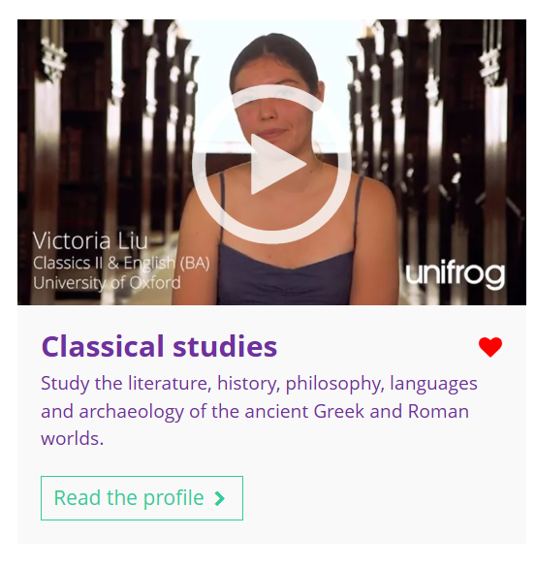

February’s subject of the month is…
Classical studies
Note down at least one thing you think you know about this subject.
Notes:
Teacher’s notes:
Click to reveal the subject of the month: Classical studies.
Before you’re ready to watch the Subjects library video as a class, ask students to note down anything they think they already know about this subject.

Slide 12
February’s subject of the month is… Classical studies
There are lots of subjects that fall under the category of classical studies. Today we’ll be hearing from Victoria Liu, who’s a classics II and English student.
Whilst you’re watching, think about the different challenges Victoria Liu faces in her course.
Notes:
Teacher’s notes:
Make sure you’re logged into your Unifrog account and click ‘use the platform as a student’. Click the image on the screen to go to the Subjects library profile, then click the play button on the video. Alternatively, copy this URL into an internet browser: unifrog.org/student/subjects/direct/classical-studies
If you have more time available, you could read the subject profile text as a class too.

Slide 13
February’s subject of the month is… Classical studies
Victoria Liu says she enjoys how broad her studies are. What details does she give?
Victoria Liu says studying classics and English can feel challenging. What reasons does she give?
What does a typical day look like for a classics and English student?
How can an interest in archaeology or ancient history help with this course?
Notes:
Teacher’s notes:
This slide contains reflection questions about the subject of the month. You could ask students to write down their answers, discuss in pairs or small groups, or discuss as a whole class.
The aim of this activity is for students to think about their own preferences, experiences, and skills and how these could relate to the subject. Students are encouraged to draw links between skills used in their current school subjects and the subject in the video. If students would like to know more about the subject, encourage them to read the full subject profile, which contains the following sections:
In a nutshell
Getting in
Prospects
Statement
Reference
Geek out
Recommendations: Read
Recommendations: Watch
Recommendations: Listen
Explore
People also liked…
Example answers:
You can learn about history, philosophy, archaeology, art, and literature, plus ancient Greek and Latin. It’s like exploring two different civilisations in one course!
The course needs precision, especially with grammar and translations, but understanding the beautiful language and stories makes it worth it.
It might include some early morning exercise, followed by morning language classes, library time for reading and essay work, and relaxing with friends in the evening.
If you enjoy archaeology or ancient history, studying classics and English lets you explore these areas further. Universities often provide support to help you learn ancient languages like Greek or Latin to deepen your understanding.

Slide 14
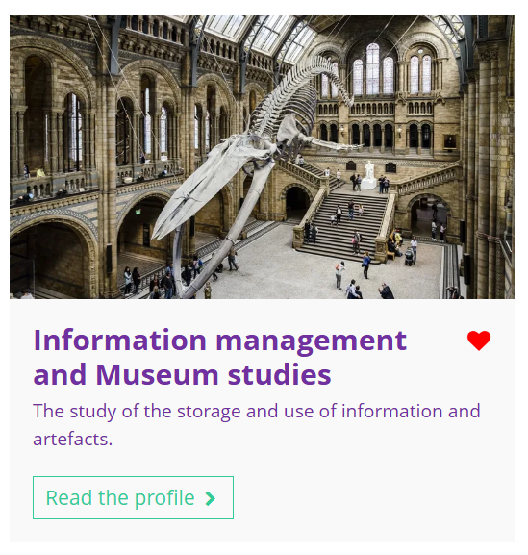
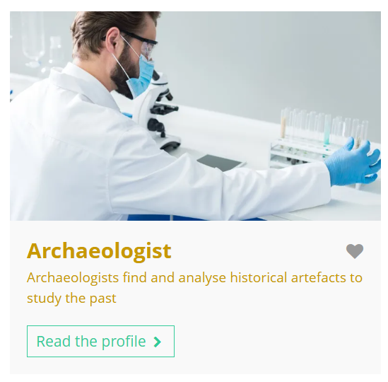
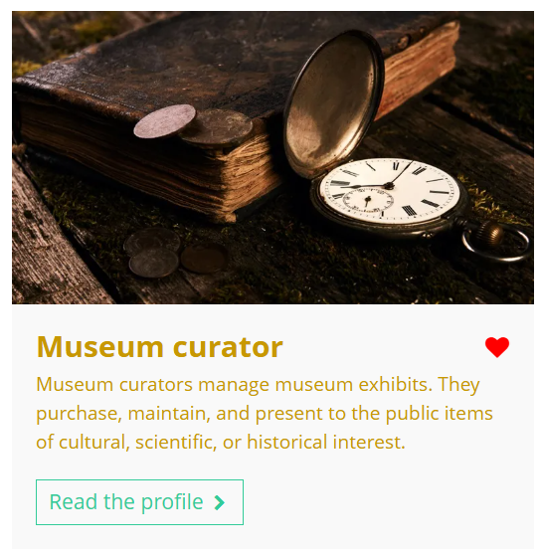
Fascinated by this field? Find out more on Unifrog!
Explore the classical studies subject profile.
Explore related subject profiles, like information management and museum studies.
Explore related career profiles, like archaeologist and museum curator.
Remember to click the heart symbol to add a profile to your Favourites!
Notes:
Teacher’s notes:
This slide contains career and subject profiles that are relevant to the subject of the month.
If you have additional time available and students have computer access, you can direct them to these resources.
Remember to log into the student side of your Unifrog account to access these links and remind students to favourite any careers or subjects they like the look of.
You can track student progress with favouriting careers or subjects by clicking Advanced>Sort by>Library profiles in Favourites.

Slide 16
Career of the month
Year 8 – February
Notes:
Teacher’s notes:
February’s career of the month for year 8 is: Chef.

Slide 17

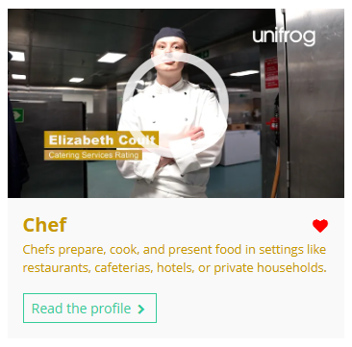

February’s career of the month is…
Chef
Note down at least one thing you think you know about this career.
Notes:
Teacher’s notes:
Click to reveal the career of the month: Chef.
Before you’re ready to watch the Careers library video as a class, ask students to note down anything they think they already know about this career.

Slide 18
February’s career of the month is… Chef
There are lots of roles that fall under the category of chef. Today we'll be hearing from Elizabeth who’s a chef in the Royal Navy.
Whilst you’re watching, think about the challenges of preparing food on a ship in a rough sea.
Notes:
Teacher’s notes:
Make sure you’re logged into your Unifrog account and click ‘use the platform as a student’. Click the image on the screen to go to the Careers library profile, then click the play button on the video. Alternatively, copy this URL into an internet browser: unifrog.org/student/careers/direct/chef
If you have more time available, you could read the career profile text as a class too.

Slide 19
February’s career of the month is… Chef
What do you think would be most exciting about cooking and serving food on a ship?
How might cooking for large events and cocktail parties on a ship be different to working in a restaurant on land?
What challenges do you think you might face working in a moving kitchen, and how would you handle them?
Does living and working on a ship away from home interest you? Why or why not?
Notes:
Teacher’s notes:
This slide contains reflection questions about the career of the month. You could ask students to write down their answers, discuss in pairs or small groups, or discuss as a whole class.
The aim of this activity is for students to think about their own preferences, experiences, and skills and how these could relate to the career. Students are encouraged to draw links between skills used in their current school subjects and the career in the video. If students would like to know more about the career, encourage them to read the full career profile, which contains the following sections:
What you’ll do
Working hours and environment
Career path and progression
Skills required
Entry requirements
Related know-how guides
Related university subject profiles
Related career profiles
Explore
Labour Market Information (LMI)
People also liked…
Example answers:
It would be exciting to travel to different places while doing a job you love. Cooking for people who work on the ship and at special events, like fancy dinners or themed nights, would also make each day interesting and different.
On a ship, you’d have to work in a smaller space and deal with the ship moving, which could make things tricky. But it could also be more exciting because you’d get to cook for lots of different people, including officers or even celebrities.
The ship moving could make it hard to keep everything steady, especially when the sea is rough. You’d need to learn how to secure things and work carefully to avoid accidents. It might take time to get used to, but practising and staying calm would help.
It could be really interesting because you’d get to see new places and meet different people while working. But it might also be hard to be away from family and friends for a long time, so you’d need to be ready for that part of the job.

Slide 20
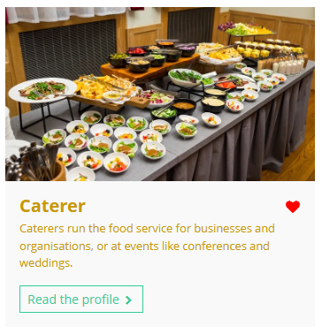
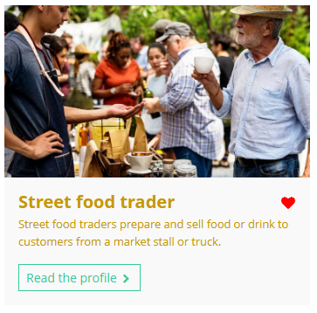
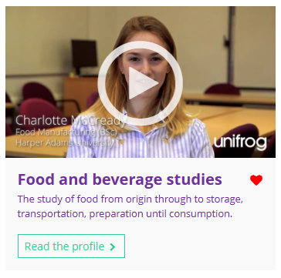
Curious about this career? Discover more on Unifrog!
Explore the chef career profile.
Explore related career profiles, like caterer and street food trader.
Explore related subject profiles, like food and beverage studies.
Remember to click the heart symbol to add a profile to your Favourites!
Notes:
Teacher’s notes:
This slide contains career and subject profiles that are relevant to the career of the month.
If you have additional time available and students have computer access, you can direct them to these resources.
Remember to log into the student side of your Unifrog account to access these links and remind students to favourite any careers or subjects they like the look of.
You can track student progress with favouriting careers or subjects by clicking Advanced>Sort by>Library profiles in Favourites.

Slide 22
Subject of the month
Year 8 – February
Notes:
Teacher’s notes:
February’s subject of the month for year 8 is: Asian studies.

Slide 23

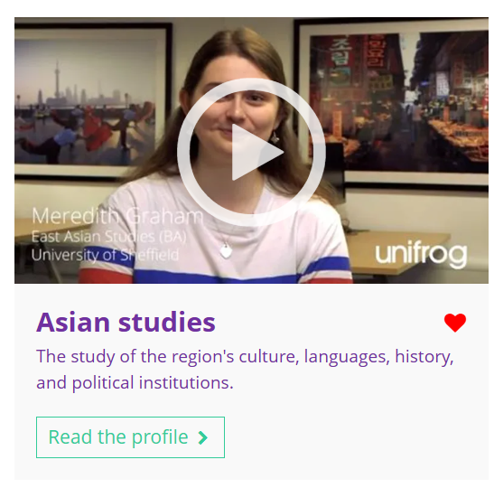

February’s subject of the month is…
Asian studies
Note down at least one thing you think you know about this subject.
Notes:
Teacher’s notes:
Click to reveal the subject of the month: Asian studies.
Before you’re ready to watch the Subjects library video as a class, ask students to note down anything they think they already know about this subject.

Slide 24
February’s subject of the month is… Asian studies
Today we'll be hearing from Meredith, who’s studying East Asian studies.
Whilst you’re watching, think about the different countries found in Asia.
Notes:
Teacher’s notes:
Make sure you’re logged into your Unifrog account and click ‘use the platform as a student’. Click the image on the screen to go to the Subjects library profile, then click the play button on the video. Alternatively, copy this URL into an internet browser: unifrog.org/student/subjects/direct/Asian-studies
If you have more time available, you could read the subject profile text as a class too.

Slide 25
February’s subject of the month is… Asian studies
What are some of the topics you can study in East Asian studies?
Why is it important to have an open mind when studying East Asian studies?
What skills are needed to balance the different areas of East Asian studies?
How does studying East Asian history help with understanding modern culture?
Notes:
Teacher’s notes:
This slide contains reflection questions about the subject of the month. You could ask students to write down their answers, discuss in pairs or small groups, or discuss as a whole class.
The aim of this activity is for students to think about their own preferences, experiences, and skills and how these could relate to the subject. Students are encouraged to draw links between skills used in their current school subjects and the subject in the video. If students would like to know more about the subject, encourage them to read the full subject profile, which contains the following sections:
In a nutshell
Getting in
Prospects
Statement
Reference
Geek out
Recommendations: Read
Recommendations: Watch
Recommendations: Listen
Explore
People also liked…
Example answers:
You can explore a wide range of topics, including literature, politics, history, and popular culture. If you have specific interests, like North Korea, there might even be opportunities to take specialised modules.
Having an open mind helps you explore areas you might not have considered before, like history or connections between different countries. It allows you to see every module as an opportunity to learn and grow.
Balancing historical, political, and language studies, along with a lot of reading, is key. You’ll need to organise your time and make connections between different subjects to succeed.
Learning about the history of countries like Japan and Korea helps you see how their past connects to their current culture and politics, giving you a deeper understanding of the region as a whole.

Slide 26
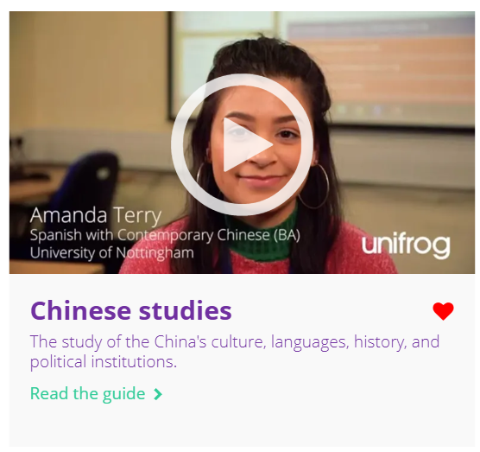
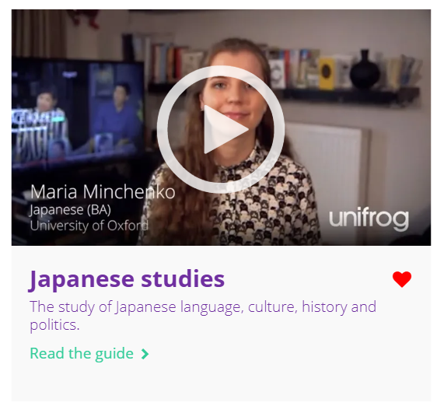
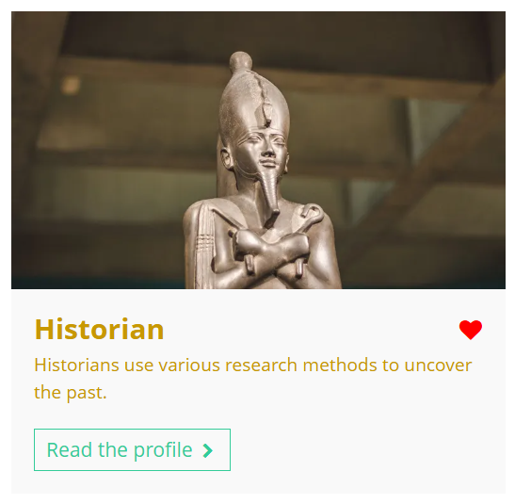
Fascinated by this field? Find out more on Unifrog!
Explore the Asian studies subject profile.
Explore related subject profiles, like Chinese studies and Japanese studies.
Explore related career profiles, like historian.
Remember to click the heart symbol to add a profile to your Favourites!
Notes:
Teacher’s notes:
This slide contains career and subject profiles that are relevant to the subject of the month.
If you have additional time available and students have computer access, you can direct them to these resources.
Remember to log into the student side of your Unifrog account to access these links and remind students to favourite any careers or subjects they like the look of.
You can track student progress with favouriting careers or subjects by clicking Advanced>Sort by>Library profiles in Favourites.

Slide 28
Career of the month
Year 9 – February
Notes:
Teacher’s notes:
February’s career of the month for year 9 is: Electronics engineer.

Slide 29

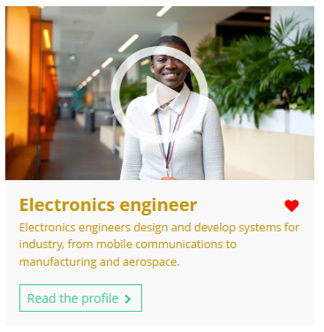

February’s career of the month is…
Electronics engineer
Note down at least one thing you think you know about this career.
Notes:
Teacher’s notes:
Click to reveal the career of the month: Electronics engineer.
Before you’re ready to watch the Careers library video as a class, ask students to note down anything they think they already know about this career.

Slide 30
February’s career of the month is… Electronics engineer
There are lots of roles that fall under the category of electronics engineer. Today we'll be hearing from Natalie, who’s an automation engineer for GSK.
Whilst you’re watching, think about how automation engineers make machines work more efficiently.
Notes:
Teacher’s notes:
Make sure you’re logged into your Unifrog account and click ‘use the platform as a student’. Click the image on the screen to go to the Careers library profile, then click the play button on the video. Alternatively, copy this URL into an internet browser: unifrog.org/student/careers/direct/electronics-engineer
If you have more time available, you could read the career profile text as a class too.

Slide 31
February’s career of the month is… Electronics engineer
What do you think would be the most interesting part of working with machines that help make medicine?
How might travelling to other countries to test and learn about new machines make the job exciting?
What skills do you think you’d need to solve problems with machines under pressure?
Why do you think gaining work experience before deciding on this career is important?
Notes:
Teacher’s notes:
This slide contains reflection questions about the career of the month. You could ask students to write down their answers, discuss in pairs or small groups, or discuss as a whole class.
The aim of this activity is for students to think about their own preferences, experiences, and skills and how these could relate to the career. Students are encouraged to draw links between skills used in their current school subjects and the career in the video. If students would like to know more about the career, encourage them to read the full career profile, which contains the following sections:
What you’ll do
Working hours and environment
Career path and progression
Skills required
Entry requirements
Related know-how guides
Related university subject profiles
Related career profiles
Explore
Labour Market Information (LMI)
People also liked…
Example answers:
The most interesting part would be knowing that the machines you work on help create important products, like inhalers, which can improve people’s health. It's exciting to think that the work you do directly affects people's lives in a positive way.
Traveling to different countries would be exciting because you get to see how other places work and learn new ideas. It would be cool to visit companies in countries like Germany or Italy and test out machines before they come to your own company. It’s a great chance to learn from other experts and experience new cultures.
You’d need problem-solving skills, good communication, and the ability to stay calm under pressure. When something goes wrong with a machine, you need to think clearly, talk to the right people to find solutions, and fix the issue quickly so production doesn’t stop.
Work experience helps you understand what electronics engineering is really like, lets you practise skills, and helps you decide which area of engineering you enjoy most.

Slide 32
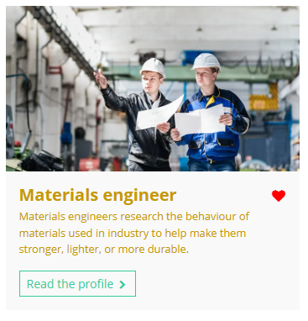
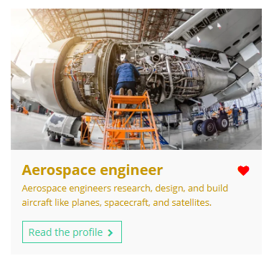
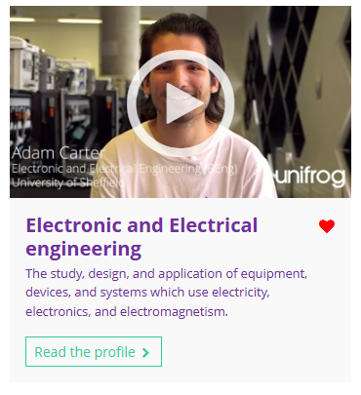
Curious about this career? Discover more on Unifrog!
Explore the electronics engineer career profile.
Explore related career profiles, like materials engineer and aerospace engineer.
Explore related subject profiles, like electronic and electrical engineering.
Remember to click the heart symbol to add a profile to your Favourites!
Notes:
Teacher’s notes:
This slide contains career and subject profiles that are relevant to the career of the month.
If you have additional time available and students have computer access, you can direct them to these resources.
Remember to log into the student side of your Unifrog account to access these links and remind students to favourite any careers or subjects they like the look of.
You can track student progress with favouriting careers or subjects by clicking Advanced>Sort by>Library profiles in Favourites.

Slide 34
Subject of the month
Year 9 – February
Notes:
Teacher’s notes:
February’s subject of the month for year 9 is: Economics.

Slide 35

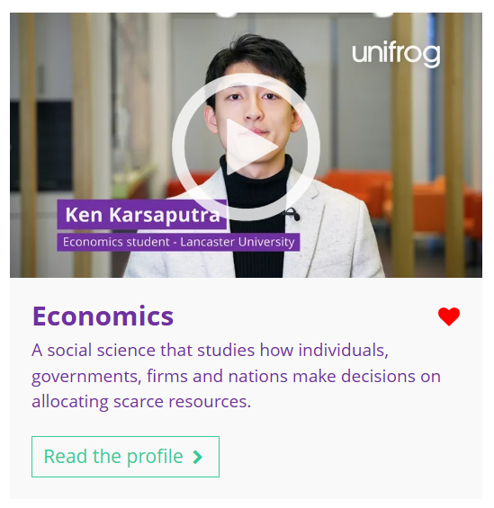

February’s subject of the month is…
Economics
Note down at least one thing you think you know about this subject.
Notes:
Teacher’s notes:
Click to reveal the subject of the month: Economics.
Please note, there are two videos for this profile – Ken and Matthew.
Before you’re ready to watch the Subjects library video as a class, ask students to note down anything they think they already know about this subject.

Slide 36
February’s subject of the month is… Economics
Today we'll be hearing from Ken, who’s an economics student.
Whilst you’re watching, think about the different subjects linked to economics, besides maths.
Notes:
Teacher’s notes:
Make sure you’re logged into your Unifrog account and click ‘use the platform as a student’. Click the image on the screen to go to the Subjects library profile, then click the play button on the video. Alternatively, copy this URL into an internet browser: unifrog.org/student/subjects/direct/economics
If you have more time available, you could read the subject profile text as a class too.

Slide 37
February’s subject of the month is… Economics
Which of your current school subjects could help you with economics?
What kind of things do you already enjoy learning about that could link to economics?
How could you learn more about economics outside of school?
What skills can you practise now to help with studying economics later?
Notes:
Teacher’s notes:
This slide contains reflection questions about the subject of the month. You could ask students to write down their answers, discuss in pairs or small groups, or discuss as a whole class.
The aim of this activity is for students to think about their own preferences, experiences, and skills and how these could relate to the subject. Students are encouraged to draw links between skills used in their current school subjects and the subject in the video. If students would like to know more about the subject, encourage them to read the full subject profile, which contains the following sections:
In a nutshell
Getting in
Prospects
Statement
Reference
Geek out
Recommendations: Read
Recommendations: Watch
Recommendations: Listen
Explore
People also liked…
Example answers:
I think maths will help, especially with graphs and numbers. Also, geography, because it talks about how countries work together and how resources are used, which sounds like what economics does.
I like reading about how businesses work and why prices go up and down. I also watch news about how the economy is doing, so I think economics might help me understand that better.
I could watch YouTube videos about economics or follow the news about businesses and countries. Maybe reading books or articles that explain how the world economy works would help too.
I could practise problem solving and looking at things from different angles, like when we do word problems in maths. Being able to figure out patterns in data could also help later on.

Slide 38

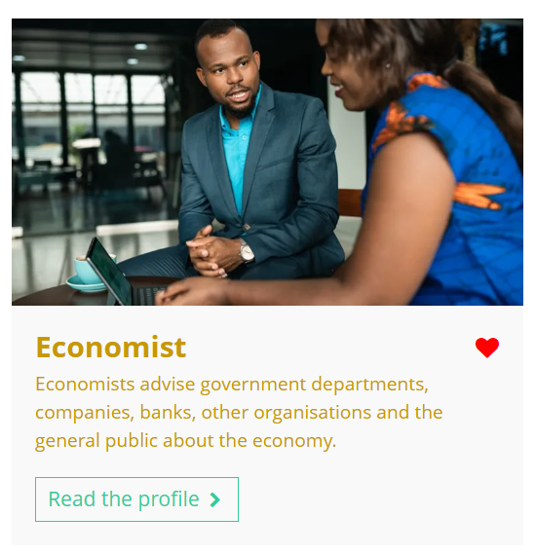

Fascinated by this field? Find out more on Unifrog!
Explore the economics subject profile.
Explore related subject profiles, like mathematics.
Explore related career profiles, like economist and business analyst.
Remember to click the heart symbol to add a profile to your Favourites!
Notes:
Teacher’s notes:
This slide contains career and subject profiles that are relevant to the subject of the month.
If you have additional time available and students have computer access, you can direct them to these resources.
Remember to log into the student side of your Unifrog account to access these links and remind students to favourite any careers or subjects they like the look of.
You can track student progress with favouriting careers or subjects by clicking Advanced>Sort by>Library profiles in Favourites.

Slide 40
Career of the month
Year 10 – February
Notes:
Teacher’s notes:
February’s career of the month for year 10 is: Web developer.

Slide 41

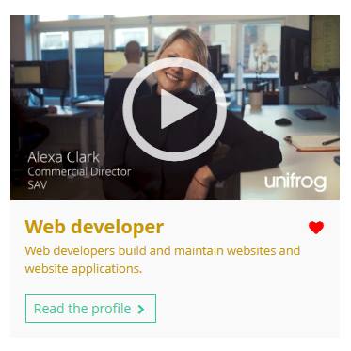

February’s career of the month is…
Web developer
Note down at least one thing you think you know about this career.
Notes:
Teacher’s notes:
Click to reveal the career of the month: Web developer.
Before you’re ready to watch the Careers library video as a class, ask students to note down anything they think they already know about this career.

Slide 42
February’s career of the month is… Web developer
There are several roles that fall under the category of web developer. Today we'll be hearing from Alexa, who’s a commercial director at SAV (a web development company).
Whilst you’re watching, think about how creativity and problem solving can help businesses stand out in a competitive market.
Notes:
Teacher’s notes:
Make sure you’re logged into your Unifrog account and click ‘use the platform as a student’. Click the image on the screen to go to the Careers library profile, then click the play button on the video. Alternatively, copy this URL into an internet browser: unifrog.org/student/careers/direct/web-developer
If you have more time available, you could read the career profile text as a class too.

Slide 43
February’s career of the month is… Web developer
What do you think is the most rewarding part of helping businesses grow with technology?
How can learning about technology and innovation benefit your future career?
What challenges do you think a web developer might face when making sure a website meets both client expectations and user needs?
How do you think an interest in arts subjects could help in a business focused role like this?
Notes:
Teacher’s notes:
This slide contains reflection questions about the career of the month. You could ask students to write down their answers, discuss in pairs or small groups, or discuss as a whole class.
The aim of this activity is for students to think about their own preferences, experiences, and skills and how these could relate to the career. Students are encouraged to draw links between skills used in their current school subjects and the career in the video. If students would like to know more about the career, encourage them to read the full career profile, which contains the following sections:
What you’ll do
Working hours and environment
Career path and progression
Skills required
Entry requirements
Related know-how guides
Related university subject profiles
Related career profiles
Explore
Labour Market Information (LMI)
People also liked…
Example answers:
It’s rewarding to know your work helps a business succeed and stand out.
Learning about tech can open up a lot of career opportunities and help solve problems, for example, as a data analyst cybersecurity analyst, or software developer.
A web developer might struggle to balance what the client wants with what works best for users. For example, a client might ask for a fancy design, but it could make the website hard to navigate.
Creativity from arts subjects can help come up with new ideas and solutions in business.

Slide 44
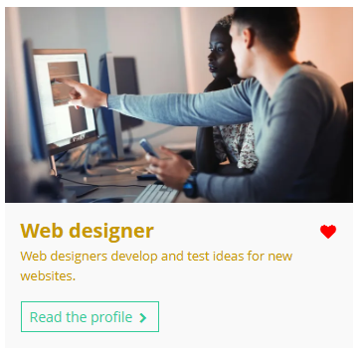
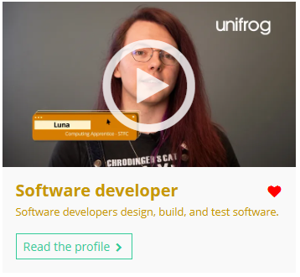
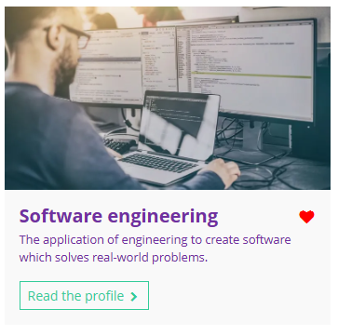
Curious about this career? Discover more on Unifrog!
Explore the web developer career profile.
Explore related career profiles, like web designer and software developer.
Explore related subject profiles, like software engineering.
Remember to click the heart symbol to add a profile to your Favourites!
Notes:
Teacher’s notes:
This slide contains career and subject profiles that are relevant to the career of the month.
If you have additional time available and students have computer access, you can direct them to these resources.
Remember to log into the student side of your Unifrog account to access these links and remind students to favourite any careers or subjects they like the look of.
You can track student progress with favouriting careers or subjects by clicking Advanced>Sort by>Library profiles in Favourites.

Slide 46
Subject of the month
Year 10 – February
Notes:
Teacher’s notes:
February’s subject of the month for year 10 is: Dentistry.

Slide 47
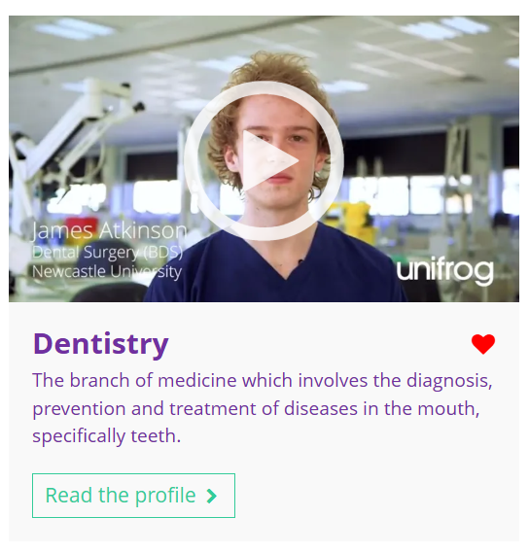


February’s subject of the month is…
Dentistry
Note down at least one thing you think you know about this subject.
Notes:
Teacher’s notes:
Click to reveal the subject of the month: Dentistry.
Before you’re ready to watch the Subjects library video as a class, ask students to note down anything they think they already know about this subject.

Slide 48
February’s subject of the month is… Dentistry
There are lots of different subjects that fall under the category of dentistry. Today we'll be hearing from James, who’s studying dental surgery at Newcastle University.
Whilst you’re watching, think about what you might enjoy about dentistry.
Notes:
Teacher’s notes:
Make sure you’re logged into your Unifrog account and click ‘use the platform as a student’. Click the image on the screen to go to the Subjects library profile, then click the play button on the video. Alternatively, copy this URL into an internet browser: unifrog.org/student/subjects/direct/dentistry
If you have more time available, you could read the subject profile text as a class too.

Slide 49
February’s subject of the month is… Dentistry
What subjects are you already studying that might help with dental surgery?
What aspects of dental surgery surprise you?
How could you prepare now for a career in dental surgery?
What do you think would be the best part of studying dental surgery at university?
Notes:
Teacher’s notes:
This slide contains reflection questions about the subject of the month. You could ask students to write down their answers, discuss in pairs or small groups, or discuss as a whole class.
The aim of this activity is for students to think about their own preferences, experiences, and skills and how these could relate to the subject. Students are encouraged to draw links between skills used in their current school subjects and the subject in the video. If students would like to know more about the subject, encourage them to read the full subject profile, which contains the following sections:
In a nutshell
Getting in
Prospects
Statement
Reference
Geek out
Recommendations: Read
Recommendations: Watch
Recommendations: Listen
Explore
People also liked…
Example answers:
Maths and science – particularly biology could be helpful. Also, learning about health could be useful for understanding treatments and patient care.
I’m surprised by how much teamwork is involved, not just working with patients but with other professionals in the dental team. Also, the balance of academic work and practical skills.
I could try shadowing a dentist to see how the profession works and learn how they interact with patients. Practising teamwork and communication would also be important for later.
I’d probably enjoy the hands-on experience with patients and working in the lab. It seems like a good mix of practical work and learning how to apply what you know.

Slide 50
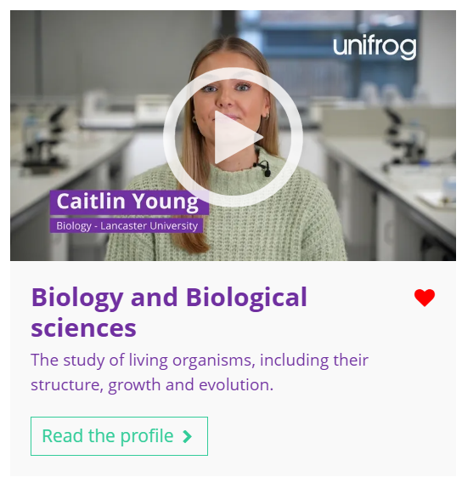

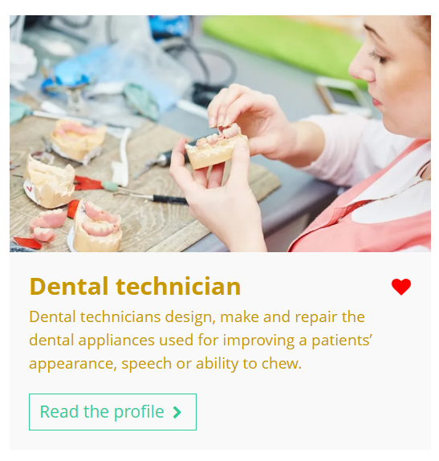
Fascinated by this field? Find out more on Unifrog!
Explore the dentistry subject profile.
Explore related subject profiles, like biology and biological sciences.
Explore related career profiles, like dental hygienist and dental technician.
Remember to click the heart symbol to add a profile to your Favourites!
Notes:
Teacher’s notes:
This slide contains career and subject profiles that are relevant to the subject of the month.
If you have additional time available and students have computer access, you can direct them to these resources.
Remember to log into the student side of your Unifrog account to access these links and remind students to favourite any careers or subjects they like the look of.
You can track student progress with favouriting careers or subjects by clicking Advanced>Sort by>Library profiles in Favourites.

Slide 52
Career of the month
Year 11 – February
Notes:
Teacher’s notes:
February’s career of the month for year 11 is: Groundsperson.

Slide 53

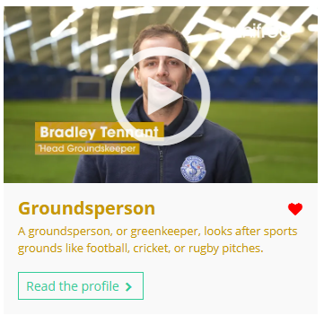

February’s career of the month is…
Groundsperson
Note down at least one thing you think you know about this career.
Notes:
Teacher’s notes:
Click to reveal the career of the month: Groundsperson.
Before you’re ready to watch the Careers library video as a class, ask students to note down anything they think they already know about this career.

Slide 54
February’s career of the month is… Groundsperson
Today we'll be hearing from Bradley, who’s head groundskeeper at Swindon Supermarine Football Club.
Whilst you’re watching, think about the different weather conditions that might affect the turf.
Notes:
Teacher’s notes:
Make sure you’re logged into your Unifrog account and click ‘use the platform as a student’. Click the image on the screen to go to the Careers library profile, then click the play button on the video. Alternatively, copy this URL into an internet browser: unifrog.org/student/careers/direct/groundsperson
If you have more time available, you could read the career profile text as a class too.

Slide 55
February’s career of the month is… Groundsperson
How could volunteering at a local club help you build the skills and experience needed to work in this career?
Why might understanding plant science and weather conditions be essential for maintaining a high-quality pitch?
How do you think working at different venues, from local grounds to international stadiums, helps develop skills in turf care?
Why is adaptability important when managing unexpected challenges, like extreme weather, in this career?
Notes:
Teacher’s notes:
This slide contains reflection questions about the career of the month. You could ask students to write down their answers, discuss in pairs or small groups, or discuss as a whole class.
The aim of this activity is for students to think about their own preferences, experiences, and skills and how these could relate to the career. Students are encouraged to draw links between skills used in their current school subjects and the career in the video. If students would like to know more about the career, encourage them to read the full career profile, which contains the following sections:
What you’ll do
Working hours and environment
Career path and progression
Skills required
Entry requirements
Related know-how guides
Related university subject profiles
Related career profiles
Explore
Labour Market Information (LMI)
People also liked…
Example answers:
Volunteering gives hands-on experience with turf care, teaches basic maintenance skills, and helps you learn how a professional pitch is managed. It also looks good on your CV.
Plant science helps you know how to care for grass, like what fertilisers to use, while weather knowledge helps you prepare for conditions like rain or frost.
You learn to adapt to different challenges, like weather and wear, and see how various teams manage their pitches.
You need to think quickly and adjust plans, like using frost sheets or extra drainage, to keep the pitch in top condition.

Slide 56
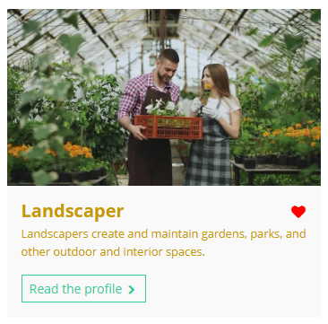
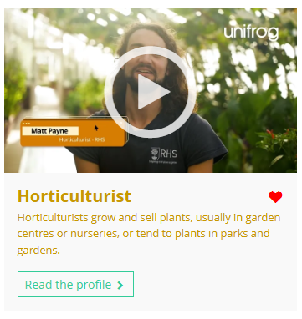
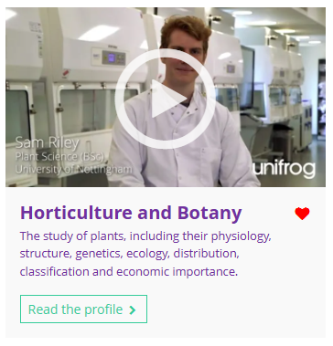
Curious about this career? Discover more on Unifrog!
Explore the groundsperson career profile.
Explore related career profiles, like landscaper and horticulturalist.
Explore related subject profiles, like horticulture and botany.
Remember to click the heart symbol to add a profile to your Favourites!
Notes:
Teacher’s notes:
This slide contains career and subject profiles that are relevant to the career of the month.
If you have additional time available and students have computer access, you can direct them to these resources.
Remember to log into the student side of your Unifrog account to access these links and remind students to favourite any careers or subjects they like the look of.
You can track student progress with favouriting careers or subjects by clicking Advanced>Sort by>Library profiles in Favourites.

Slide 58
Subject of the month
Year 11 – February
Notes:
Teacher’s notes:
February’s subject of the month for year 11 is: Events management.

Slide 59

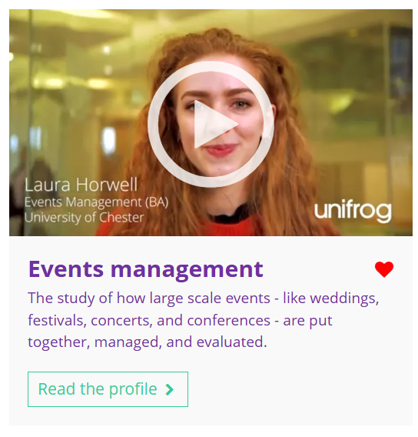

February’s subject of the month is…
Events management
Note down at least one thing you think you know about this subject.
Notes:
Teacher’s notes:
Click to reveal the subject of the month: Events management.
Before you’re ready to watch the Subjects library video as a class, ask students to note down anything they think they already know about this subject.

Slide 60
February’s subject of the month is… Events management
Today we'll be hearing from Laura, who’s an events management student at the University of Chester.
Whilst you’re watching, think about things that go on behind the scenes at a large event.
Notes:
Teacher’s notes:
Make sure you’re logged into your Unifrog account and click ‘use the platform as a student’. Click the image on the screen to go to the Subjects library profile, then click the play button on the video. Alternatively, copy this URL into an internet browser: unifrog.org/student/subjects/direct/events-management
If you have more time available, you could read the subject profile text as a class too.

Slide 61
February’s subject of the month is… Events management
How do you think the practical aspects of the course could help in any future career?
What kind of events would you like to organise if you were studying this course?
What do you think would be the hardest part of this course?
What skills do you think are most important for managing successful events?
Notes:
Teacher’s notes:
This slide contains reflection questions about the subject of the month. You could ask students to write down their answers, discuss in pairs or small groups, or discuss as a whole class.
The aim of this activity is for students to think about their own preferences, experiences, and skills and how these could relate to the subject. Students are encouraged to draw links between skills used in their current school subjects and the subject in the video. If students would like to know more about the subject, encourage them to read the full subject profile, which contains the following sections:
In a nutshell
Getting in
Prospects
Statement
Reference
Geek out
Recommendations: Read
Recommendations: Watch
Recommendations: Listen
Explore
People also liked…
Example answers:
The course teaches valuable skills like event planning, health and safety, and financial management, all of which are useful in any career.
I’d like to organise charity events and community festivals, like outdoor concerts or food markets, where people can enjoy and support good causes.
The hardest part would probably be the amount of work outside of uni hours. I’d need to manage my time well to keep up with assignments and projects while balancing other commitments.
I think that organisation, communication, and problem solving would be most important to make sure everything runs smoothly.

Slide 62
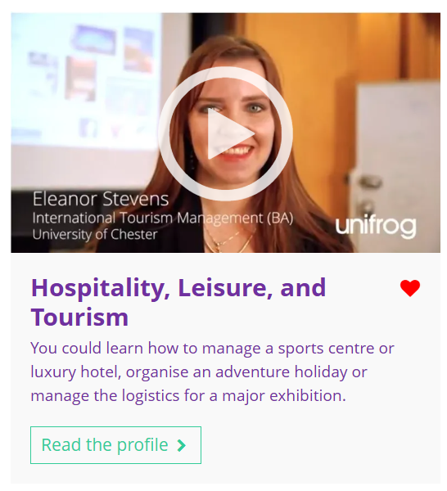
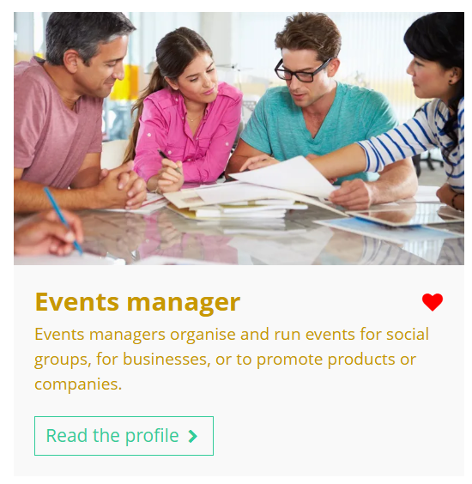
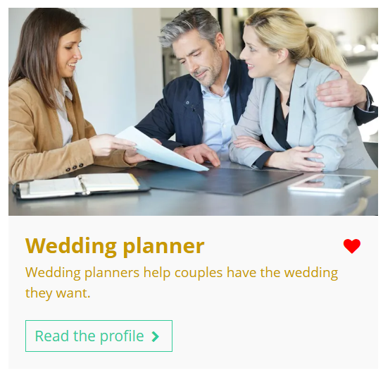
Fascinated by this field? Find out more on Unifrog!
Explore the events management subject profile.
Explore related subject profiles, like hospitality, leisure, and tourism.
Explore related career profiles, like events manager and wedding planner.
Remember to click the heart symbol to add a profile to your Favourites!
Notes:
Teacher’s notes:
This slide contains career and subject profiles that are relevant to the subject of the month.
If you have additional time available and students have computer access, you can direct them to these resources.
Remember to log into the student side of your Unifrog account to access these links and remind students to favourite any careers or subjects they like the look of.
You can track student progress with favouriting careers or subjects by clicking Advanced>Sort by>Library profiles in Favourites.

Slide 64
Career of the month
Year 12 – February
Notes:
Teacher’s notes:
February’s career of the month for year 12 is: Farmer.

Slide 65

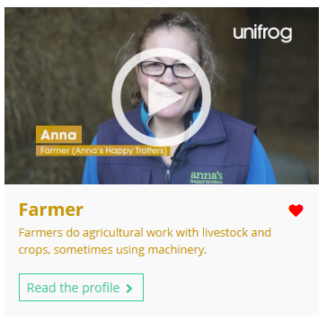

February’s career of the month is…
Farmer
Note down at least one thing you think you know about this career.
Notes:
Teacher’s notes:
Click to reveal the career of the month: Farmer.
Before you’re ready to watch the Careers library video as a class, ask students to note down anything they think they already know about this career.

Slide 66
February’s career of the month is… Farmer
There are lots of roles that fall under the category of farm worker. Today we'll be hearing from Anna, who’s a farmer at Anna’s Happy Trotters.
Whilst you’re watching, think about the link between farming and veterinary medicine.
Notes:
Teacher’s notes:
Make sure you’re logged into your Unifrog account and click ‘use the platform as a student’. Click the image on the screen to go to the Careers library profile, then click the play button on the video. Alternatively, copy this URL into an internet browser: unifrog.org/student/careers/direct/farm-worker
If you have more time available, you could read the career profile text as a class too.

Slide 67
February’s career of the month is… Farmer
Why is observing animal behaviour an important part of being a pig farmer?
What challenges might outdoor pig farmers face during winter, and how do they overcome them?
How can joining a Young Farmers’ Club help someone get started in farming?
Why is it important for pig farmers to work closely with vets, and what role do vets play on the farm?
Notes:
Teacher’s notes:
This slide contains reflection questions about the career of the month. You could ask students to write down their answers, discuss in pairs or small groups, or discuss as a whole class.
The aim of this activity is for students to think about their own preferences, experiences, and skills and how these could relate to the career. Students are encouraged to draw links between skills used in their current school subjects and the career in the video. If students would like to know more about the career, encourage them to read the full career profile, which contains the following sections:
What you’ll do
Working hours and environment
Career path and progression
Skills required
Entry requirements
Related know-how guides
Related university subject profiles
Related career profiles
Explore
Labour Market Information (LMI)
People also liked…
Example answers:
Observing animal behaviour helps farmers identify signs of illness, stress, or discomfort early, allowing them to take action quickly to maintain animal welfare and productivity.
Winter brings mud, cold, and machinery issues, making tasks harder. Farmers prepare by making sure shelters are warm and paddocks are ready, prioritising animal welfare regardless of the conditions.
Young Farmers’ Clubs offer networking, practical experience, and support for beginners. They’re a great way to build skills and connections in the industry, even for those without a farming background.
Vets help farmers monitor herd health, diagnose diseases, and provide proper treatments. This partnership supports high welfare standards and productive farming.

Slide 68
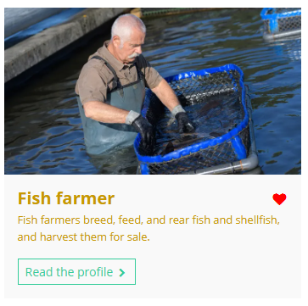
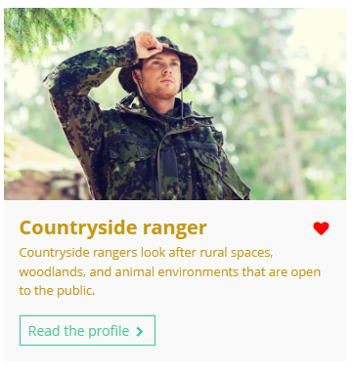
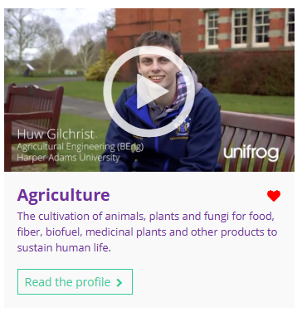
Curious about this career? Discover more on Unifrog!
Explore the farmer career profile.
Explore related career profiles, like fish farmer and countryside ranger.
Explore related subject profiles, like agriculture.
Remember to click the heart symbol to add a profile to your Favourites!
Notes:
Teacher’s notes:
This slide contains career and subject profiles that are relevant to the career of the month.
If you have additional time available and students have computer access, you can direct them to these resources.
Remember to log into the student side of your Unifrog account to access these links and remind students to favourite any careers or subjects they like the look of.
You can track student progress with favouriting careers or subjects by clicking Advanced>Sort by>Library profiles in Favourites.

Slide 69
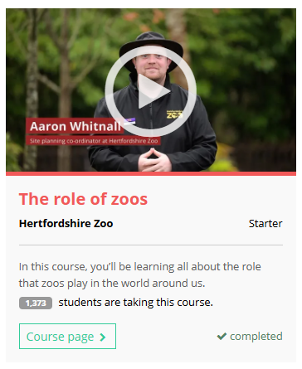
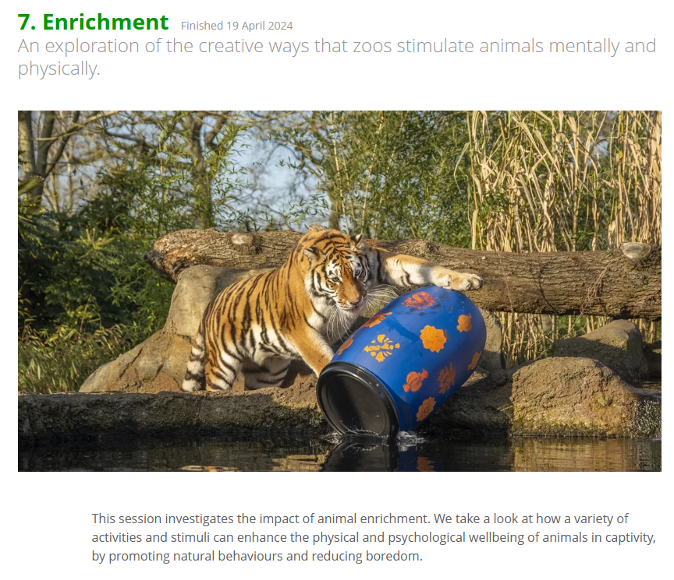
Further exploration
Visit the Courses tool to join courses relating to the career of the month:
The role of zoos
Notes:
Teacher’s notes:
This slide contains a Unifrog course that’s relevant to the career of the month.
If you have additional time available and students have computer access, you can direct them to the Courses tool.
Remember to log into the student side of your Unifrog account to access these links and remind students to join any courses they like the look of.
You can track student progress with courses by clicking Advanced>Sort by>Courses.

Slide 71
Subject of the month
Year 12 – February
Notes:
Teacher’s notes:
February’s subject of the month for year 12 is: Hospitality, leisure, and tourism.

Slide 72


February’s subject of the month is…
Hospitality, leisure, and tourism
Note down at least one thing you think you know about this subject.
Notes:
Teacher’s notes:
Click to reveal the subject of the month: Hospitality, leisure, and tourism.
Before you’re ready to watch the Subjects library video as a class, ask students to note down anything they think they already know about this subject.

Slide 73
February’s subject of the month is… Hospitality, leisure, and tourism
There are lots of subjects that fall under the category of hospitality, leisure, and tourism. Today we'll be hearing from Eleanor, who’s studying international tourism management.
Whilst you’re watching, think about the differences between working in hospitality, leisure, and tourism in your home country versus abroad.
Notes:
Teacher’s notes:
Make sure you’re logged into your Unifrog account and click ‘use the platform as a student’. Click the image on the screen to go to the Subjects library profile, then click the play button on the video. Alternatively, copy this URL into an internet browser: https://www.unifrog.org/student/subjects/direct/leisure-and-tourism
If you have more time available, you could read the subject profile text as a class too.

Slide 74
February’s subject of the month is… Hospitality, leisure, and tourism
What part of this course do you think would be the most exciting for you?
How do you think your previous experiences might help you with your studies in this course?
What skills do you already have that might help you in this course?
What would you start doing now to get ready for studying this course?
Notes:
Teacher’s notes:
This slide contains reflection questions about the subject of the month. You could ask students to write down their answers, discuss in pairs or small groups, or discuss as a whole class.
The aim of this activity is for students to think about their own preferences, experiences, and skills and how these could relate to the subject. Students are encouraged to draw links between skills used in their current school subjects and the subject in the video. If students would like to know more about the subject, encourage them to read the full subject profile, which contains the following sections:
In a nutshell
Getting in
Prospects
Statement
Reference
Geek out
Recommendations: Read
Recommendations: Watch
Recommendations: Listen
Explore
People also liked…
Example answers:
I think the most exciting part would be learning about sustainability and how tourism impacts places, not just on holidays. It sounds fascinating to understand what goes on behind the scenes of the tourism industry and how to manage it all.
I’ve visited careers fairs, attended local food and music festivals, and have been on holiday with my family, which has shown me the different things involved in hospitality and the importance of customer service.
I’m good at managing my time and working under pressure, which will help me with deadlines. I also enjoy learning about new places and cultures, so the research part of the course will be something I can really get into.
I could start reading about the impact of tourism on different regions and looking into how businesses manage tourism. I’d also keep up with current events in the tourism industry, especially related to sustainability and global tourism trends.

Slide 75
Fascinated by this field? Find out more on Unifrog!
Explore the hospitality, leisure, and tourism subject profile.
Explore related subject profiles, like events management.
Explore related career profiles, like events manager and wedding planner.
Remember to click the heart symbol to add a profile to your Favourites!
Notes:
Teacher’s notes:
This slide contains career and subject profiles that are relevant to the subject of the month.
If you have additional time available and students have computer access, you can direct them to these resources.
Remember to log into the student side of your Unifrog account to access these links and remind students to favourite any careers or subjects they like the look of.
You can track student progress with favouriting careers or subjects by clicking Advanced>Sort by>Library profiles in Favourites.

Slide 77
Career of the month
Year 13 – February
Notes:
Teacher’s notes:
February’s career of the month for year 13 is: Electricity distribution worker.

Slide 78

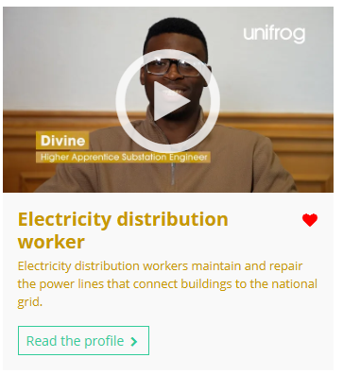
February’s career of the month is…
Electricity distribution worker
Note down at least one thing you think you know about this career.
Notes:
Teacher’s notes:
Click to reveal the career of the month: Electricity distribution worker.
Before you’re ready to watch the Careers library video as a class, ask students to note down anything they think they already know about this career.

Slide 79
February’s career of the month is… Electricity distribution worker
There are lots of roles that fall under the category of electricity distribution worker. Today we'll be hearing from Divine, who’s a substation engineer apprentice working for National Grid.
Whilst you’re watching, think about what net zero means.
Notes:
Teacher’s notes:
Make sure you’re logged into your Unifrog account and click ‘use the platform as a student’. Click the image on the screen to go to the Careers library profile, then click the play button on the video. Alternatively, copy this URL into an internet browser: unifrog.org/student/careers/direct/electricity-distribution-worker
If you have more time available, you could read the career profile text as a class too.

Slide 80
February’s career of the month is… Electricity distribution worker
How does the role of a substation engineer contribute to the UK's net zero goals?
What are the key challenges involved in planning maintenance tasks in a substation?
How does working with a variety of equipment across different substations help an engineer develop their skills?
Why might an apprenticeship be a good option for someone interested in becoming an engineer at National Grid?
Notes:
Teacher’s notes:
This slide contains reflection questions about the career of the month. You could ask students to write down their answers, discuss in pairs or small groups, or discuss as a whole class.
The aim of this activity is for students to think about their own preferences, experiences, and skills and how these could relate to the career. Students are encouraged to draw links between skills used in their current school subjects and the career in the video. If students would like to know more about the career, encourage them to read the full career profile, which contains the following sections:
What you’ll do
Working hours and environment
Career path and progression
Skills required
Entry requirements
Related know-how guides
Related university subject profiles
Related career profiles
Explore
Labour Market Information (LMI)
People also liked…
Example answers:
The role supports net zero goals by maintaining substation equipment that helps transmit cleaner energy.
Challenges include ensuring safety, managing risks, and coordinating tasks under pressure.
It broadens their knowledge and adaptability to different technical challenges.
An apprenticeship offers hands-on experience and practical skills, ideal for those who learn by doing.

Slide 81
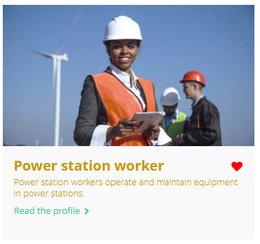
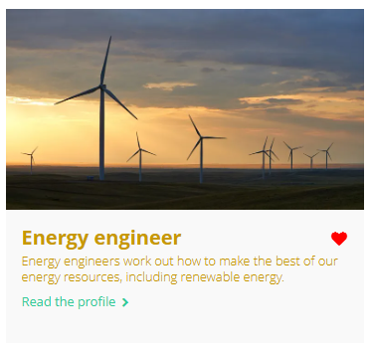

Curious about this career? Discover more on Unifrog!
Explore the electricity distribution worker career profile.
Explore related career profiles, like power station worker and energy engineer.
Explore related subject profiles, like energy and environmental engineering.
Remember to click the heart symbol to add a profile to your Favourites!
Notes:
Teacher’s notes:
This slide contains career and subject profiles that are relevant to the career of the month.
If you have additional time available and students have computer access, you can direct them to these resources.
Remember to log into the student side of your Unifrog account to access these links and remind students to favourite any careers or subjects they like the look of.
You can track student progress with favouriting careers or subjects by clicking Advanced>Sort by>Library profiles in Favourites.

Slide 82
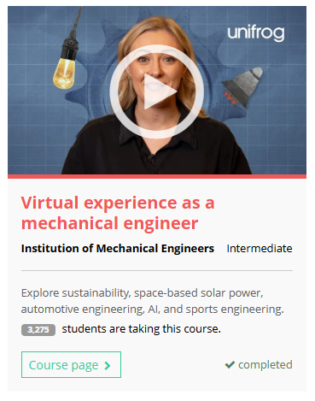



Further exploration
Visit the Courses tool to join courses relating to the career of the month:
Notes:
Teacher’s notes:
This slide contains Unifrog courses that are relevant to the career of the month.
If you have additional time available and students have computer access, you can direct them to the Courses tool.
Remember to log into the student side of your Unifrog account to access these links and remind students to join any courses they like the look of.
You can track student progress with courses by clicking Advanced>Sort by>Courses.

Slide 84
Subject of the month
Year 13 – February
Notes:
Teacher’s notes:
February’s subject of the month for year 13 is: Crafts, jewellery, and woodworking.

Slide 85



February’s subject of the month is…
Crafts, jewellery, and woodworking
Note down at least one thing you think you know about this subject.
Notes:
Teacher’s notes:
Click to reveal the subject of the month: Crafts, jewellery, and woodworking.
Before you’re ready to watch the Subjects library video as a class, ask students to note down anything they think they already know about this subject.

Slide 86
February’s subject of the month is… Crafts, jewellery, and woodworking
There are lots of degrees that fall under the category of crafts, jewellery, and woodworking. Today we'll be hearing from Emily, who’s studying jewellery and metalwork.
Whilst you’re watching, think about the challenges of working with very small and intricate items.
Notes:
Teacher’s notes:
Make sure you’re logged into your Unifrog account and click ‘use the platform as a student’. Click the image on the screen to go to the Subjects library profile, then click the play button on the video. Alternatively, copy this URL into an internet browser: unifrog.org/student/subjects/direct/crafts-jewellery-and-woodworking
If you have more time available, you could read the subject profile text as a class too.

Slide 87
February’s subject of the month is… Crafts, jewellery, and woodworking
What part of this course do you think you would find the most exciting?
How do you think your approach to creating jewellery might change after learning the history behind different techniques?
What skills do you already have that might help you with the practical side of this course?
How could you start exploring your personal style or interests in jewellery design now?
Notes:
Teacher’s notes:
This slide contains reflection questions about the subject of the month. You could ask students to write down their answers, discuss in pairs or small groups, or discuss as a whole class.
The aim of this activity is for students to think about their own preferences, experiences, and skills and how these could relate to the subject. Students are encouraged to draw links between skills used in their current school subjects and the subject in the video. If students would like to know more about the subject, encourage them to read the full subject profile, which contains the following sections:
In a nutshell
Getting in
Prospects
Statement
Reference
Geek out
Recommendations: Read
Recommendations: Watch
Recommendations: Listen
Explore
People also liked…
Example answers:
I think I'd really enjoy the creative side of it, especially working with old techniques and bringing them into modern designs. I like the idea of making something with history behind it, but also putting my own twist on it.
I feel like knowing the history would give me a deeper appreciation for the craftsmanship involved. I would probably be more mindful of the methods used and how I could incorporate them into my designs, making sure I’m respecting the tradition while still being innovative.
I’ve always been good with my hands and have a keen eye for detail. I also enjoy sketching and thinking about how things fit together, so I think my drawing skills could help with the design process.
I could start by looking at different jewellery designers and styles online or at local exhibitions. I think experimenting with materials and sketching out ideas that reflect my interests would help me develop my own style.

Slide 88



Fascinated by this field? Find out more on Unifrog!
Explore the crafts, jewellery, and woodworking subject profile.
Explore related subject profiles, like fine art and textiles and fashion.
Explore related career profiles, like jewellery designer.
Remember to click the heart symbol to add a profile to your Favourites!
Notes:
Teacher’s notes:
This slide contains career and subject profiles that are relevant to the subject of the month.
If you have additional time available and students have computer access, you can direct them to these resources.
Remember to log into the student side of your Unifrog account to access these links and remind students to favourite any careers or subjects they like the look of.
You can track student progress with favouriting careers or subjects by clicking Advanced>Sort by>Library profiles in Favourites.

